Slide 1
Fraser Valley Quilters Guild
Show and Tell December 2023

Slide 2
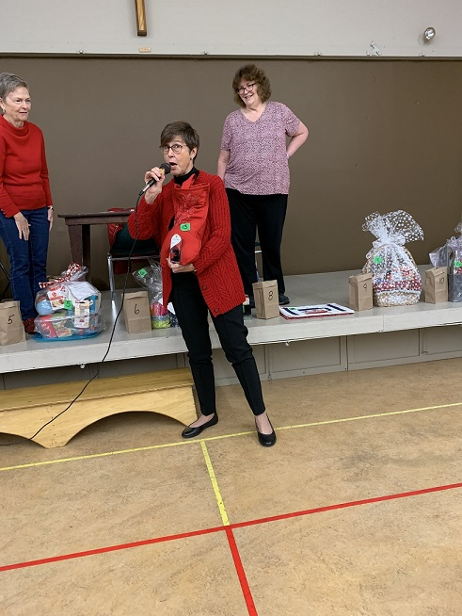
Anneve Gillon- Christmas stocking for a wine bladder

Slide 3
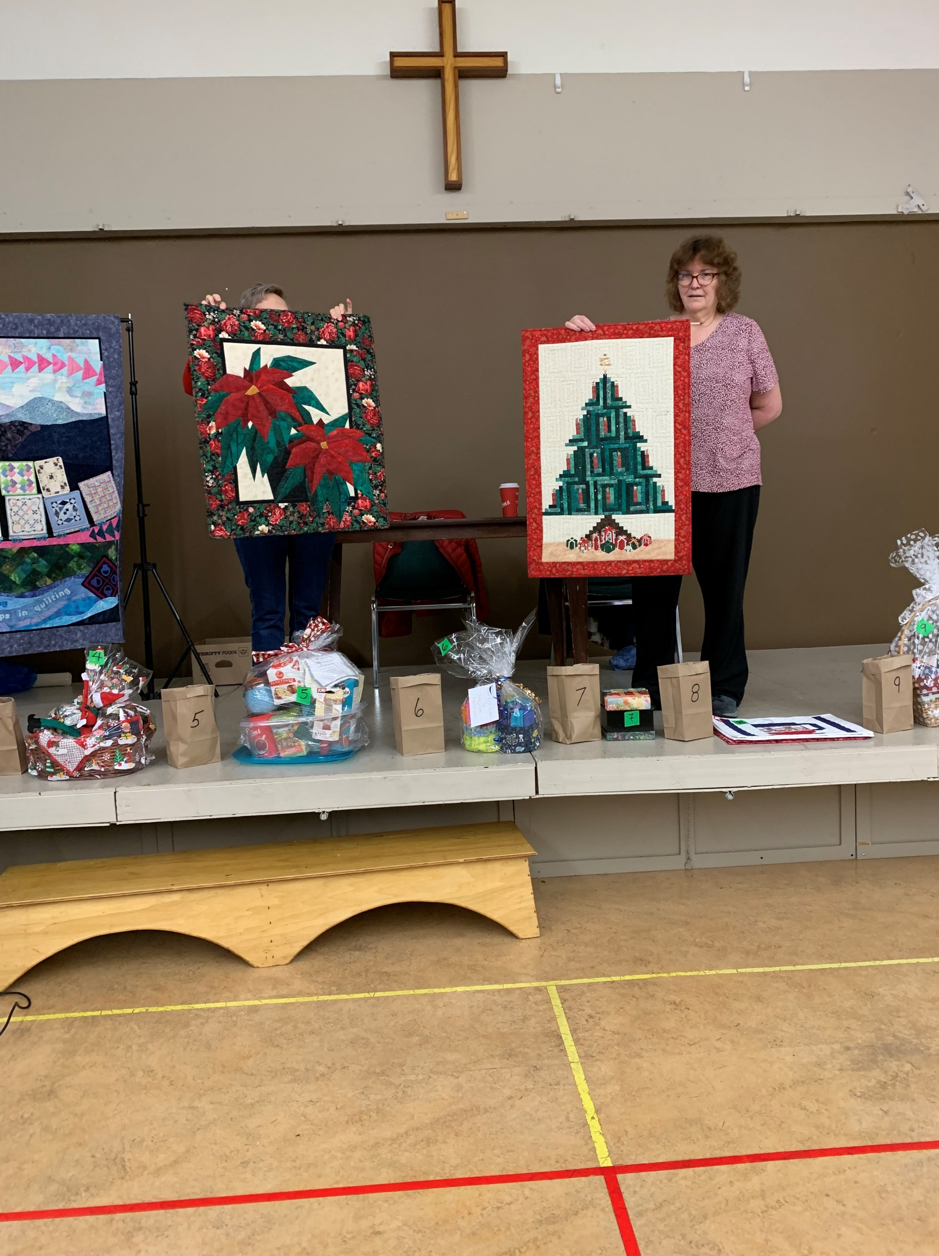
Bonnie Sampson
Poinsettia wall hanging and Christmas tree wall hanging

Slide 4
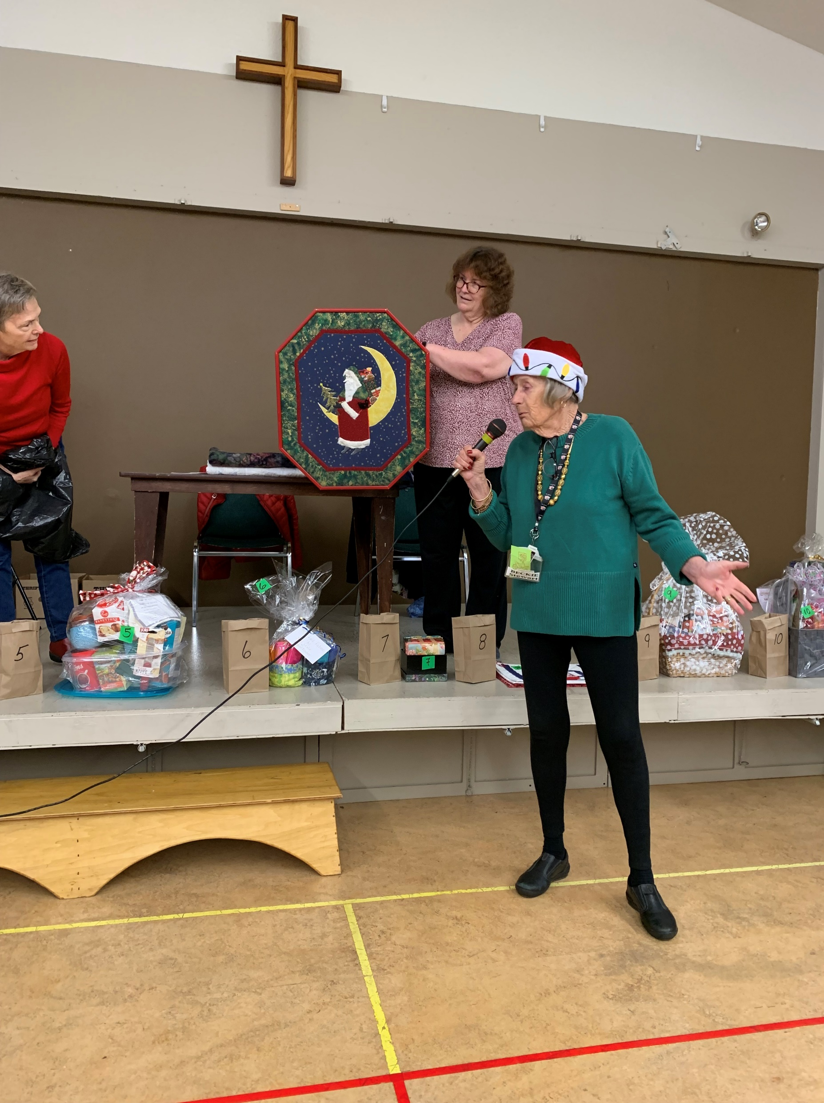
Beckie Stewart- favorite Christmas wall hanging

Slide 5
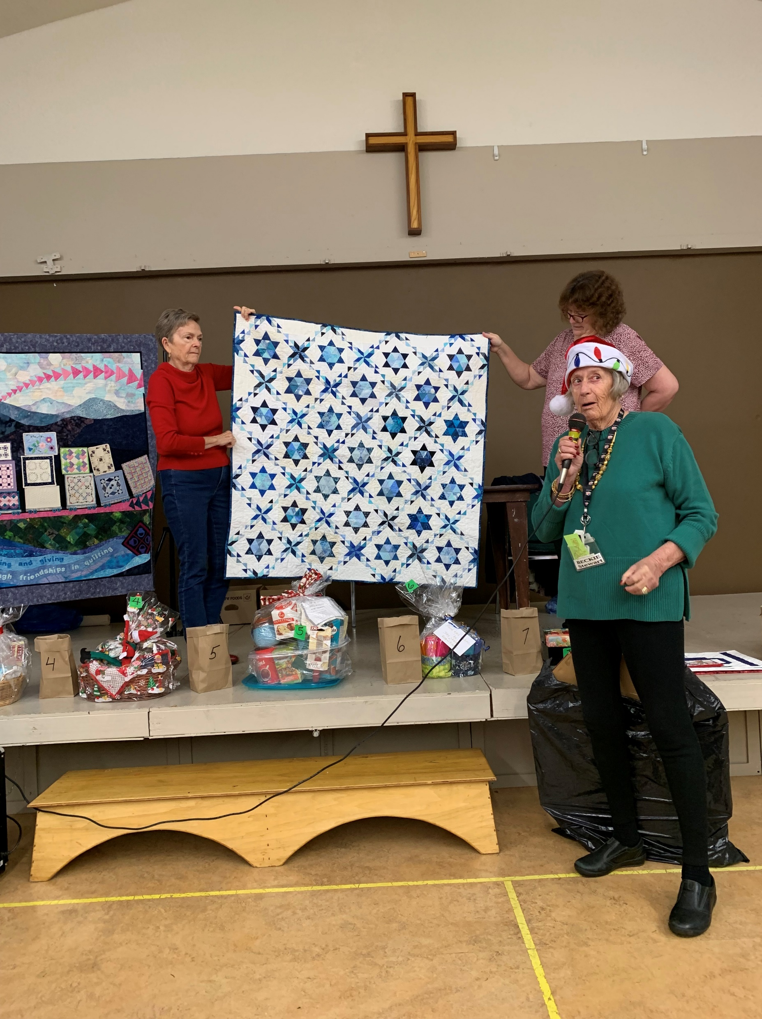
Beckie Stewart -Star of David

Slide 6
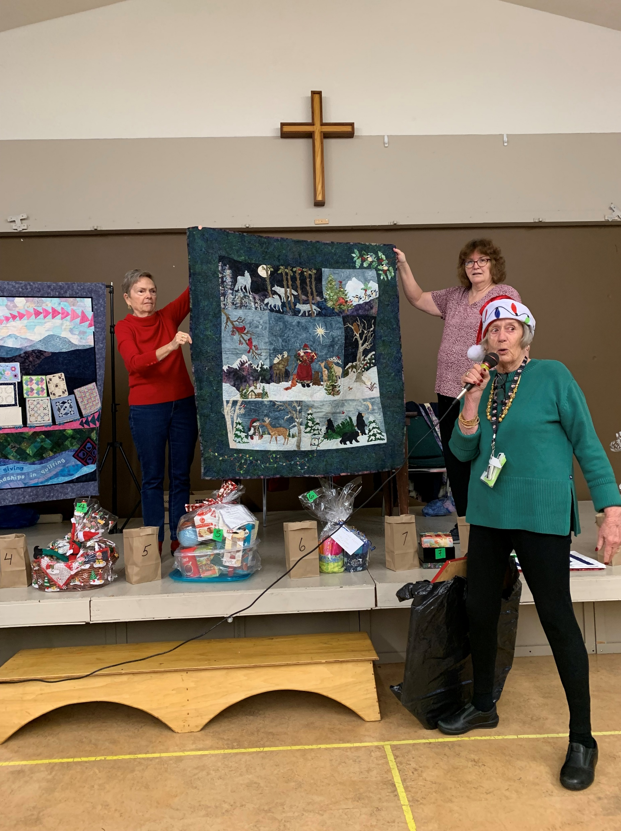
Beckie Stewart –Christmas wall hanging

Slide 7
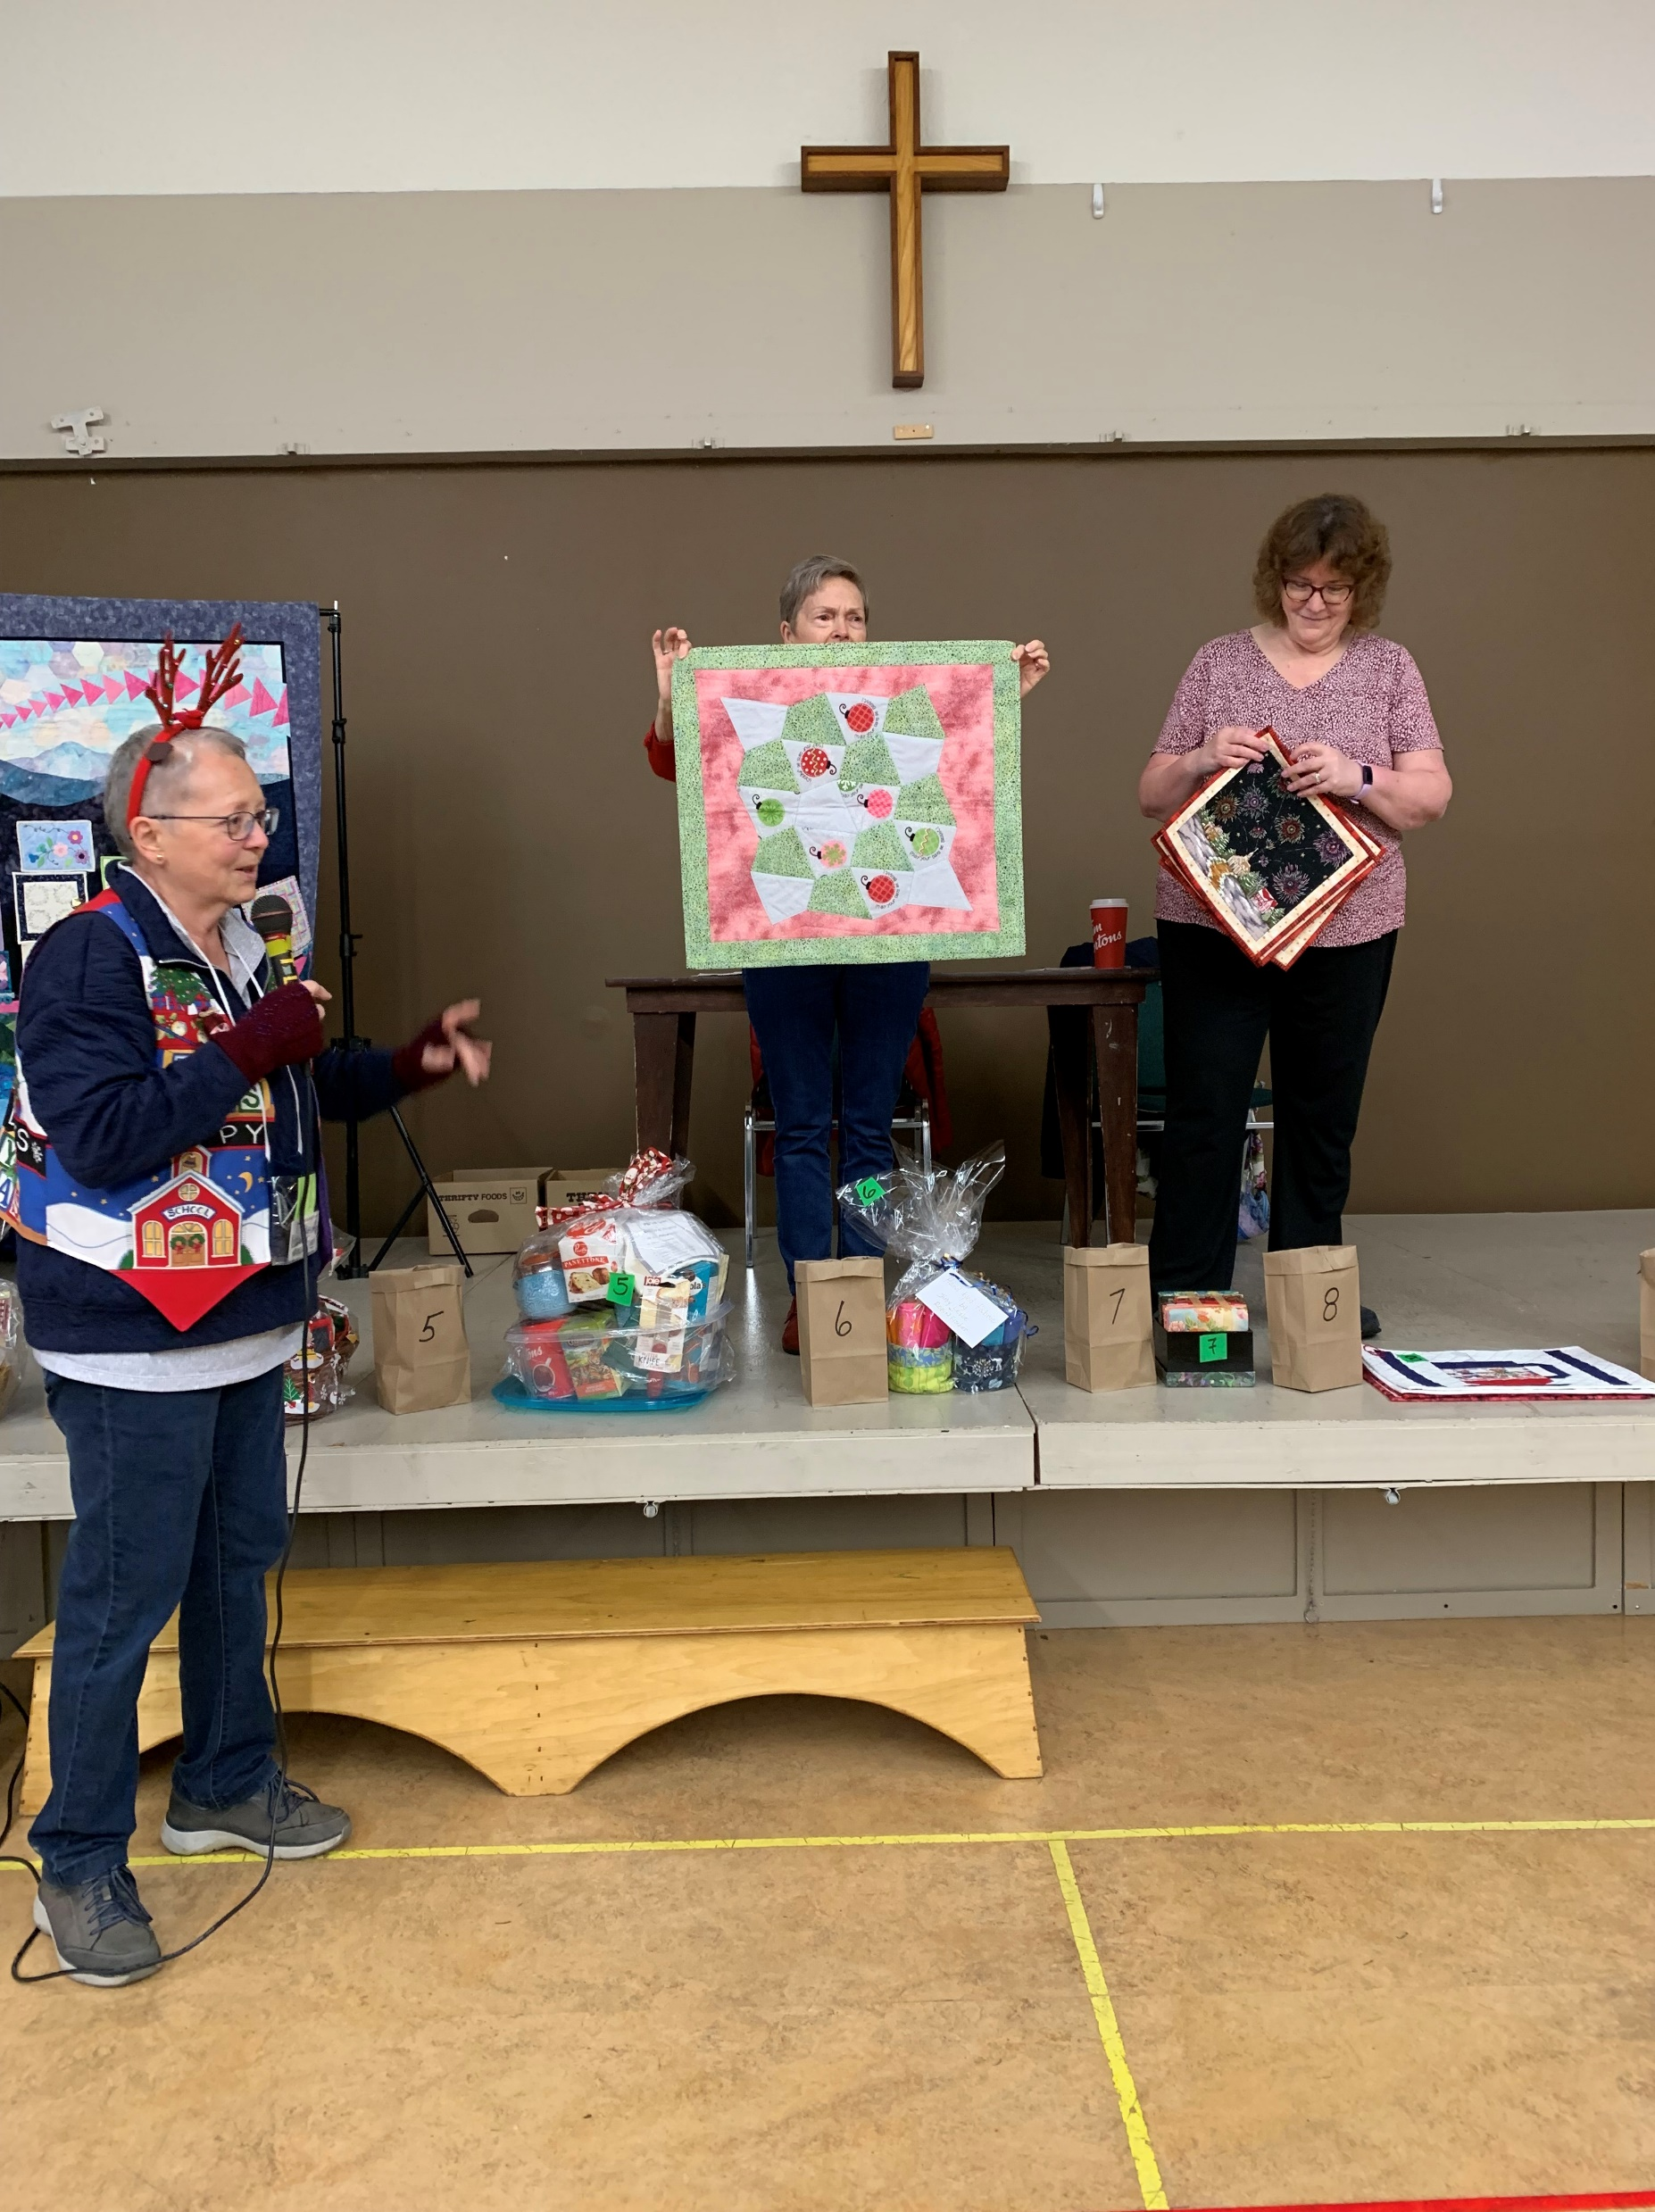
Carol Pettigrew small wall hanging

Slide 8
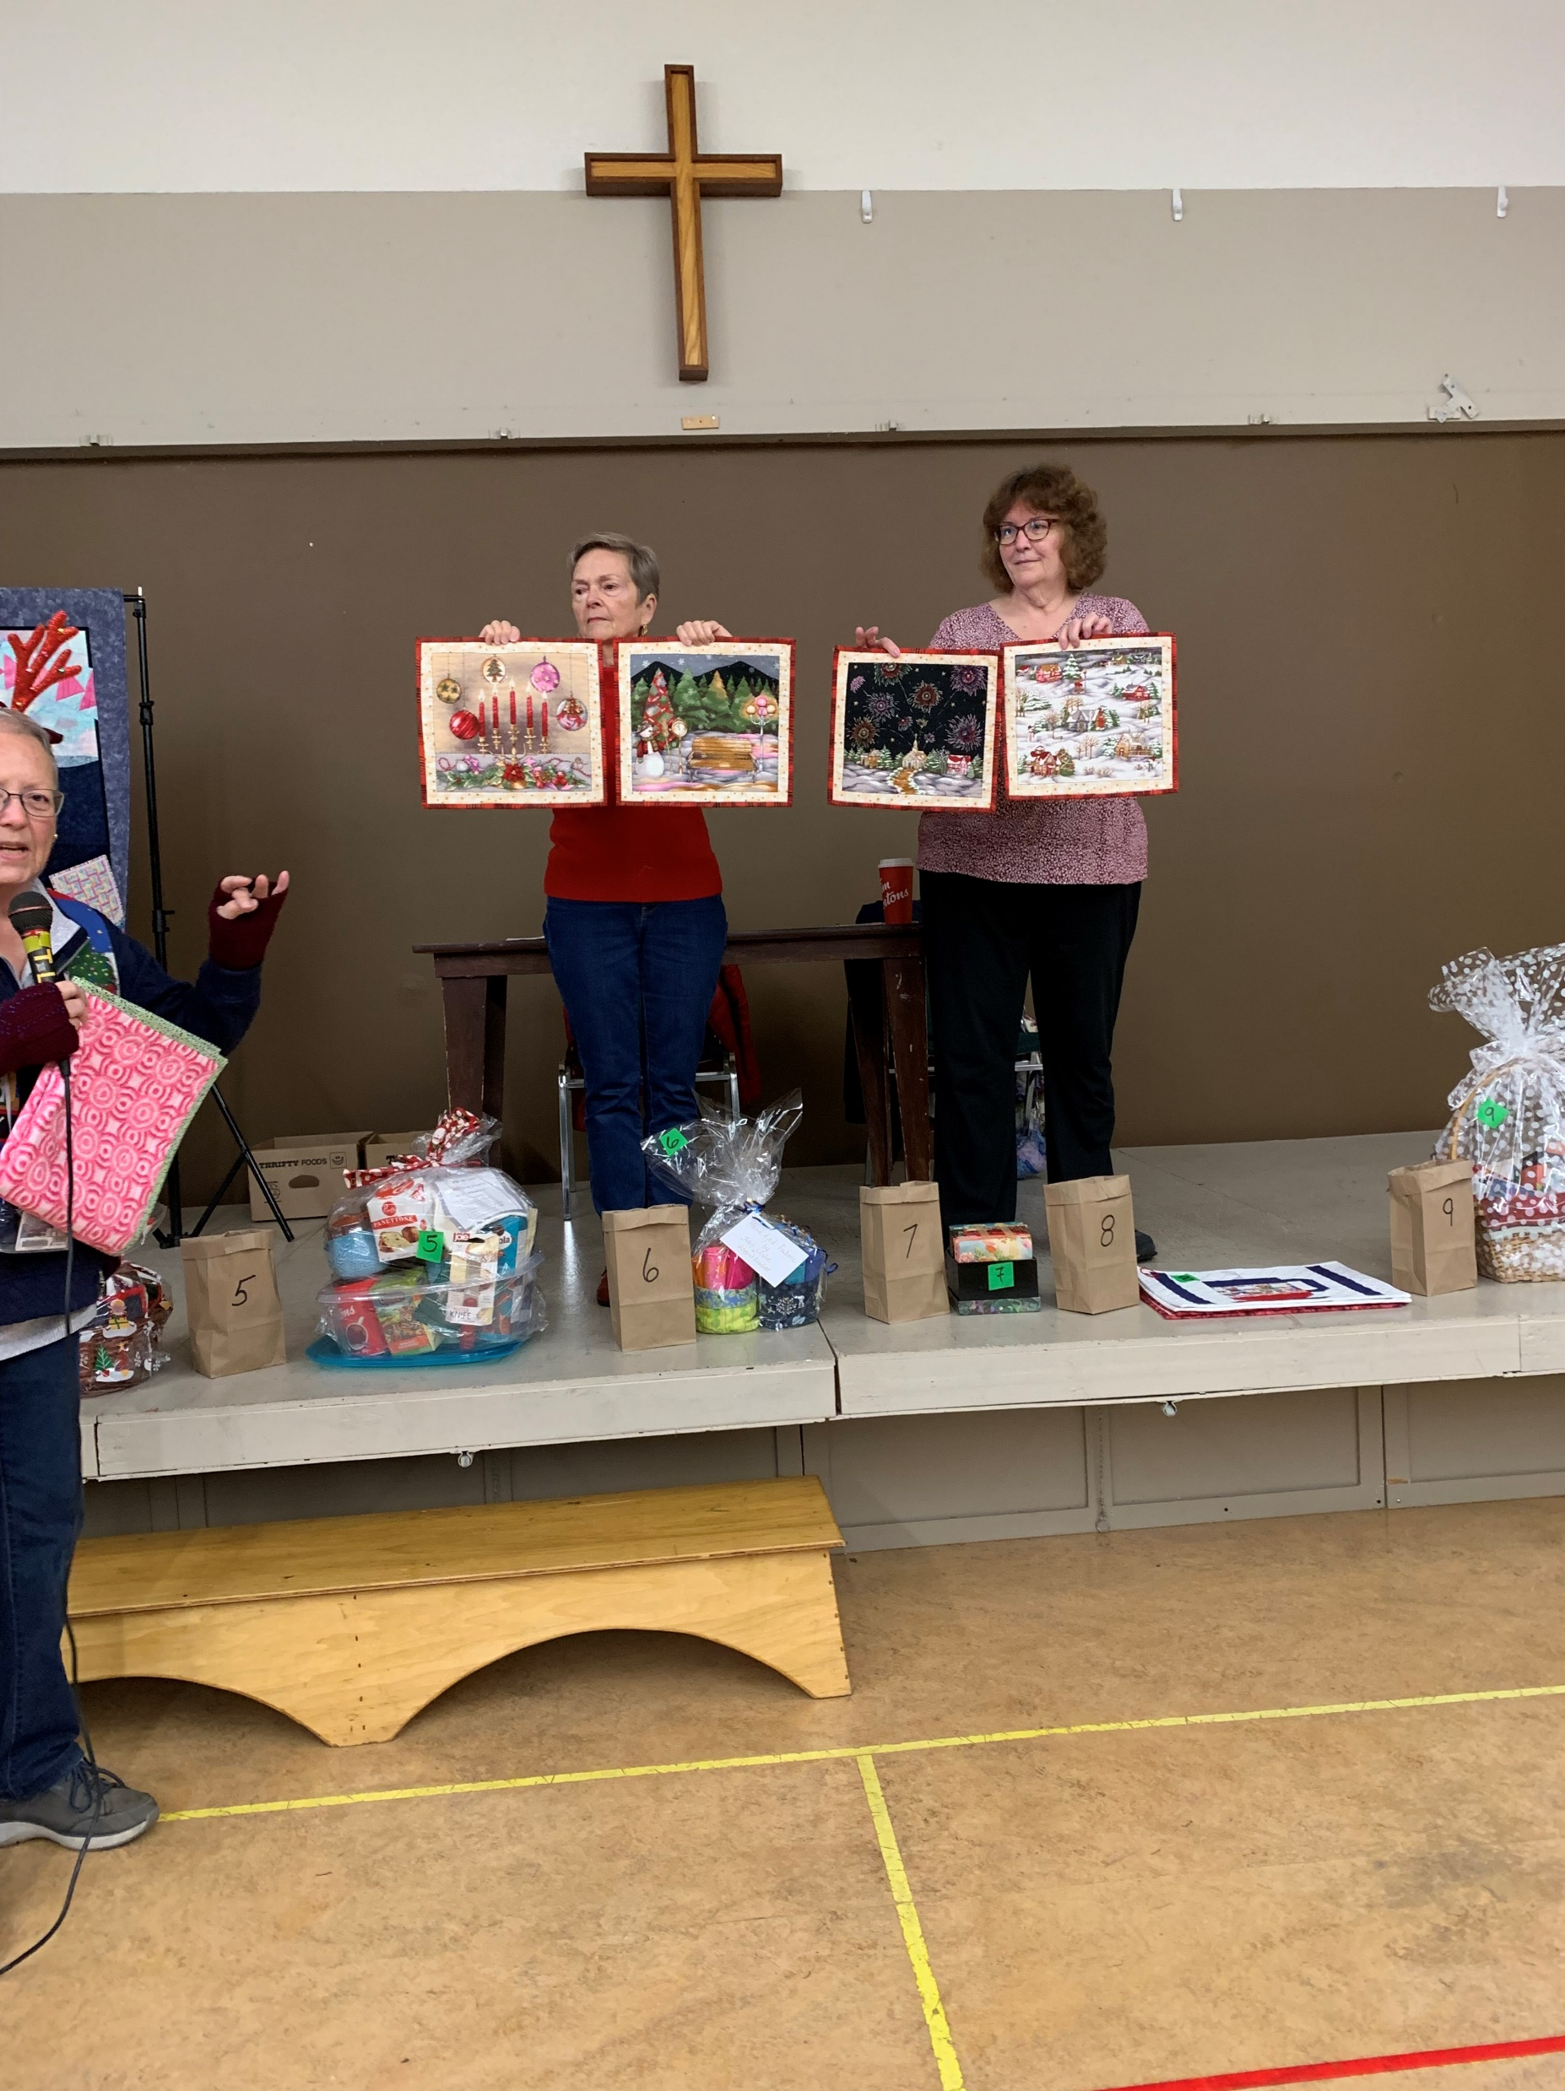
Carol Pettigrew 4 Christmas wall hangings

Slide 9
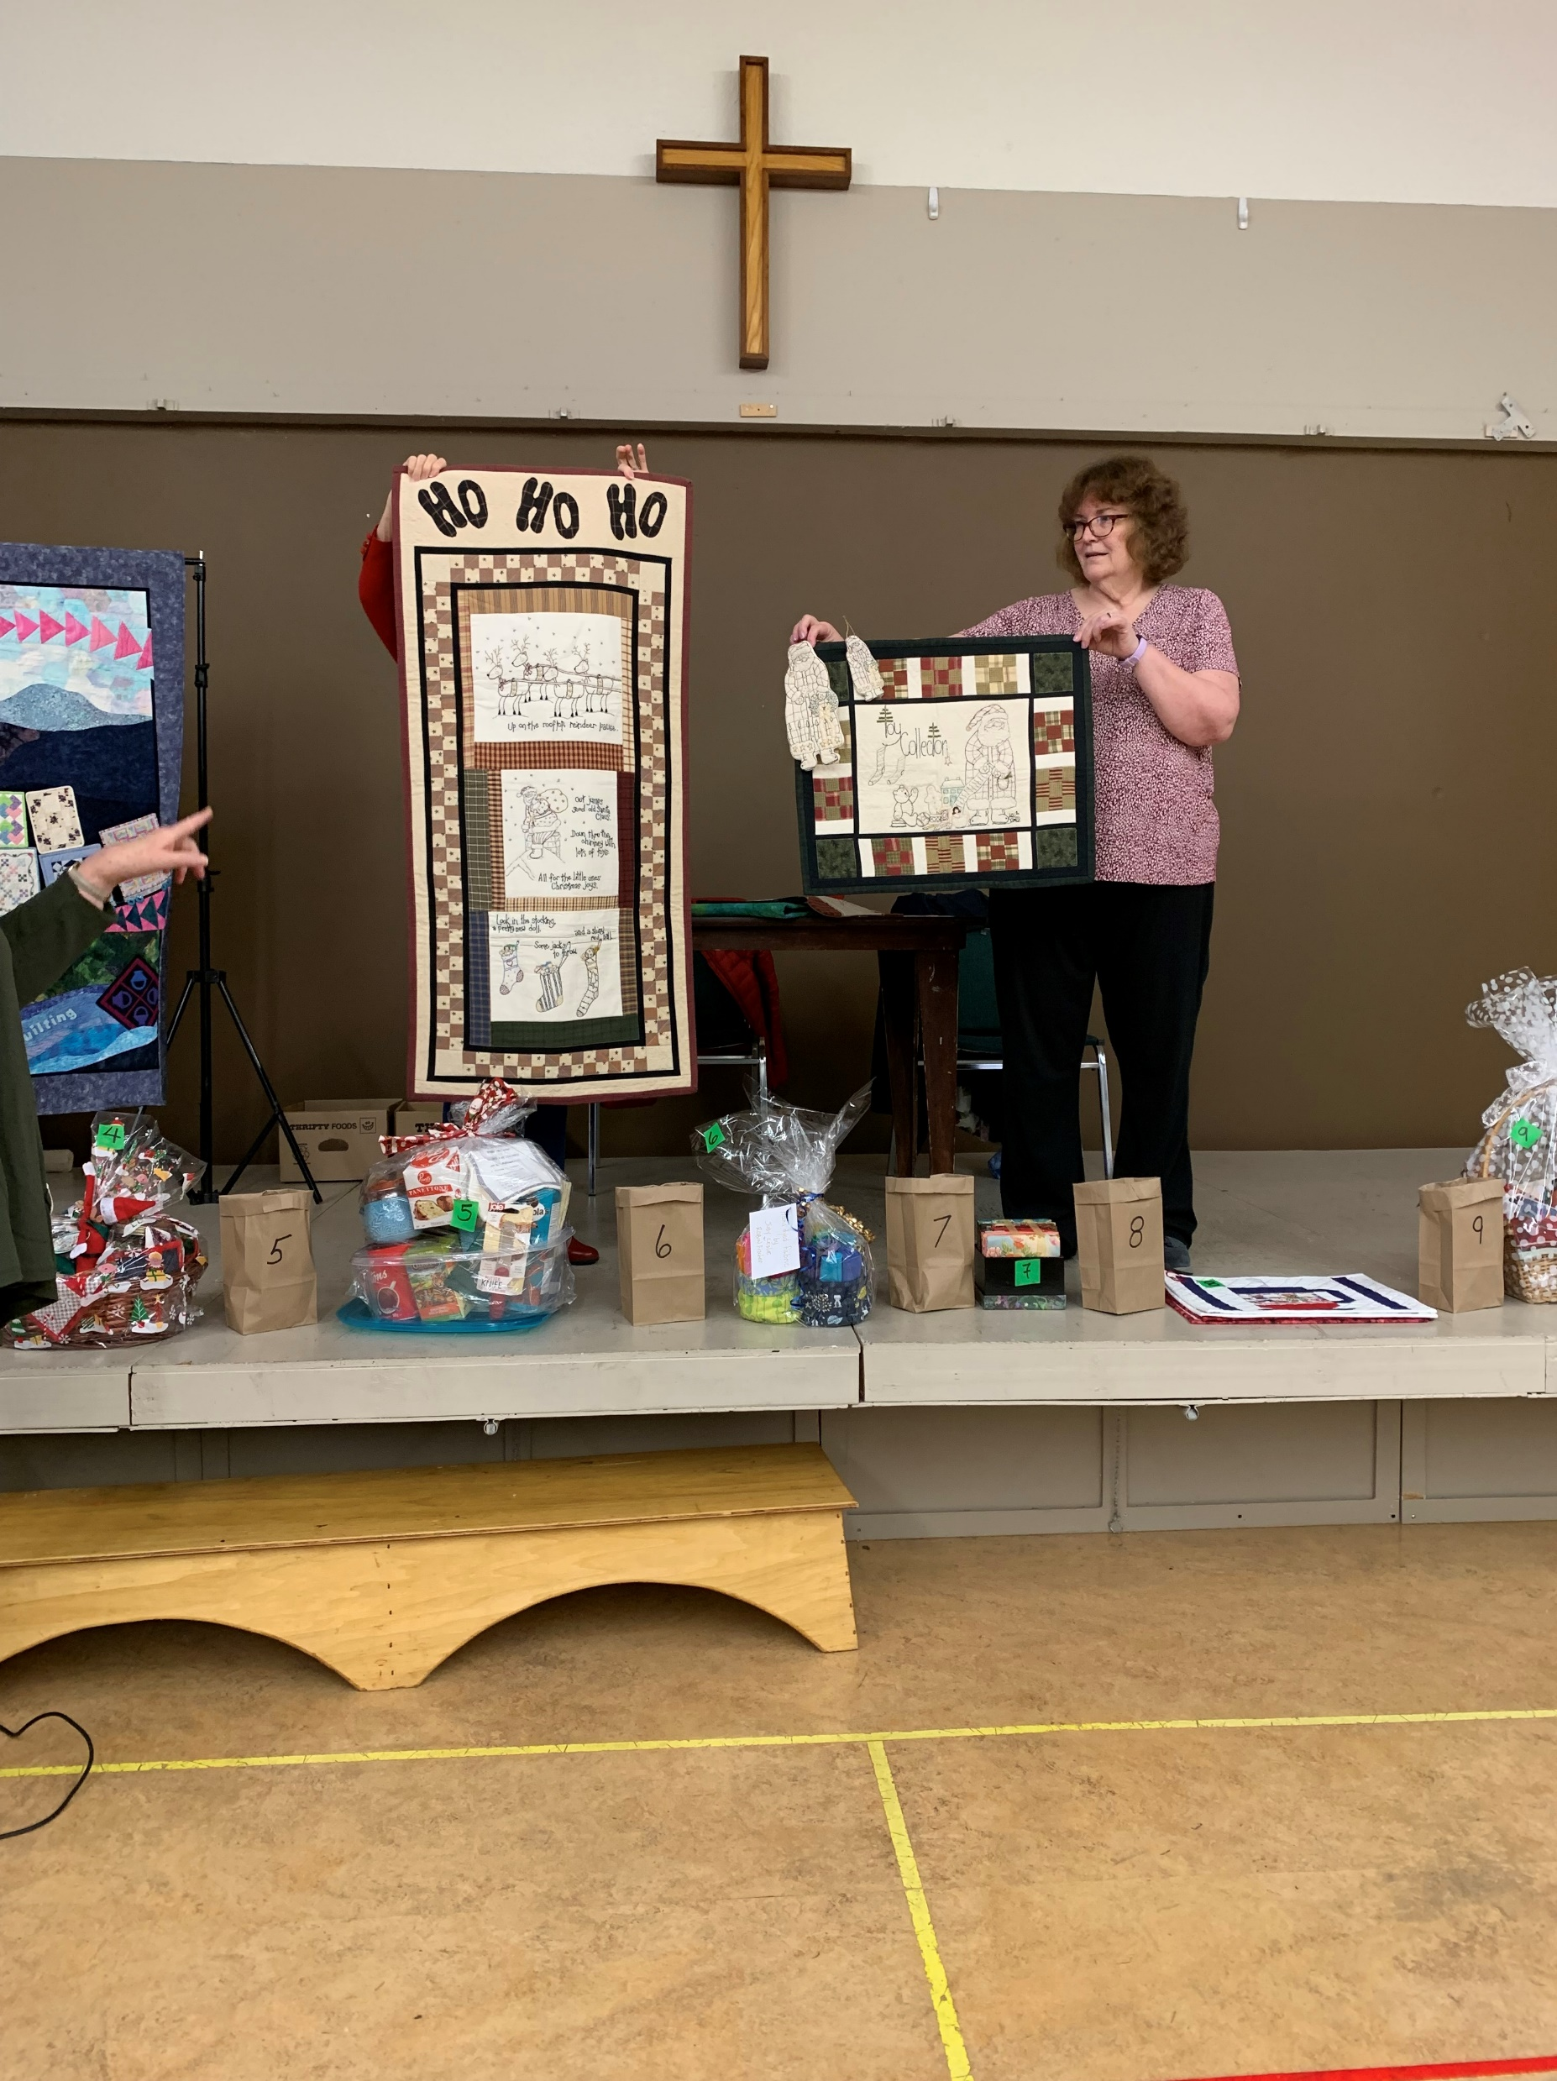
Dougal Walker- 2 Christmas wall hangings

Slide 10
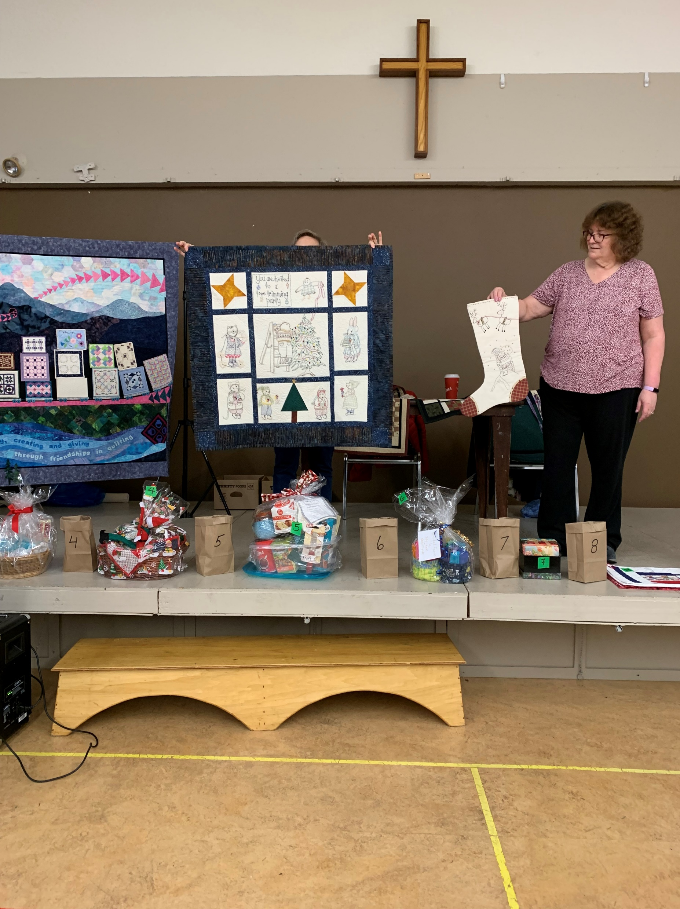
Dougal Walker –Wall hanging and Christmas stocking

Slide 11
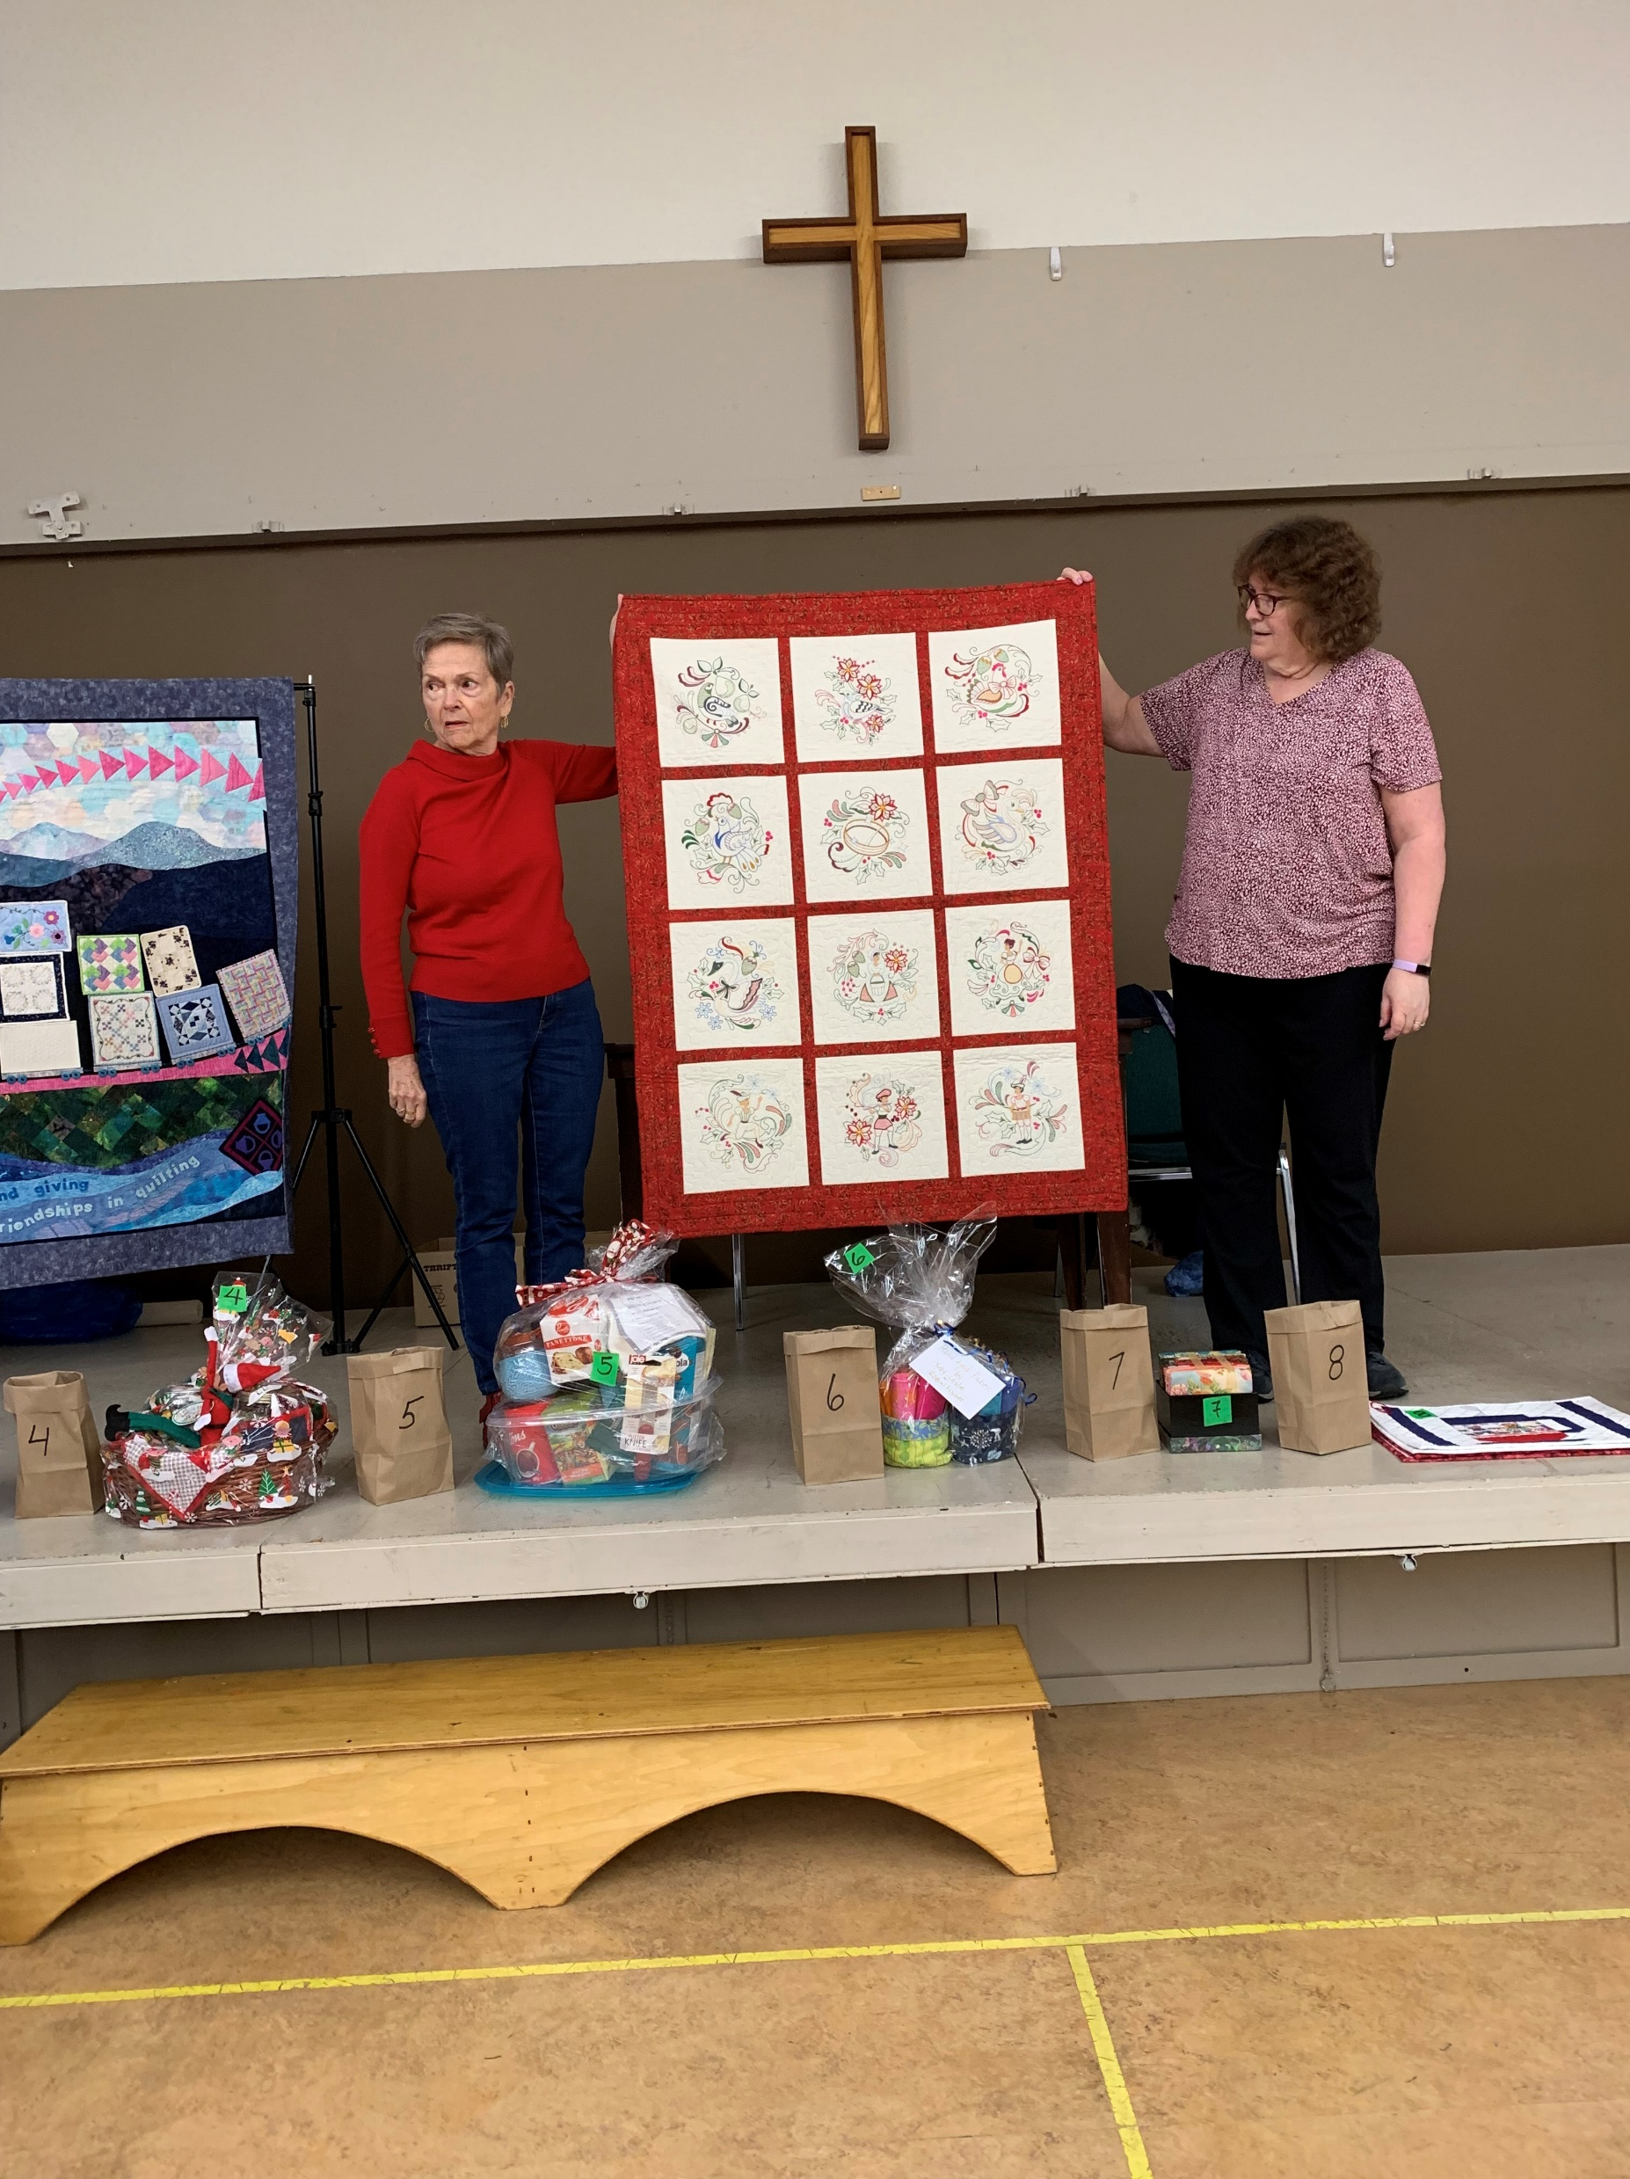
Heather Guest -12 days of Christmas wall hanging

Slide 12
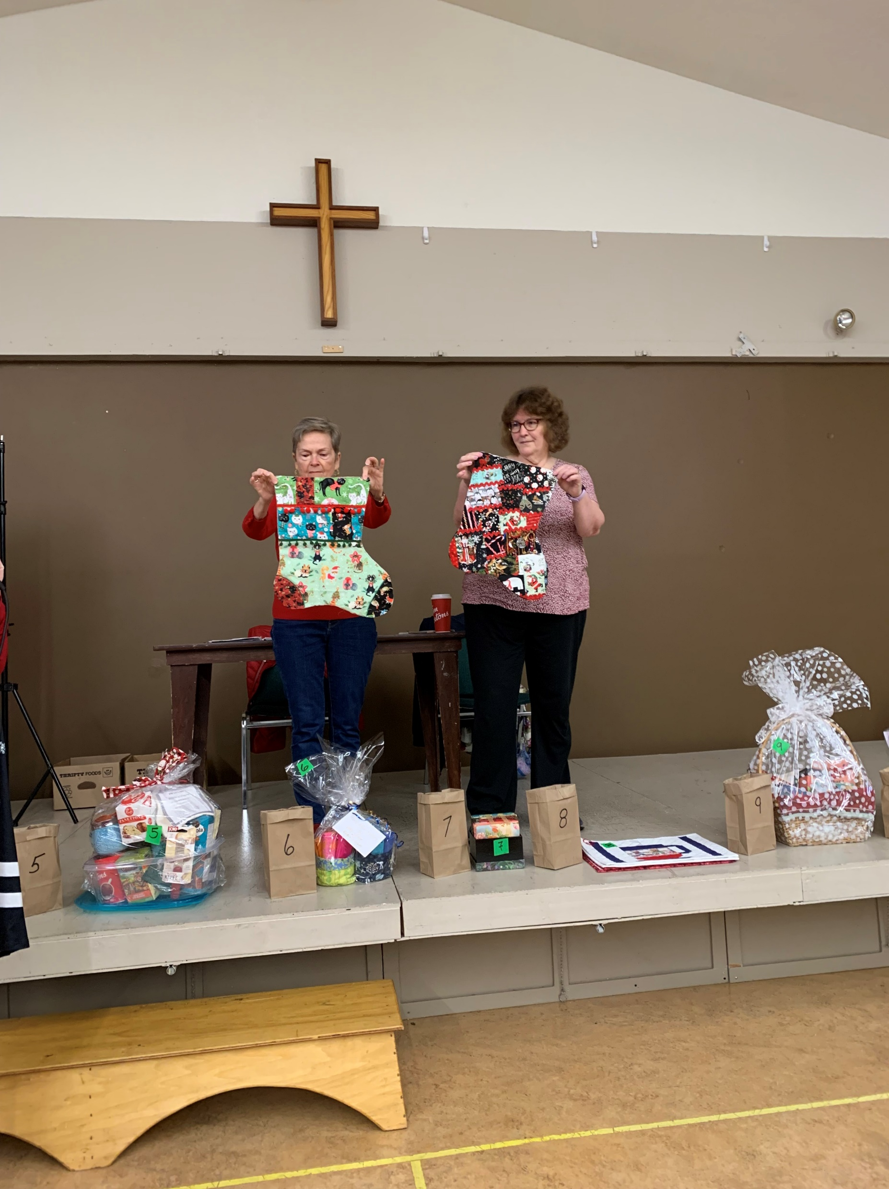
Ieke Giese - two of 75 Christmas stockings made for charity

Slide 13
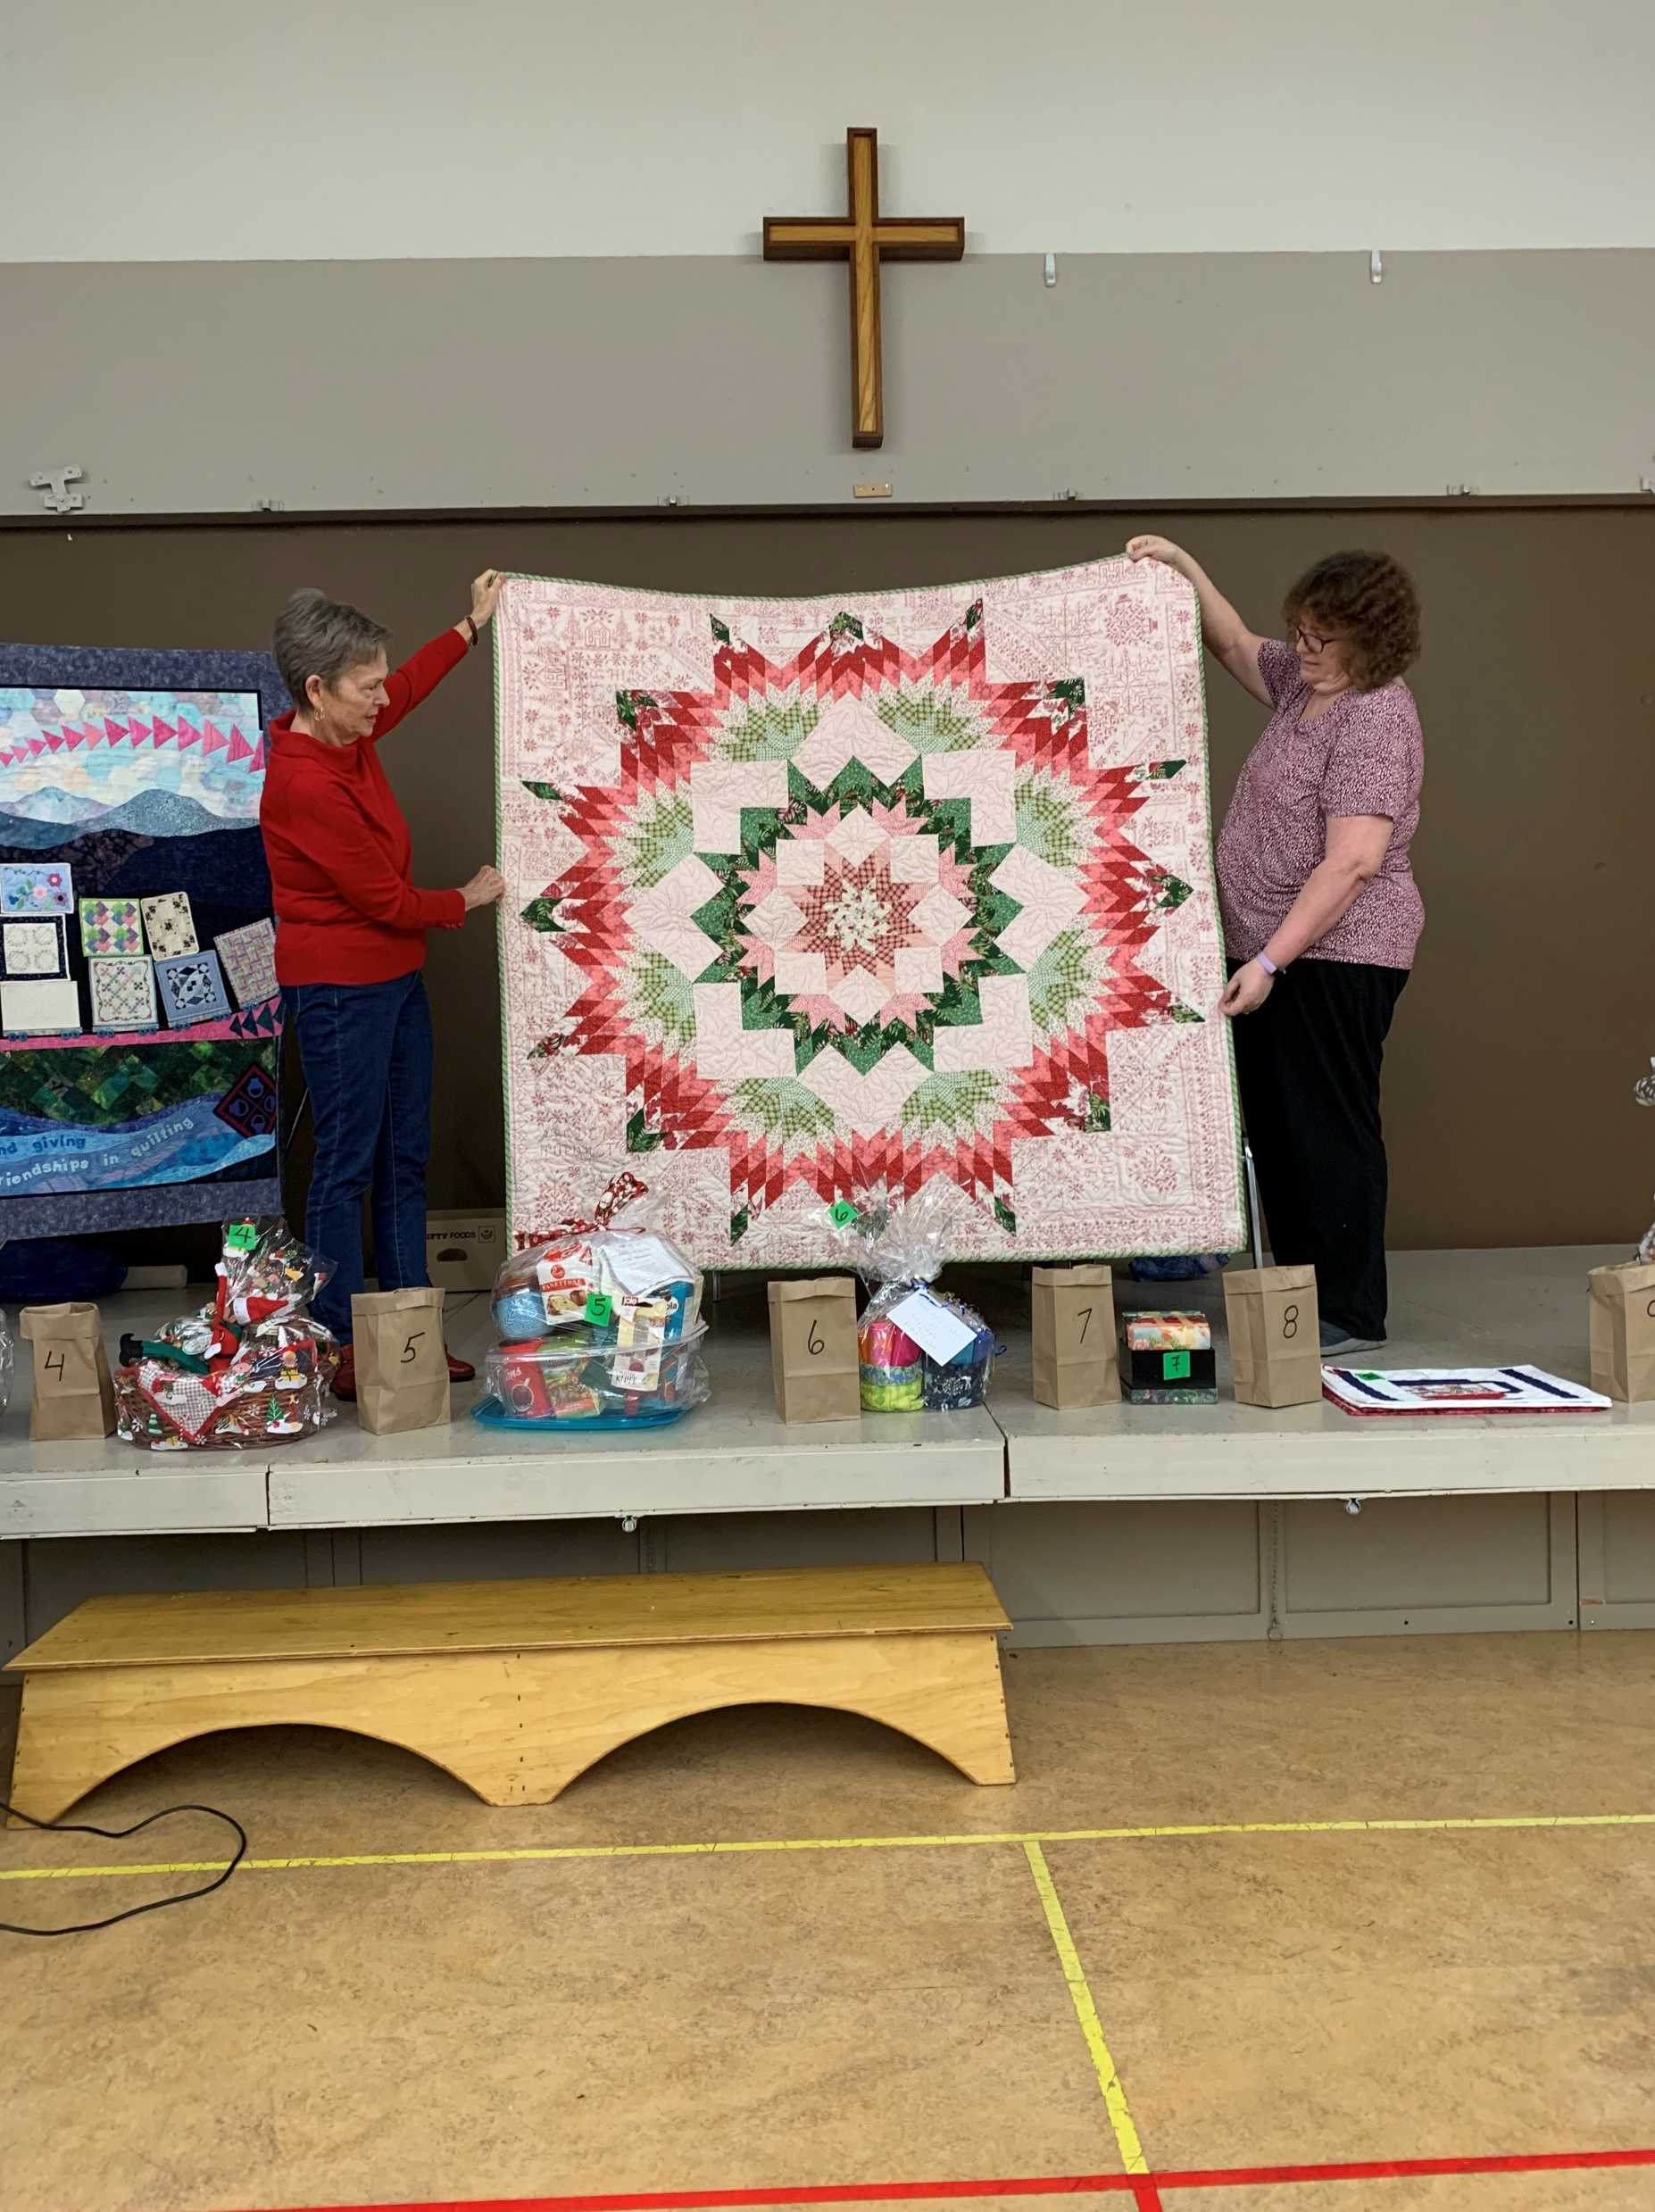
Lily Wong- Christmas Star

Slide 14
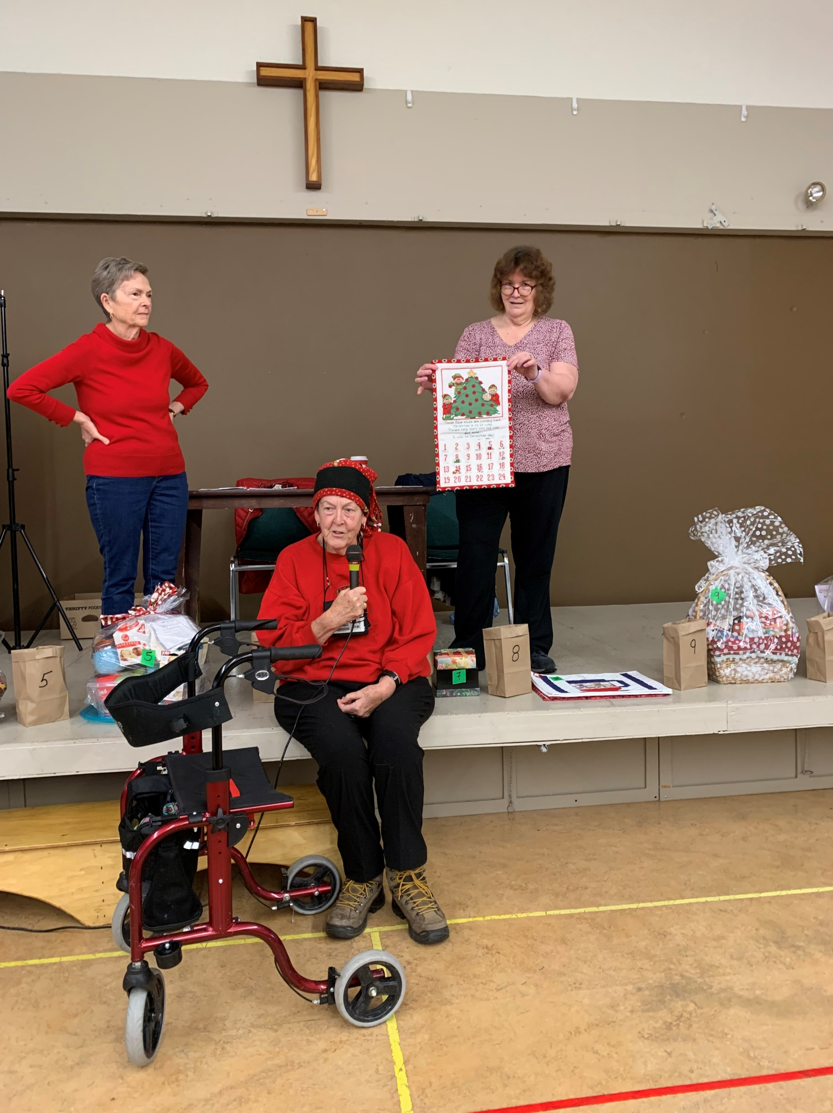
Lynne Fanthorpe - 40yr old advent calendar and home made hat

Slide 15
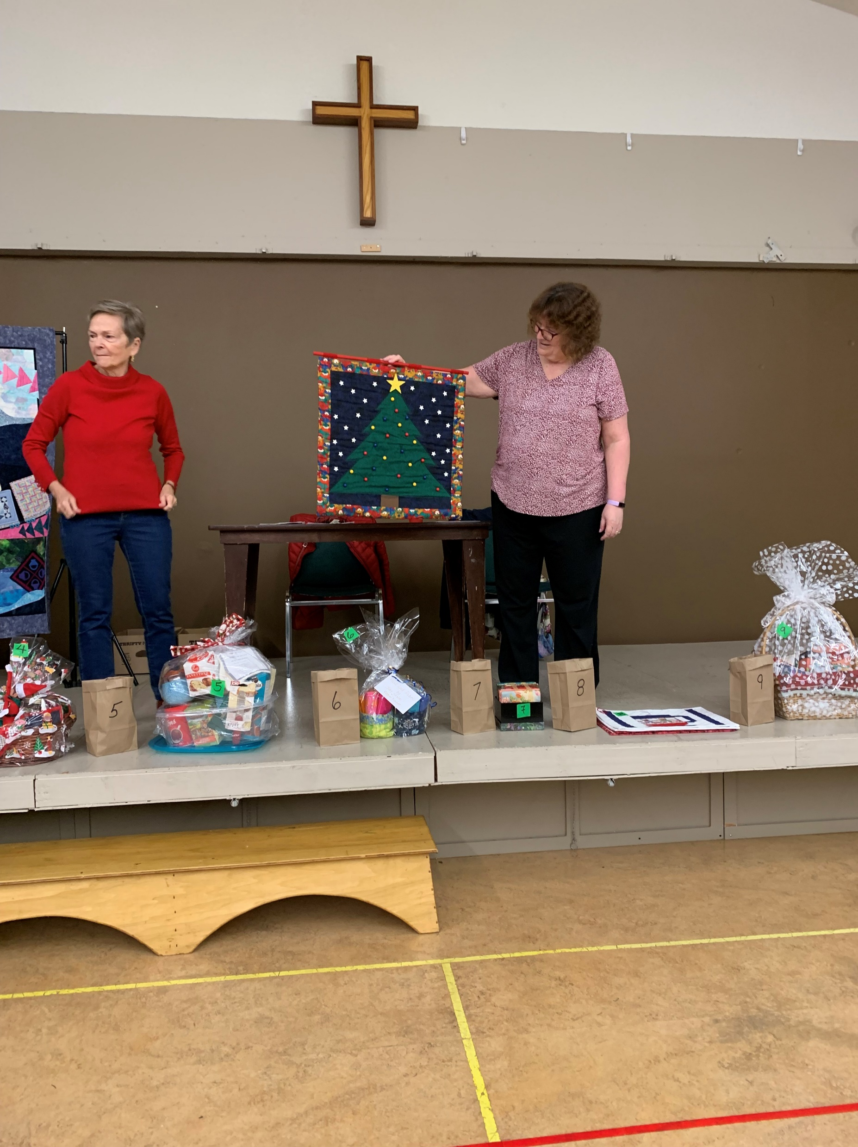
Pat Carroll - Christmas Tree wall hanging

Slide 16
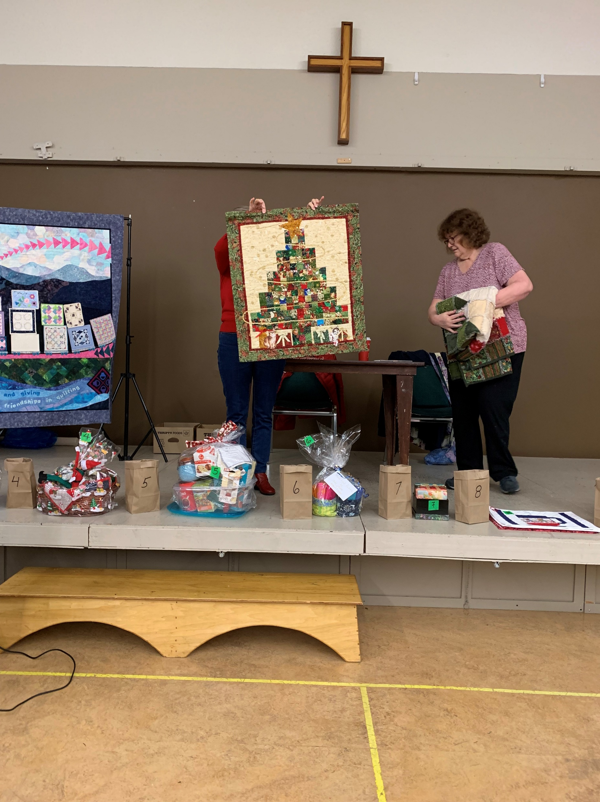
Sandra Smith -Christmas Ribbon wall hanging

Slide 17
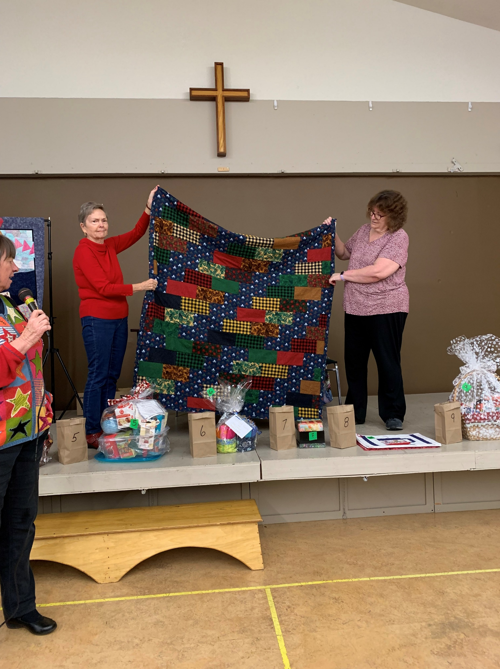
Sandra Smith Winter/Christmas rag quilt

Slide 18
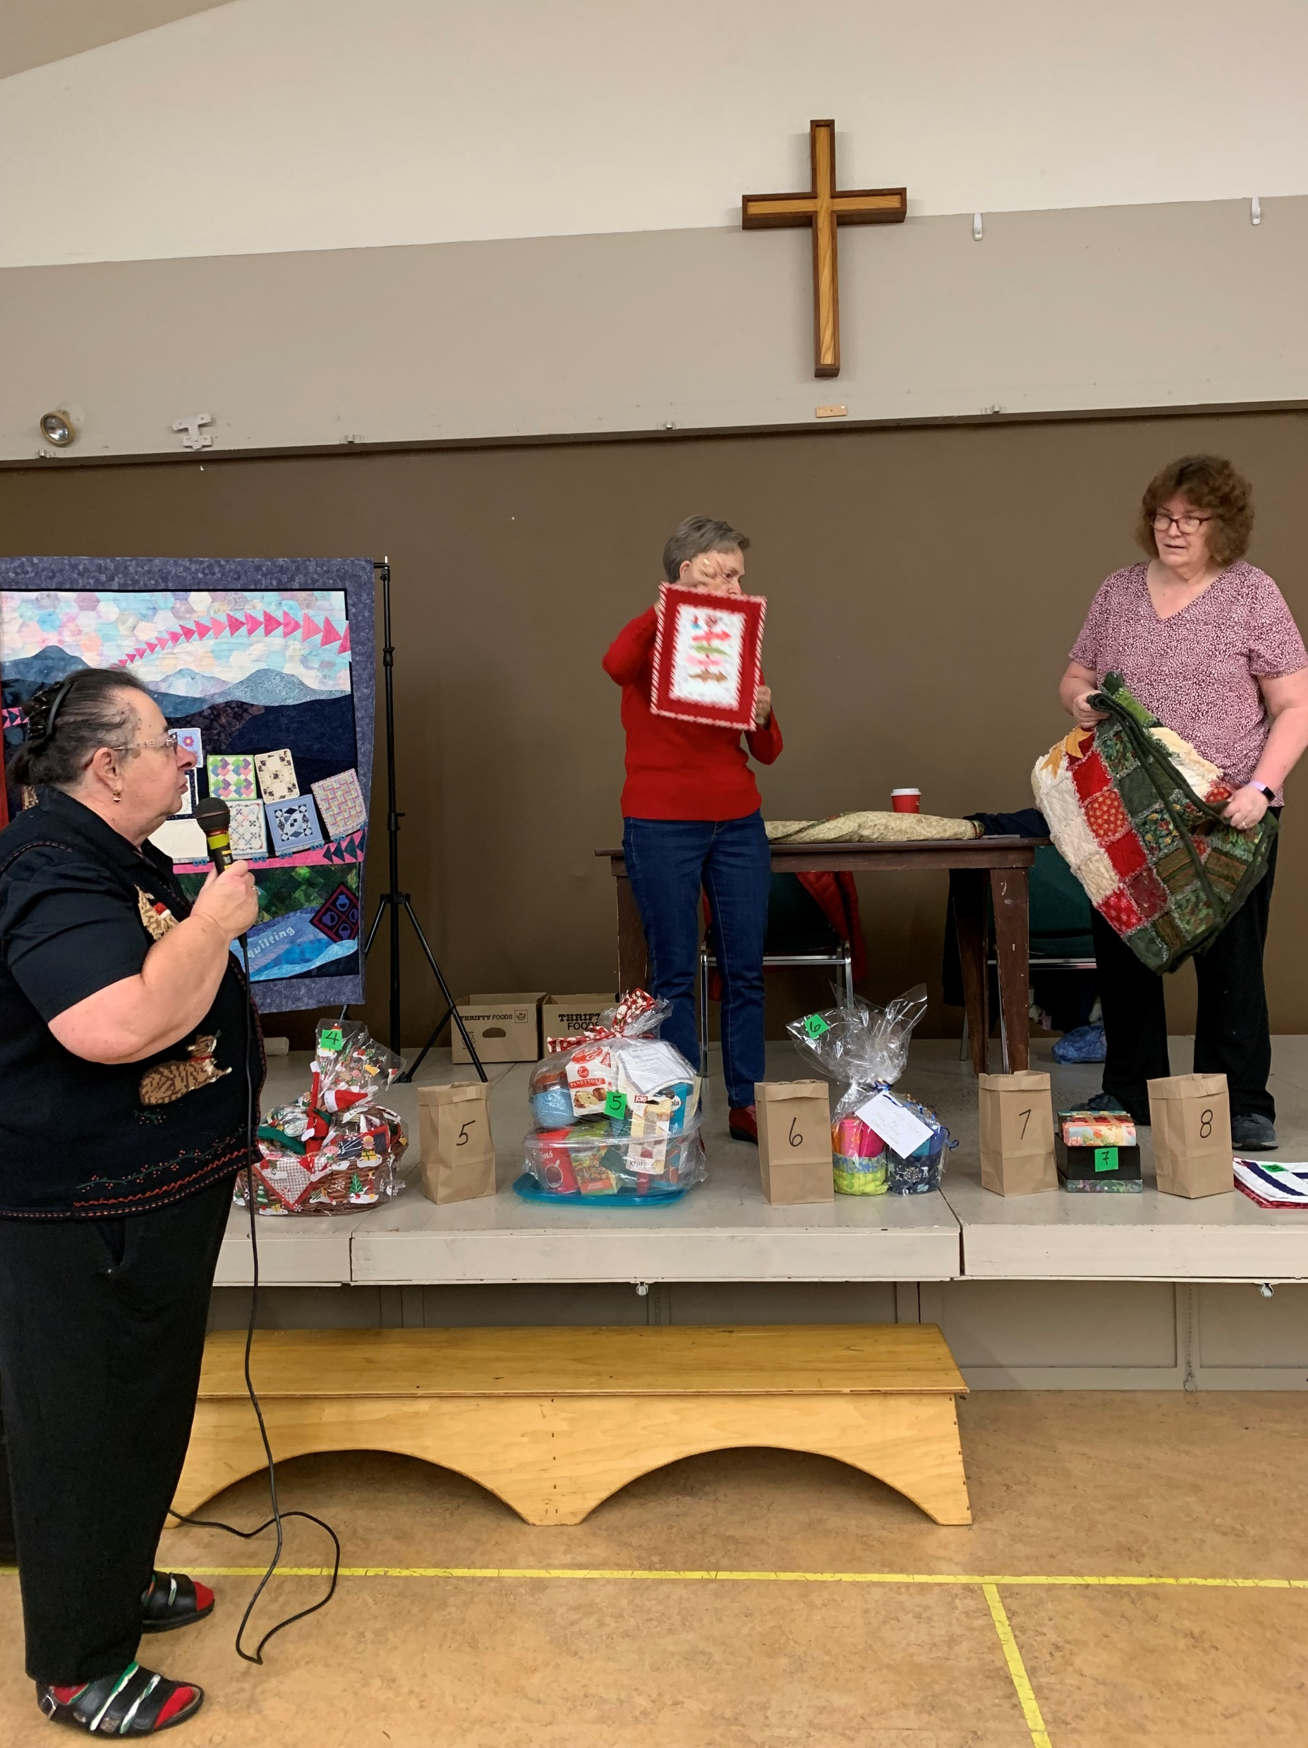
Sandra Smith Christmas wall hanging

Slide 19
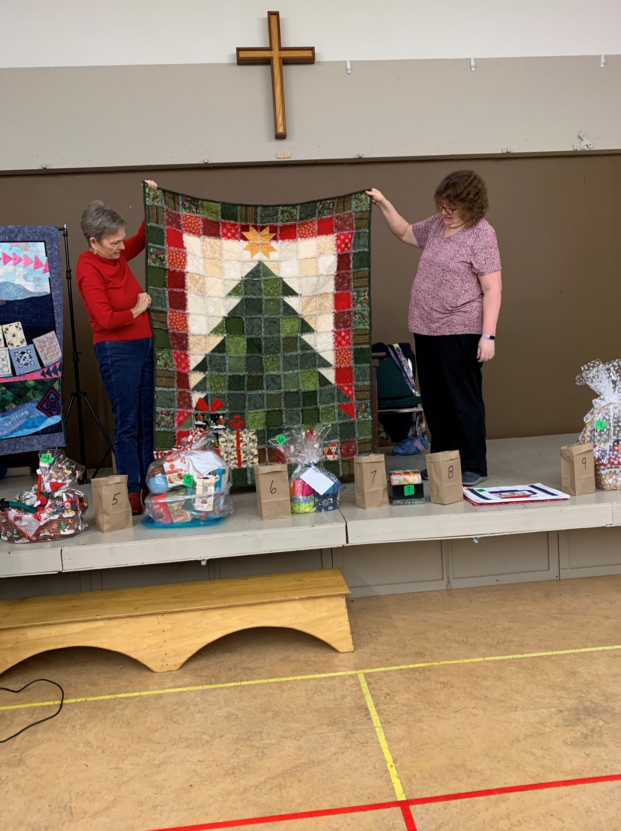
Sharon Betker Christmas rag quilt top

Slide 20
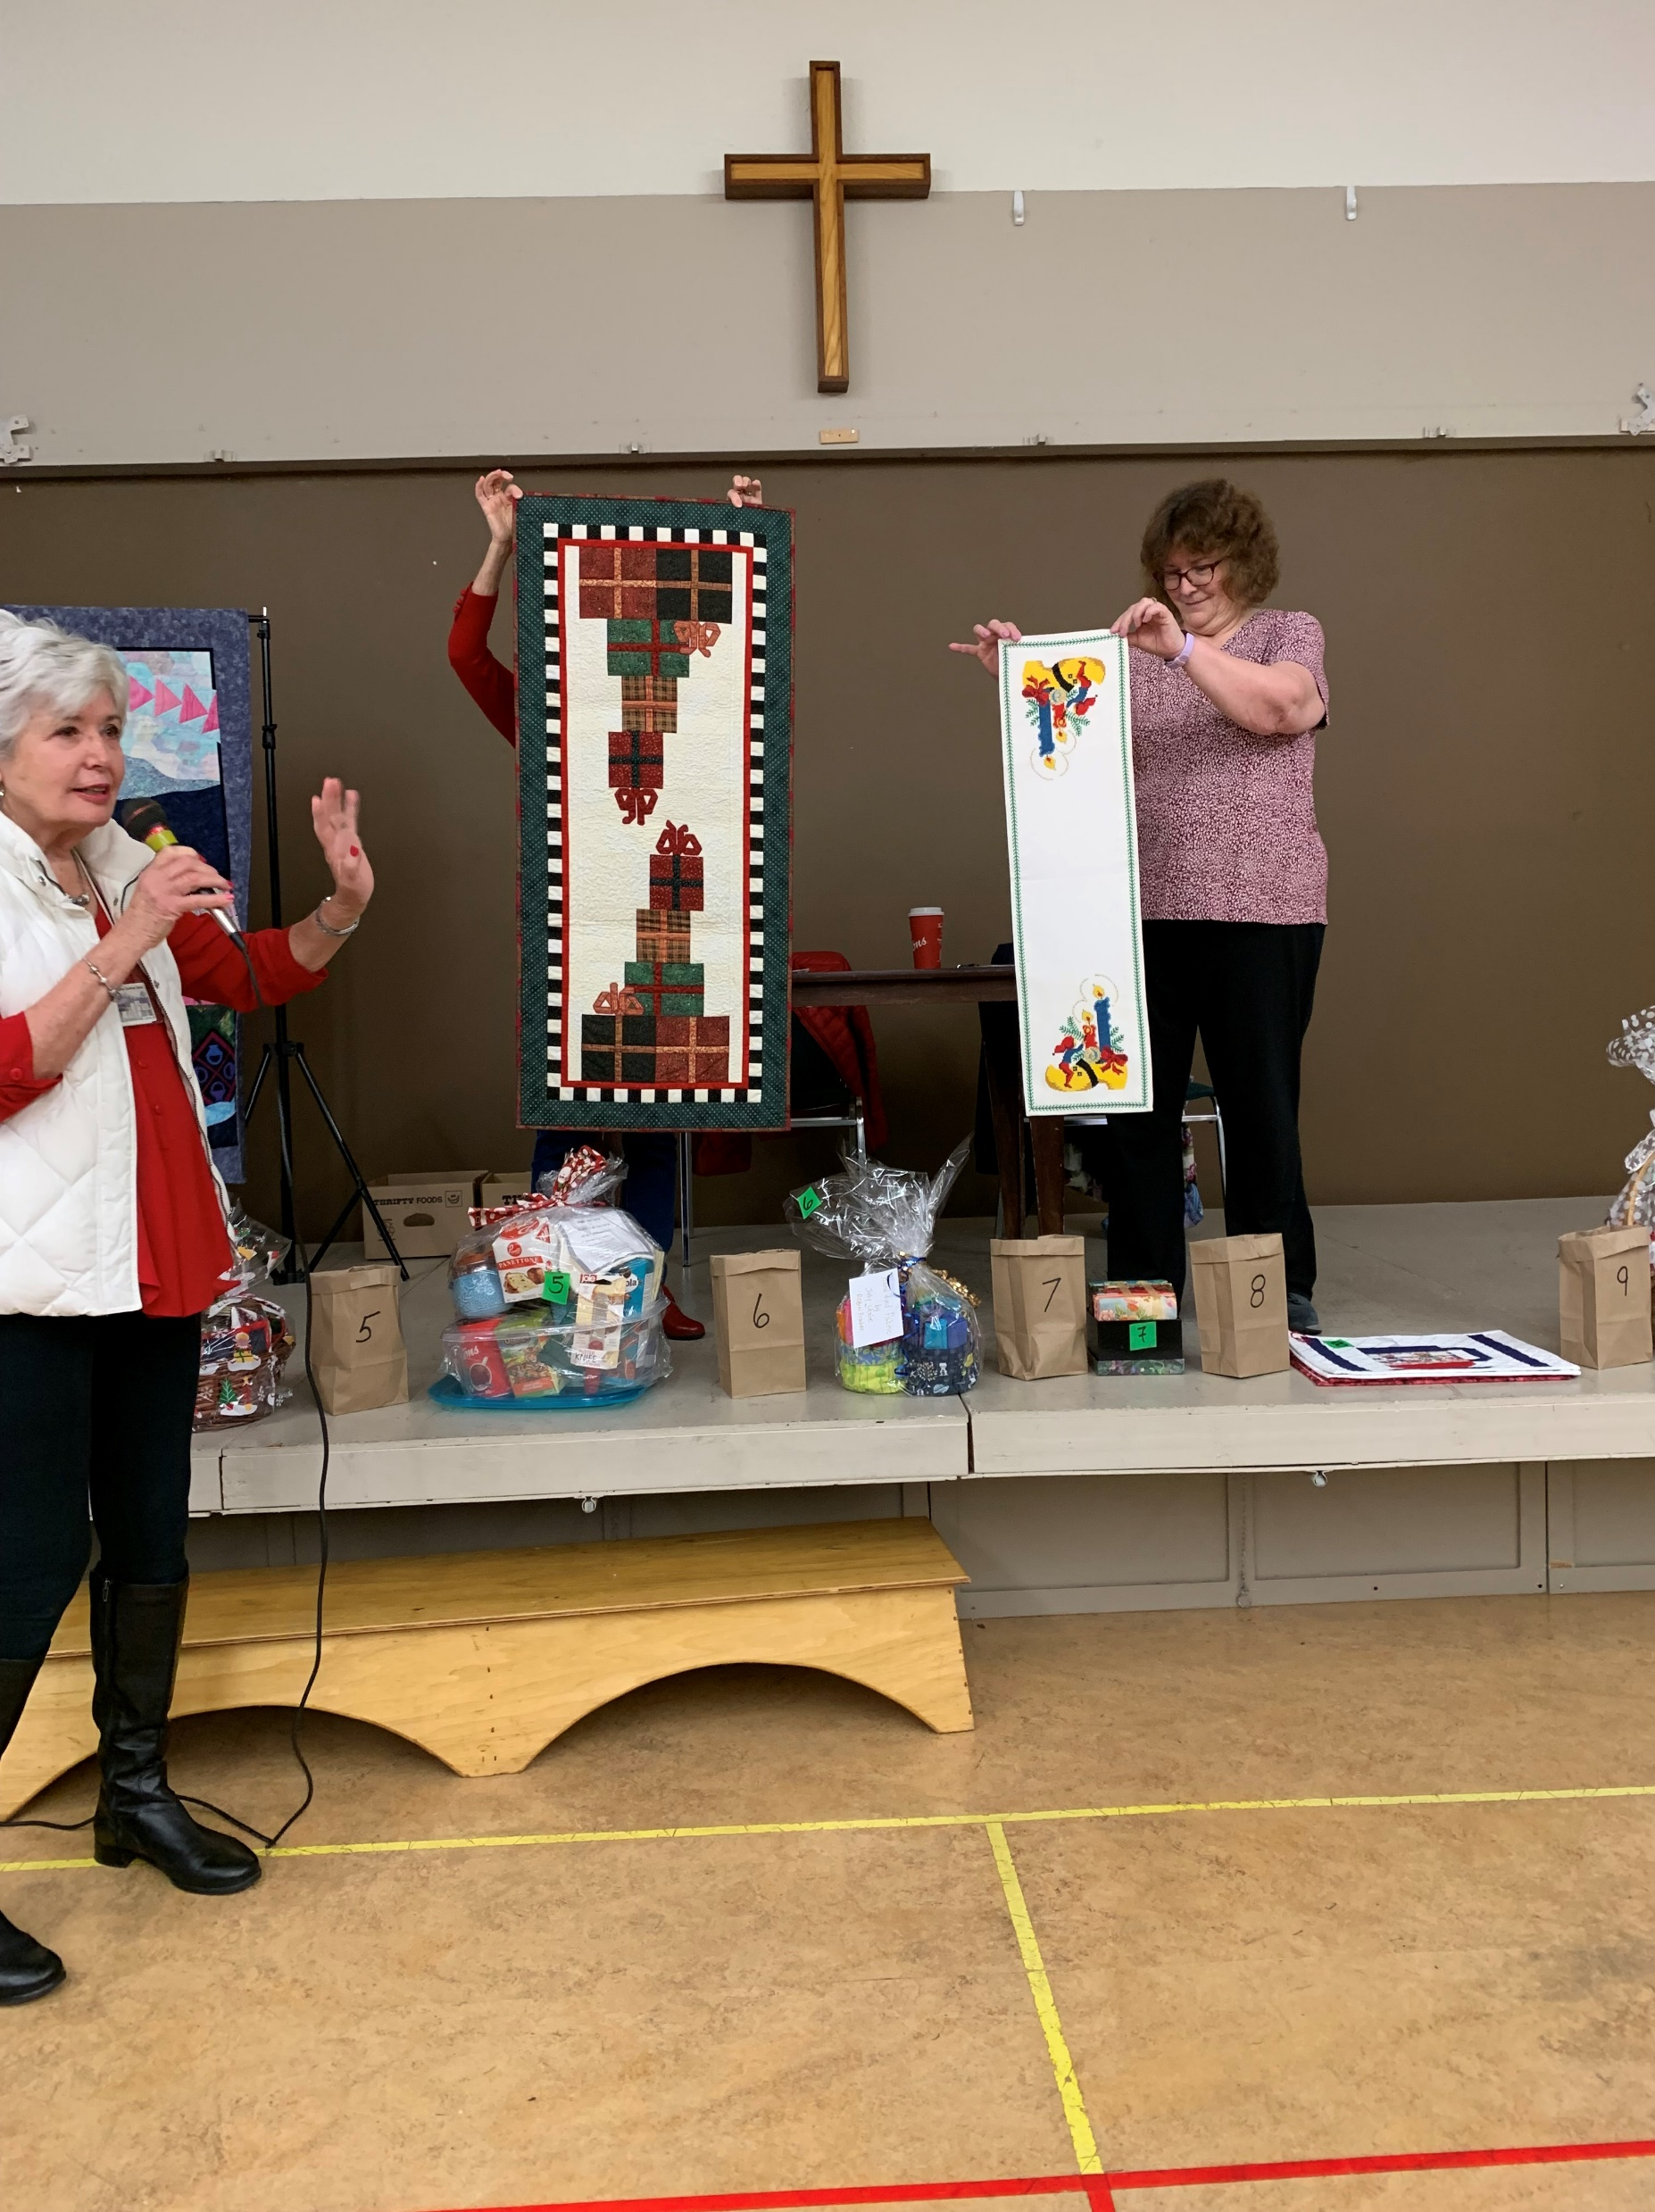
Sharon Franzius Christmas table runner

Slide 21
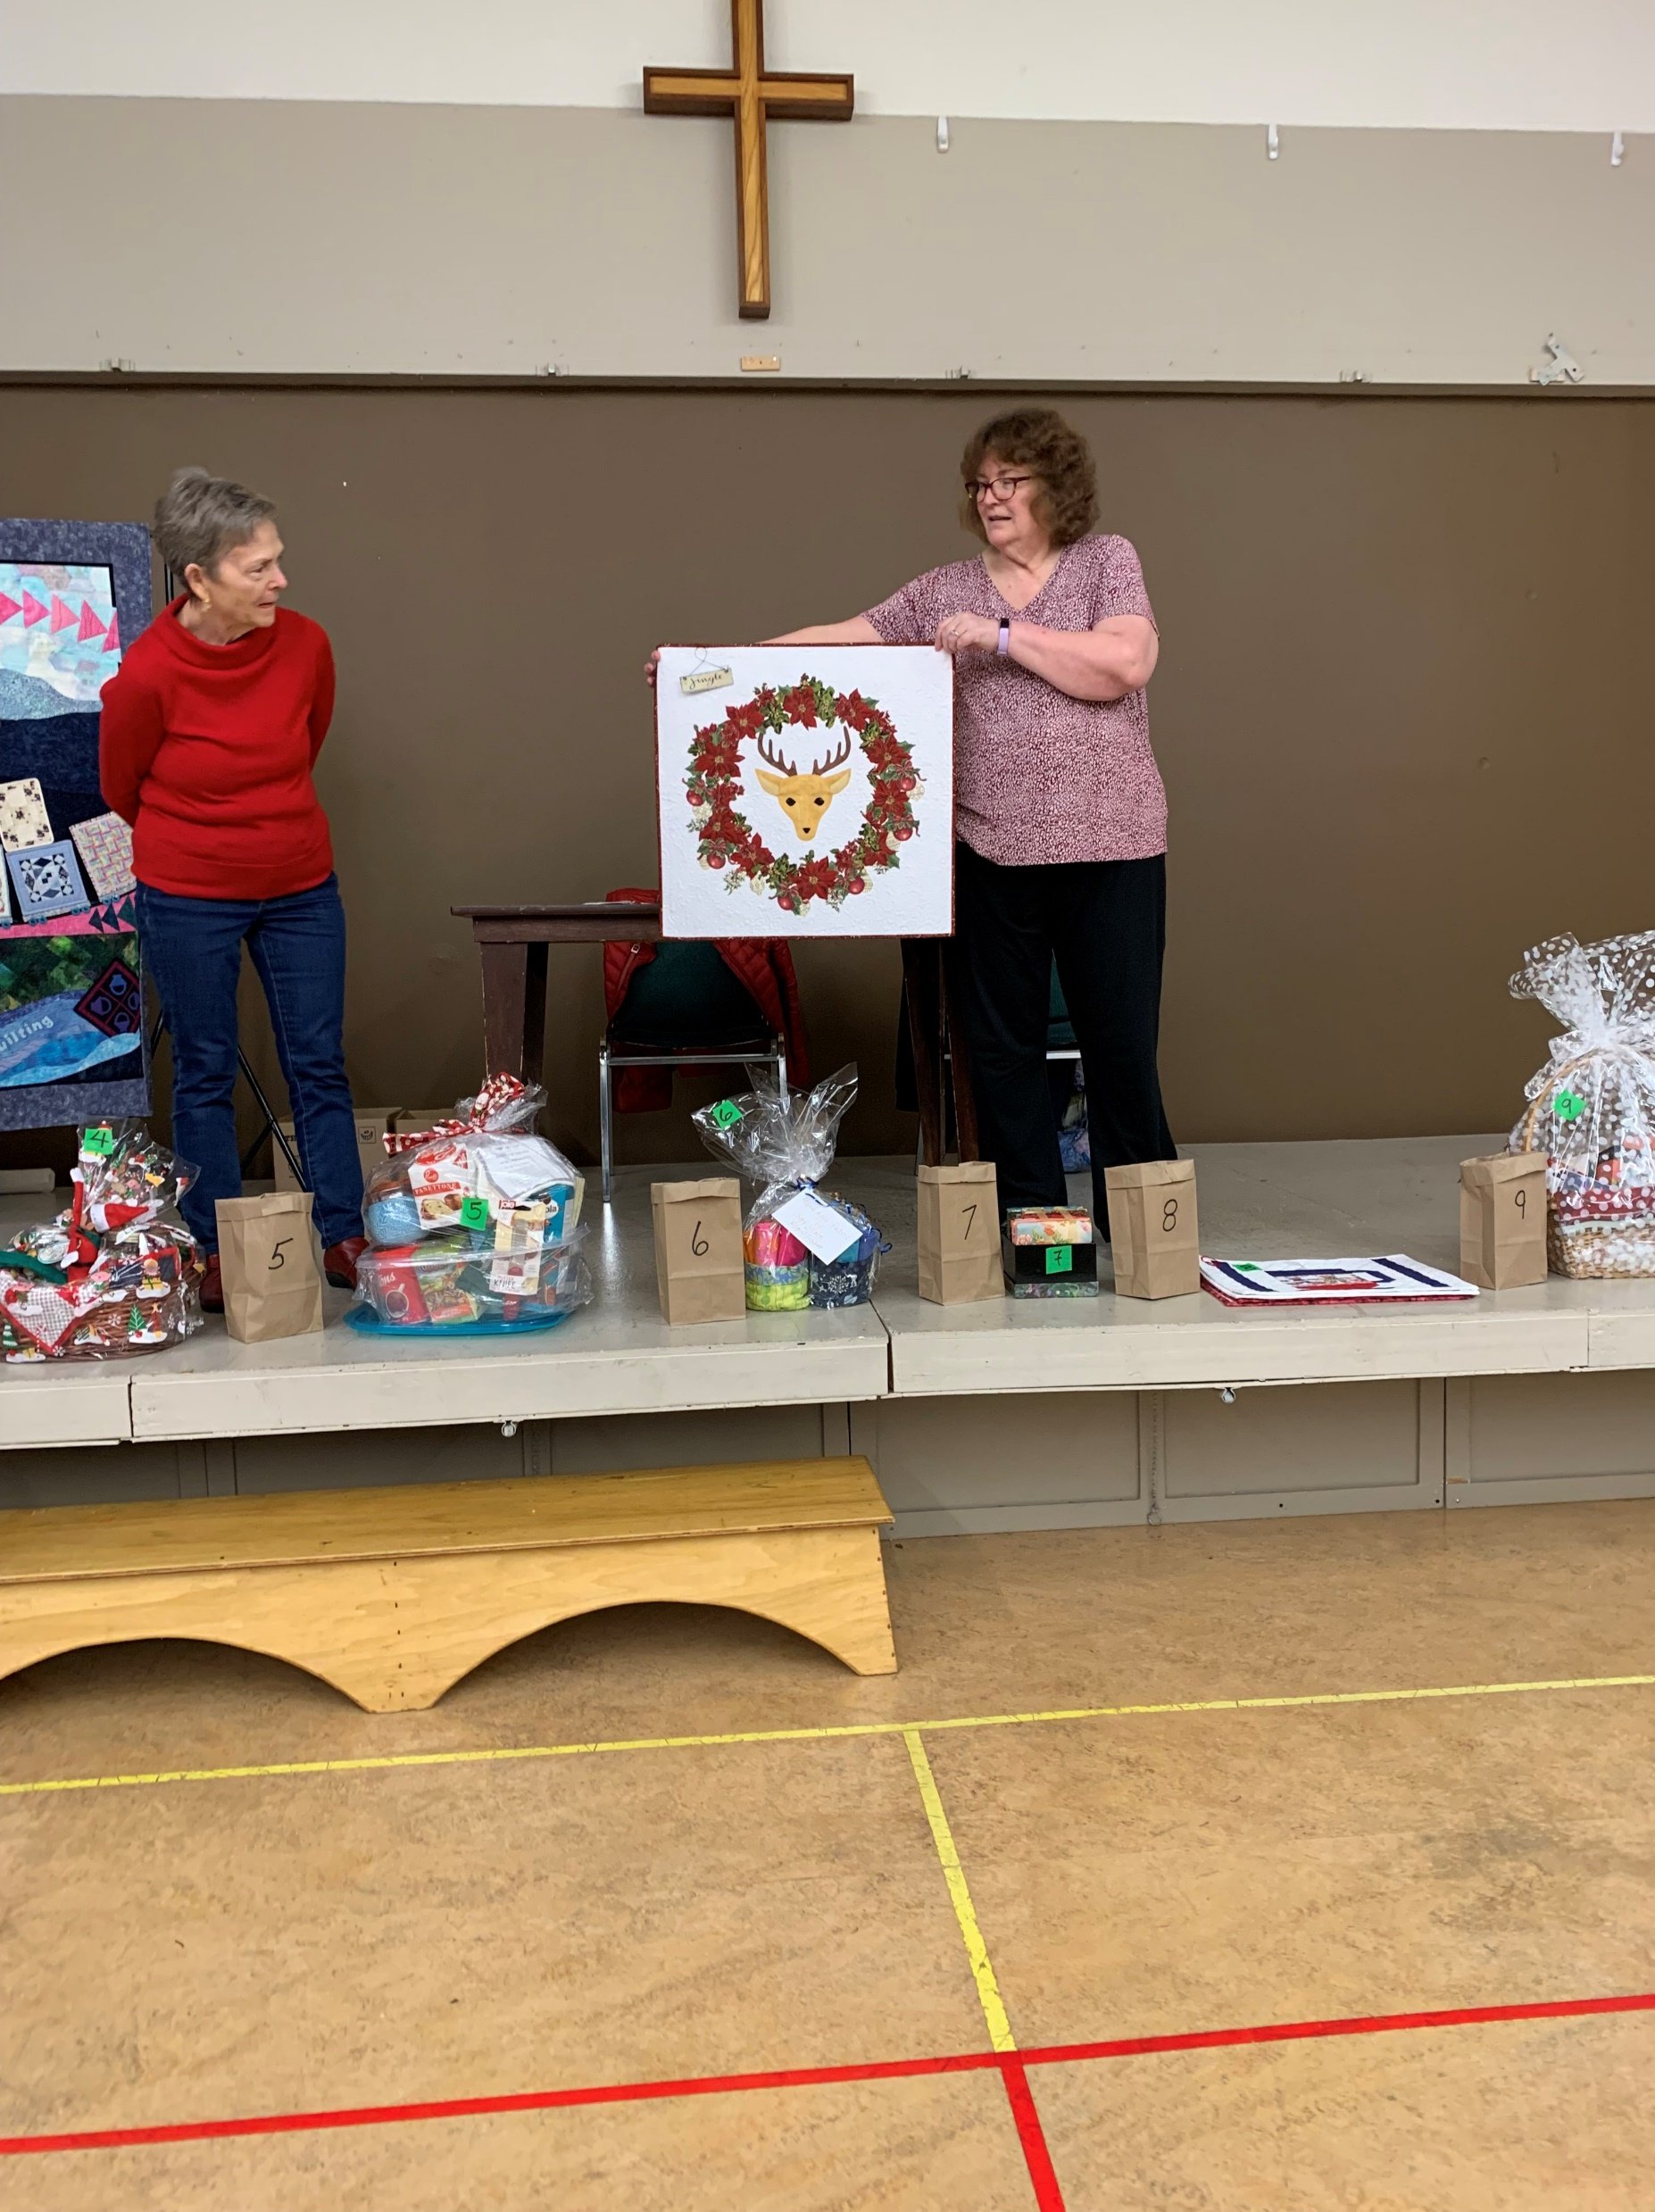
Sue Treen - Christmas Deer wall hanging

Slide 22
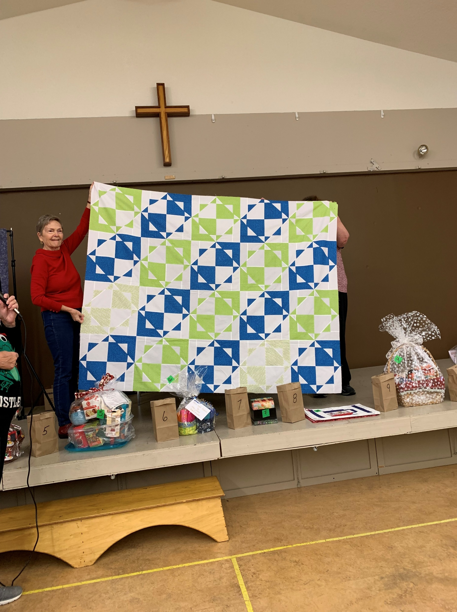
Trish Poehnell “Go Hawks Go”

Slide 23
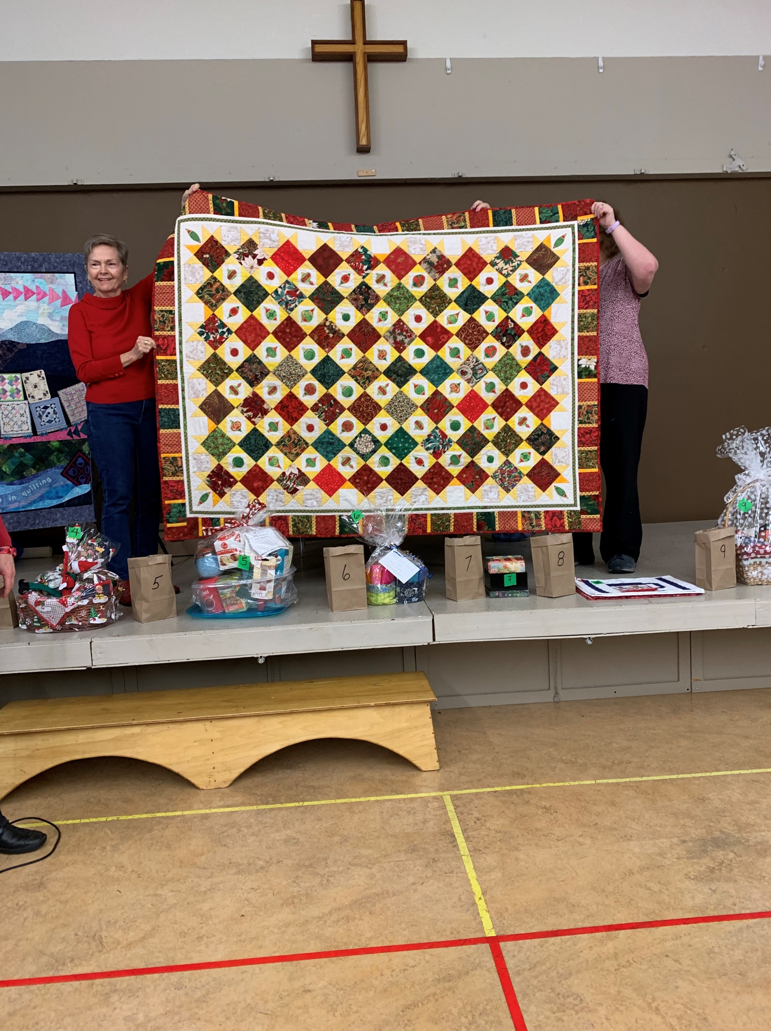
Vesna Hruska Christmas quilt

Slide 24
Vesna Hruska -Poinsettia wallhanging

Slide 25
Vesna Hruska Christmas wall hanging

Slide 26
Wendy Whiting Christmas presents quilt

Slide 27
Wendy Whiting Christmas star preemie quilt

Slide 28
THE END

