Slide 1
FRASER VALLEY QUILTERS’ GUILD
MARCH 2024

Slide 2
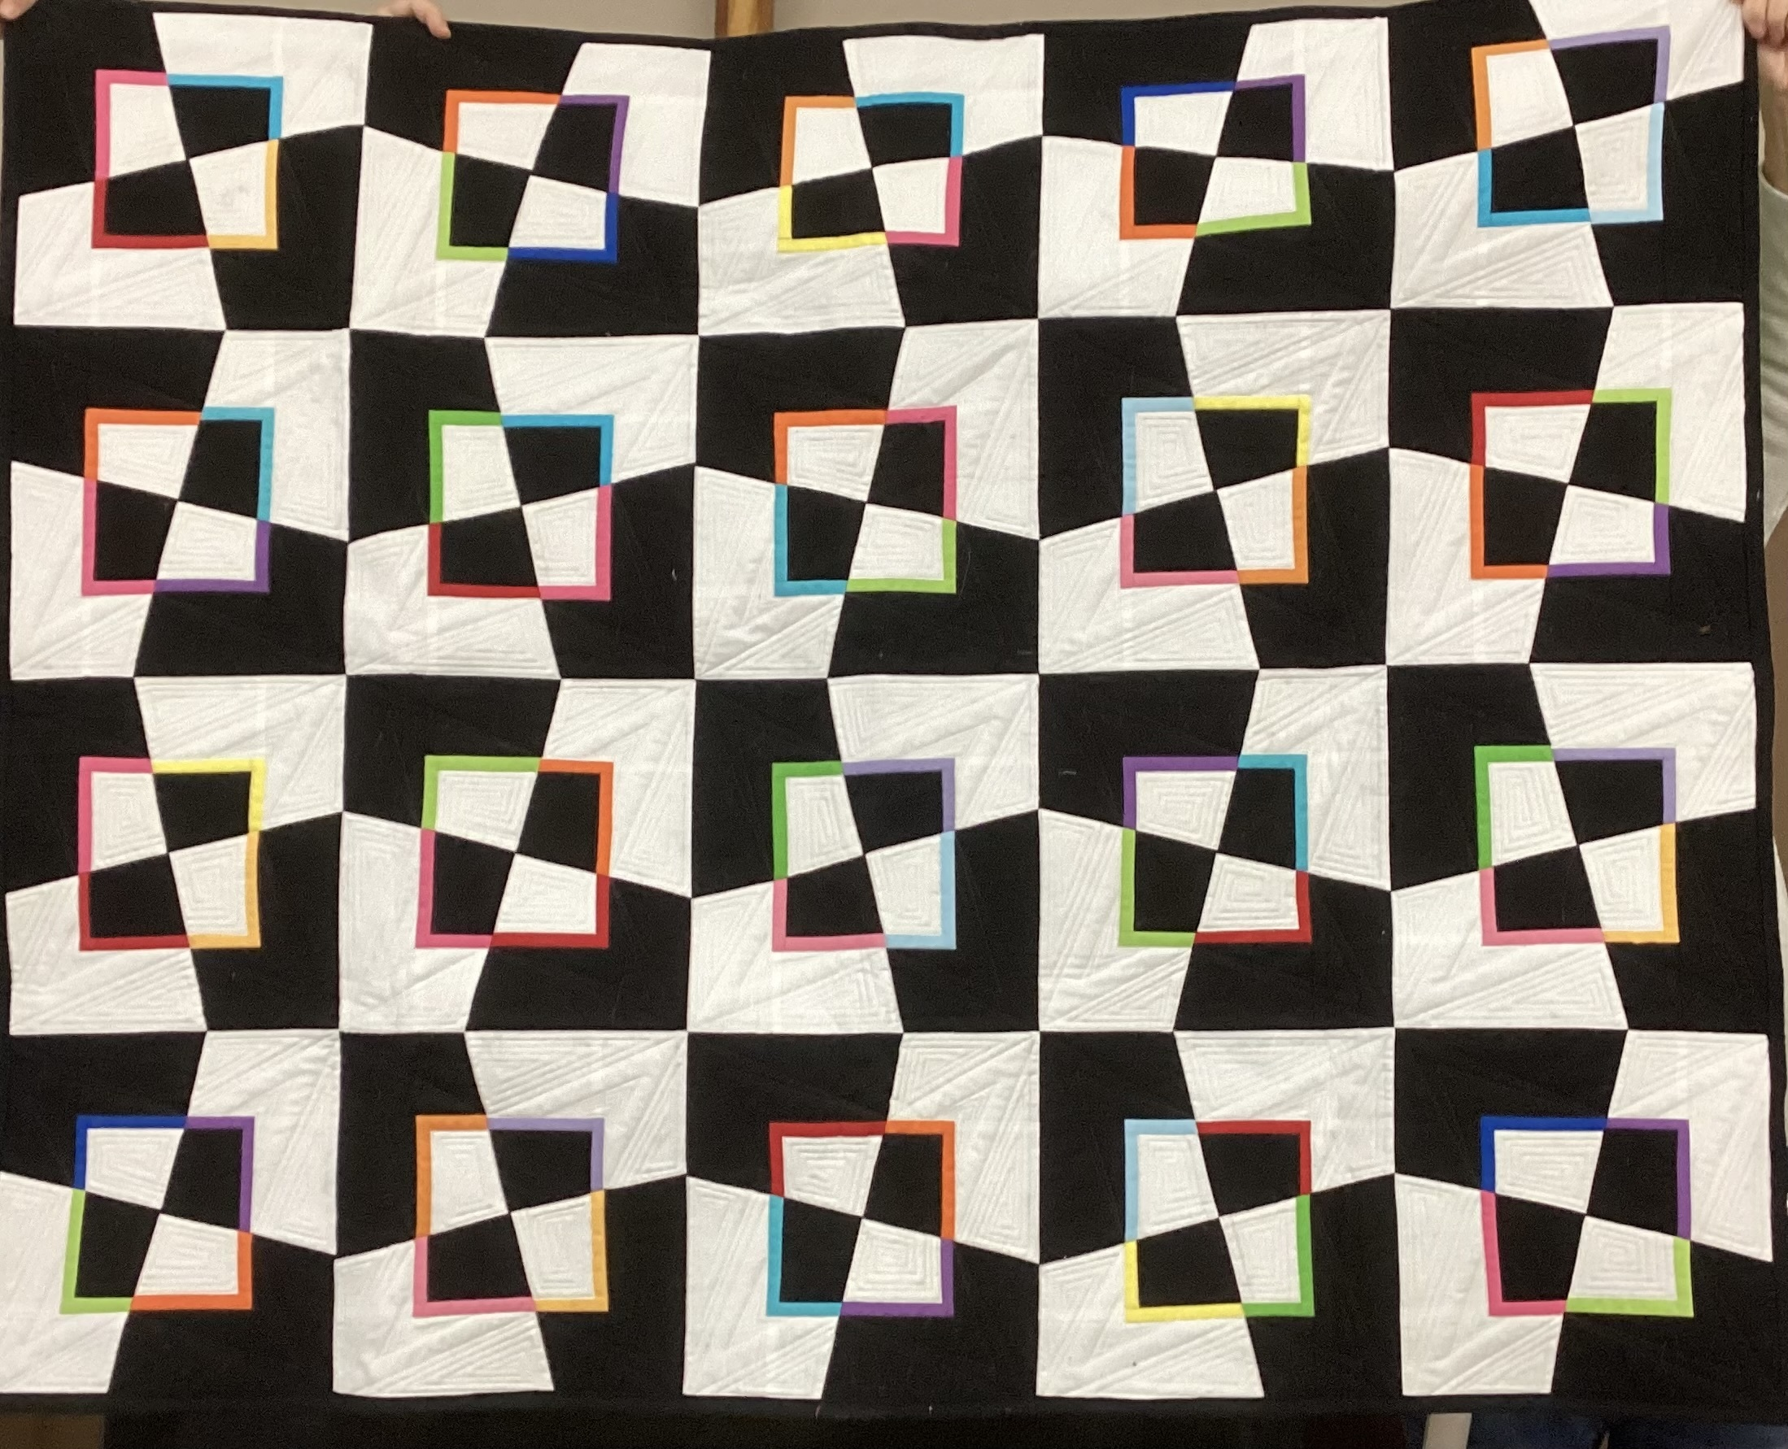
Anna Marie Wonky QUILT

Slide 3
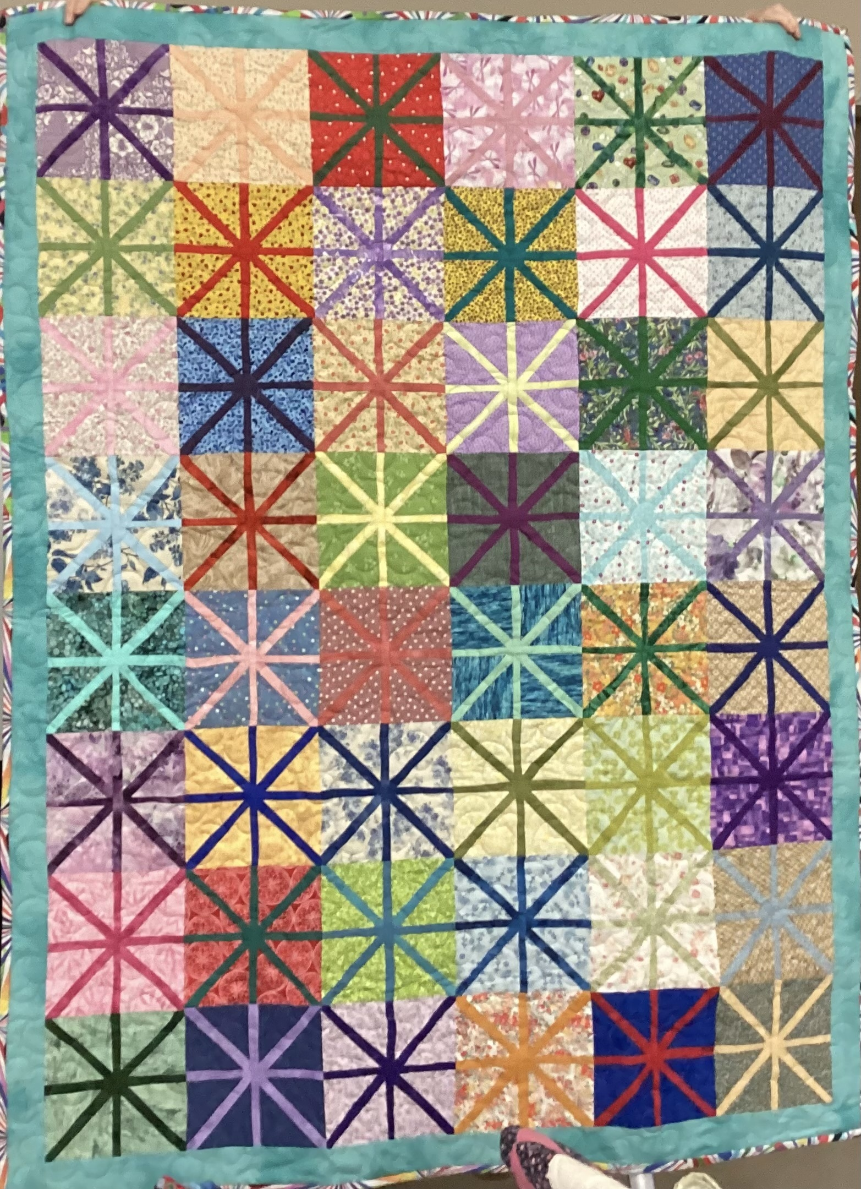
Beckie Stewart Asterik

Slide 4
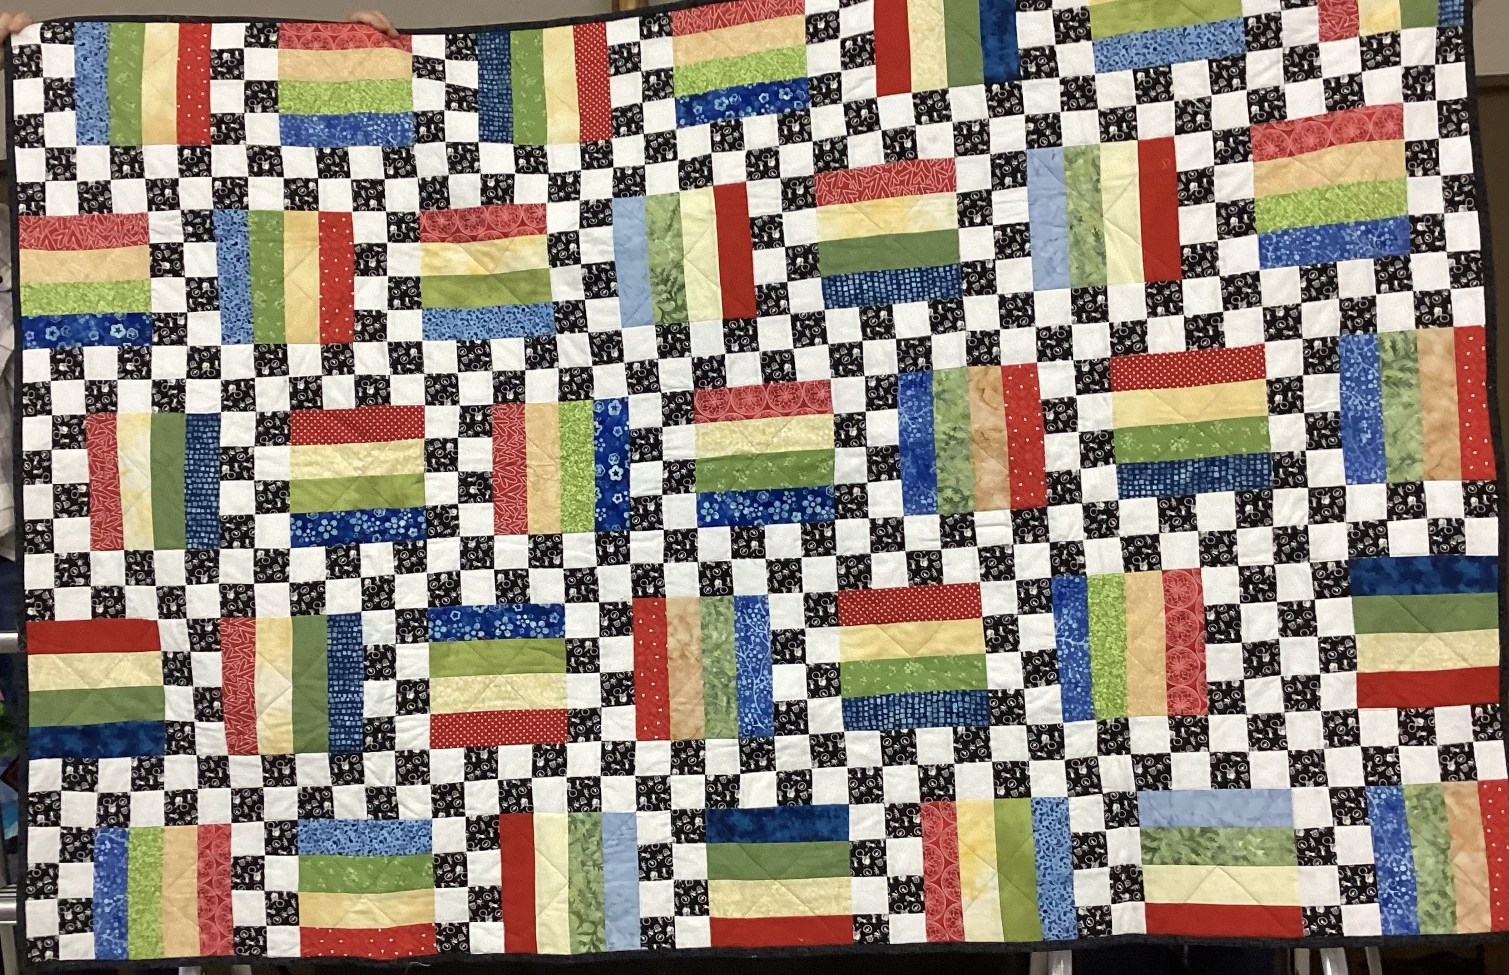
Beckie Stewart Checkerboard

Slide 5
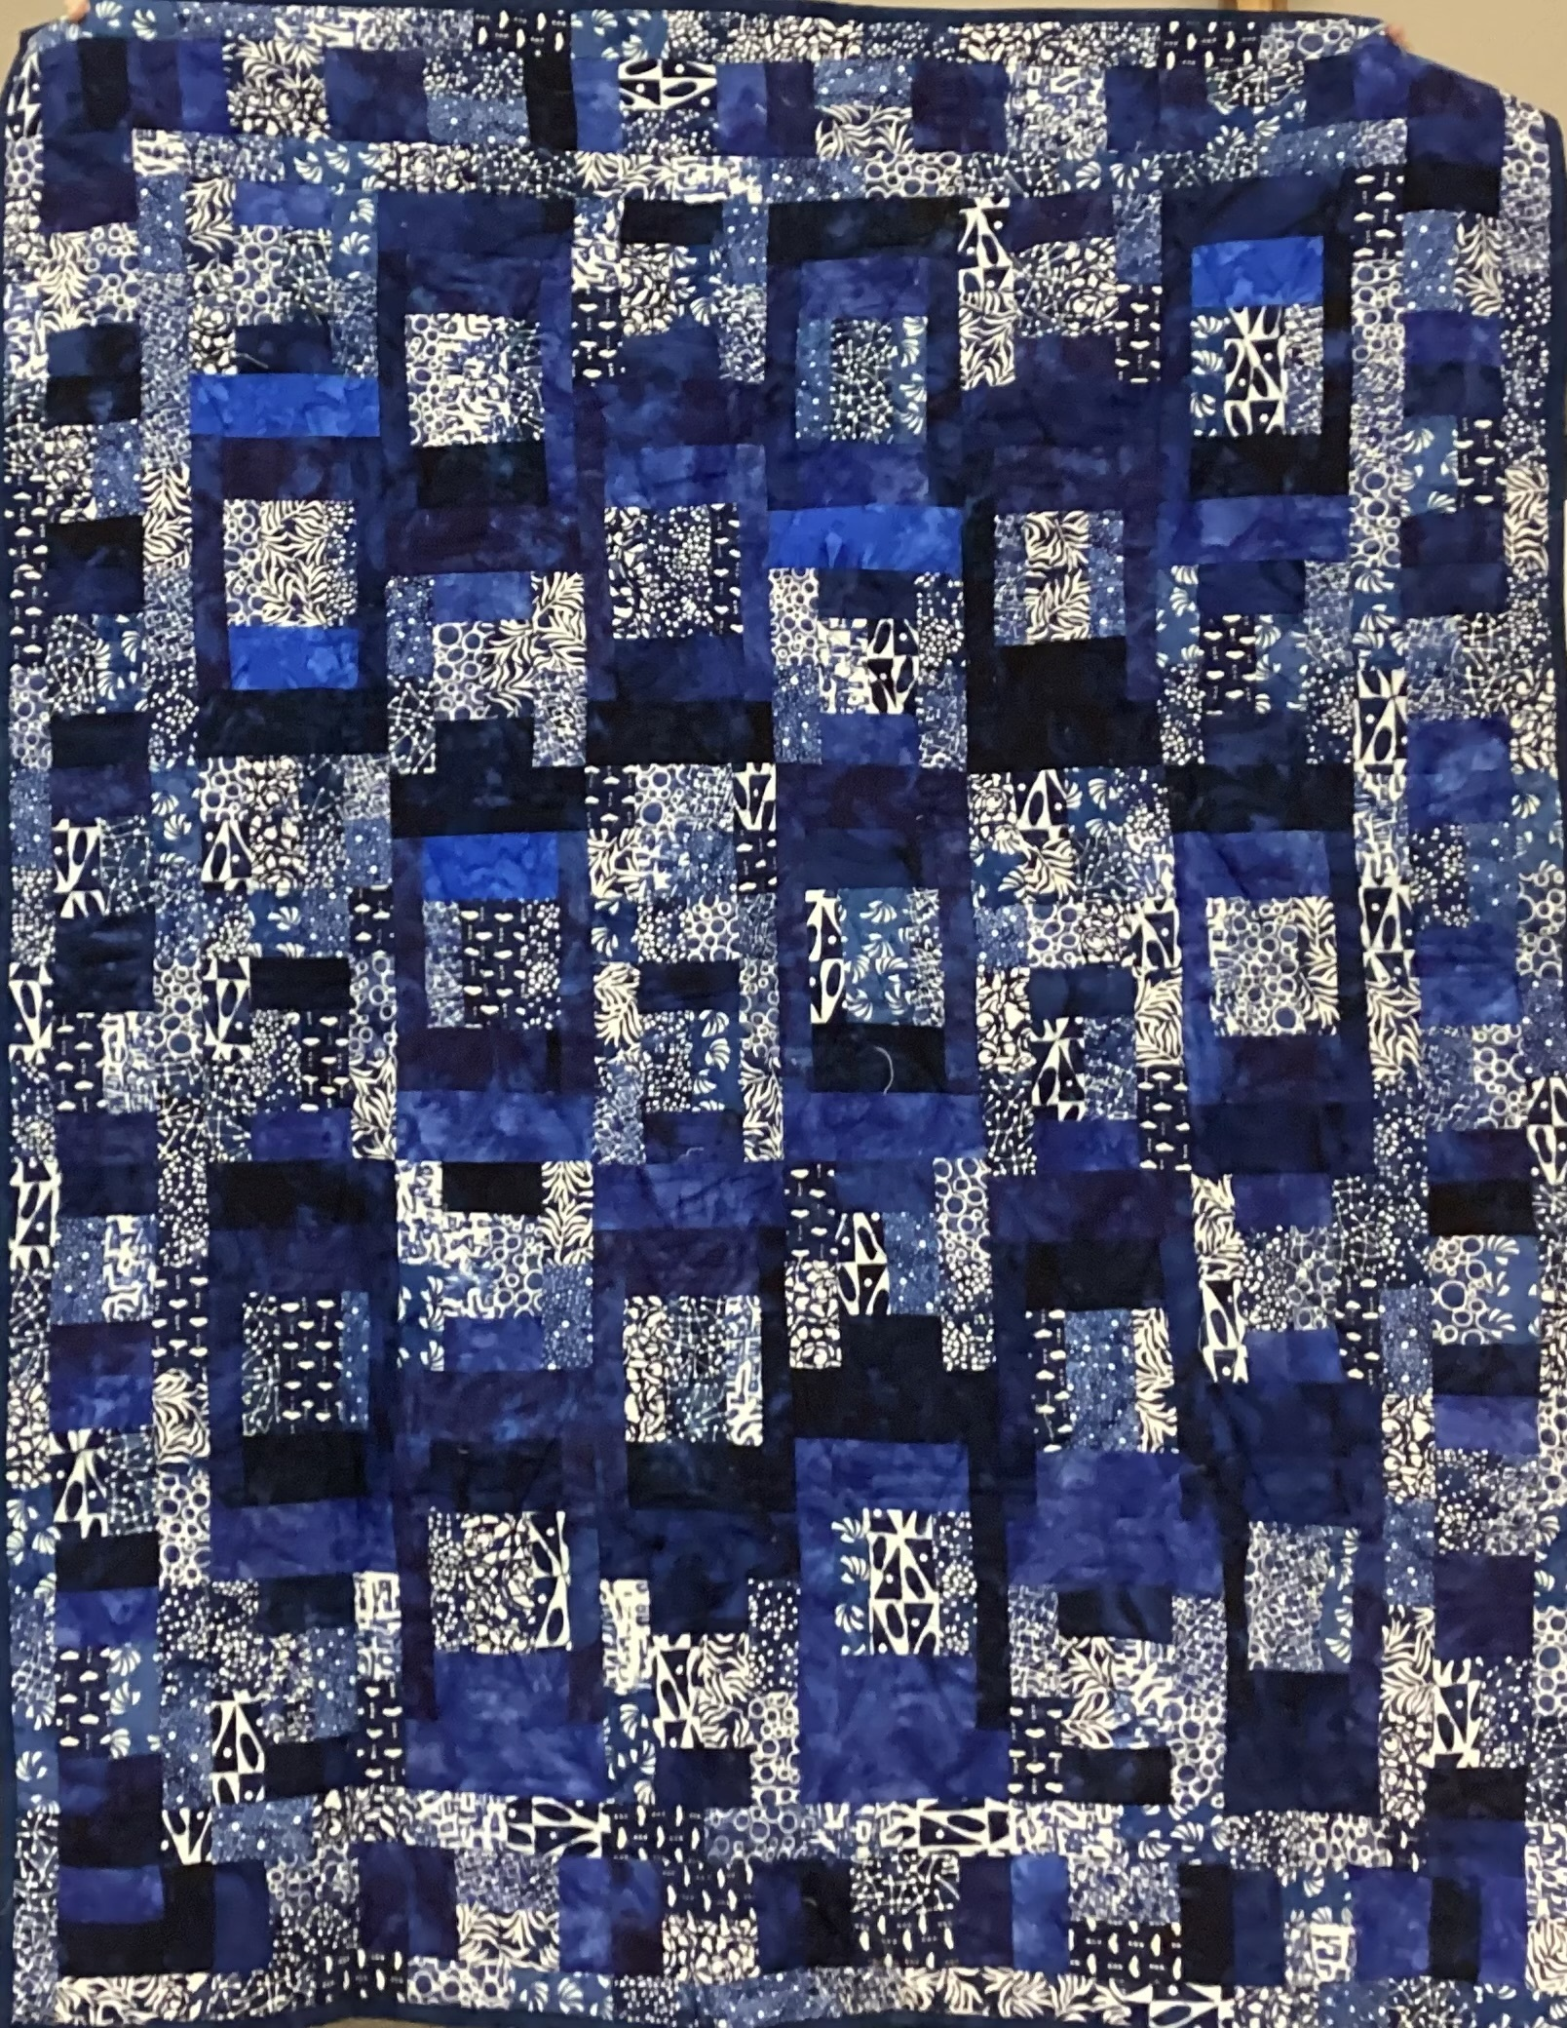
Beckie Stewart Blue just blue

Slide 6
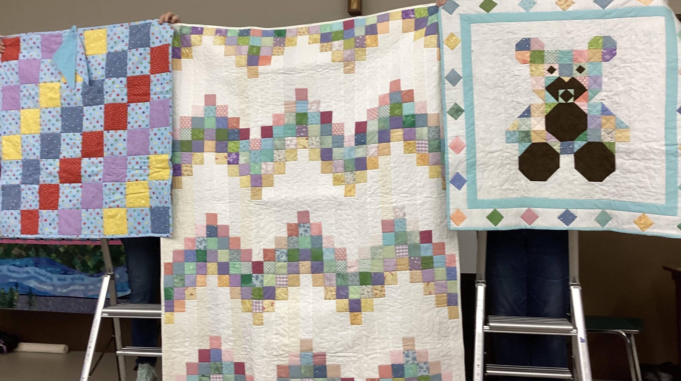
Beckie Stewart Teddy Preemie, ZIG Zag charity quilts

Slide 7
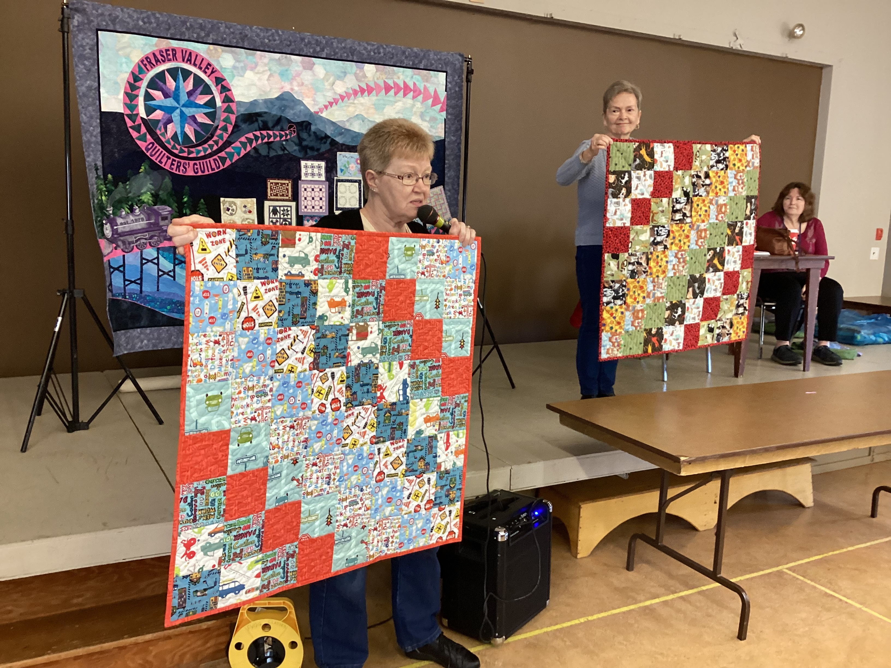
Preemie Patterns

Slide 8
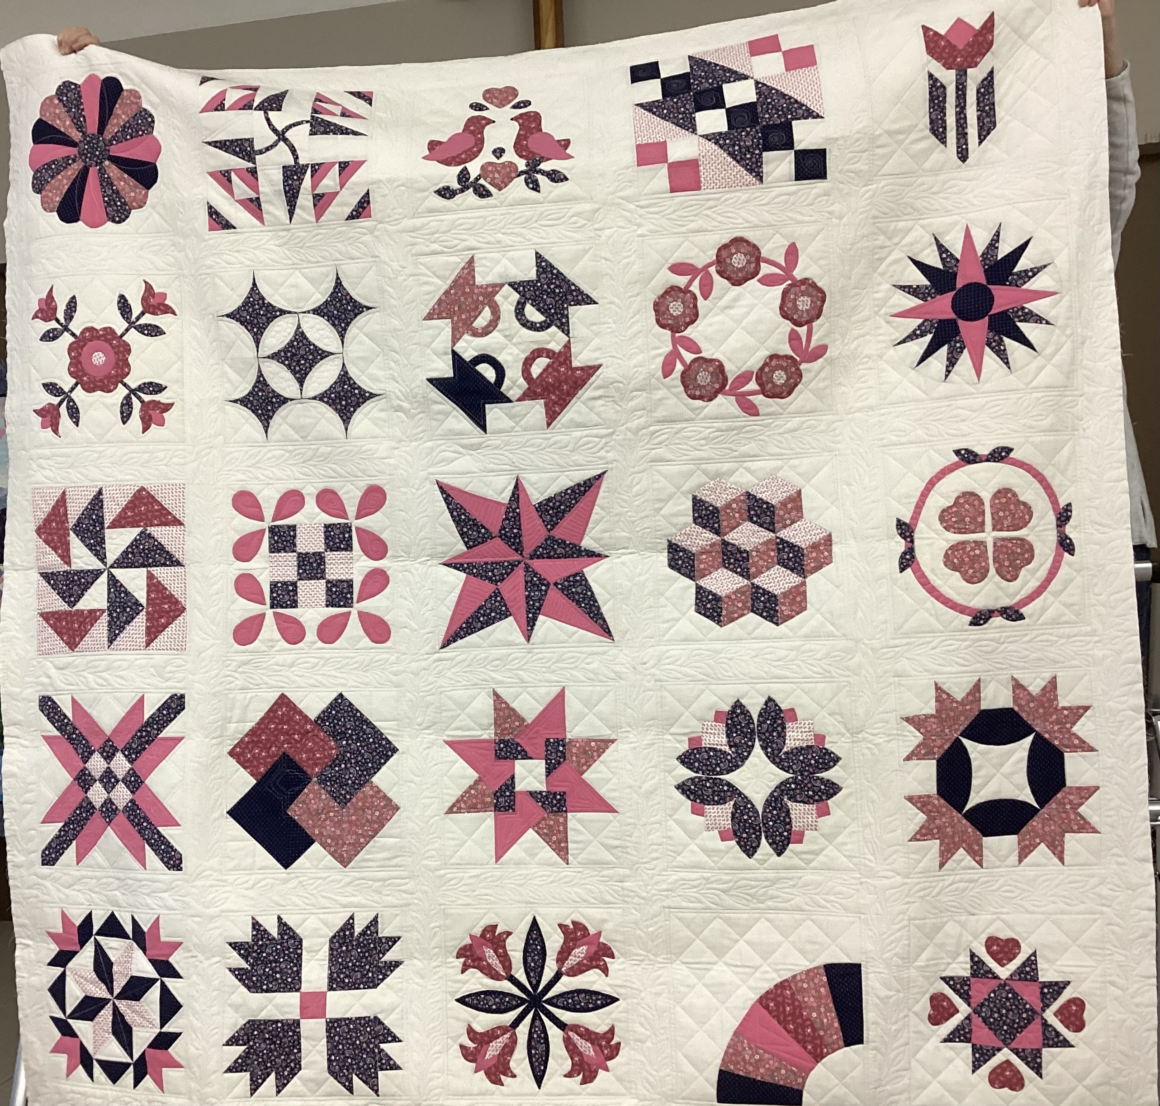
Beth Sayers finished by Rita Steeple

Slide 9
Billie Hobkirk Preemies

Slide 10
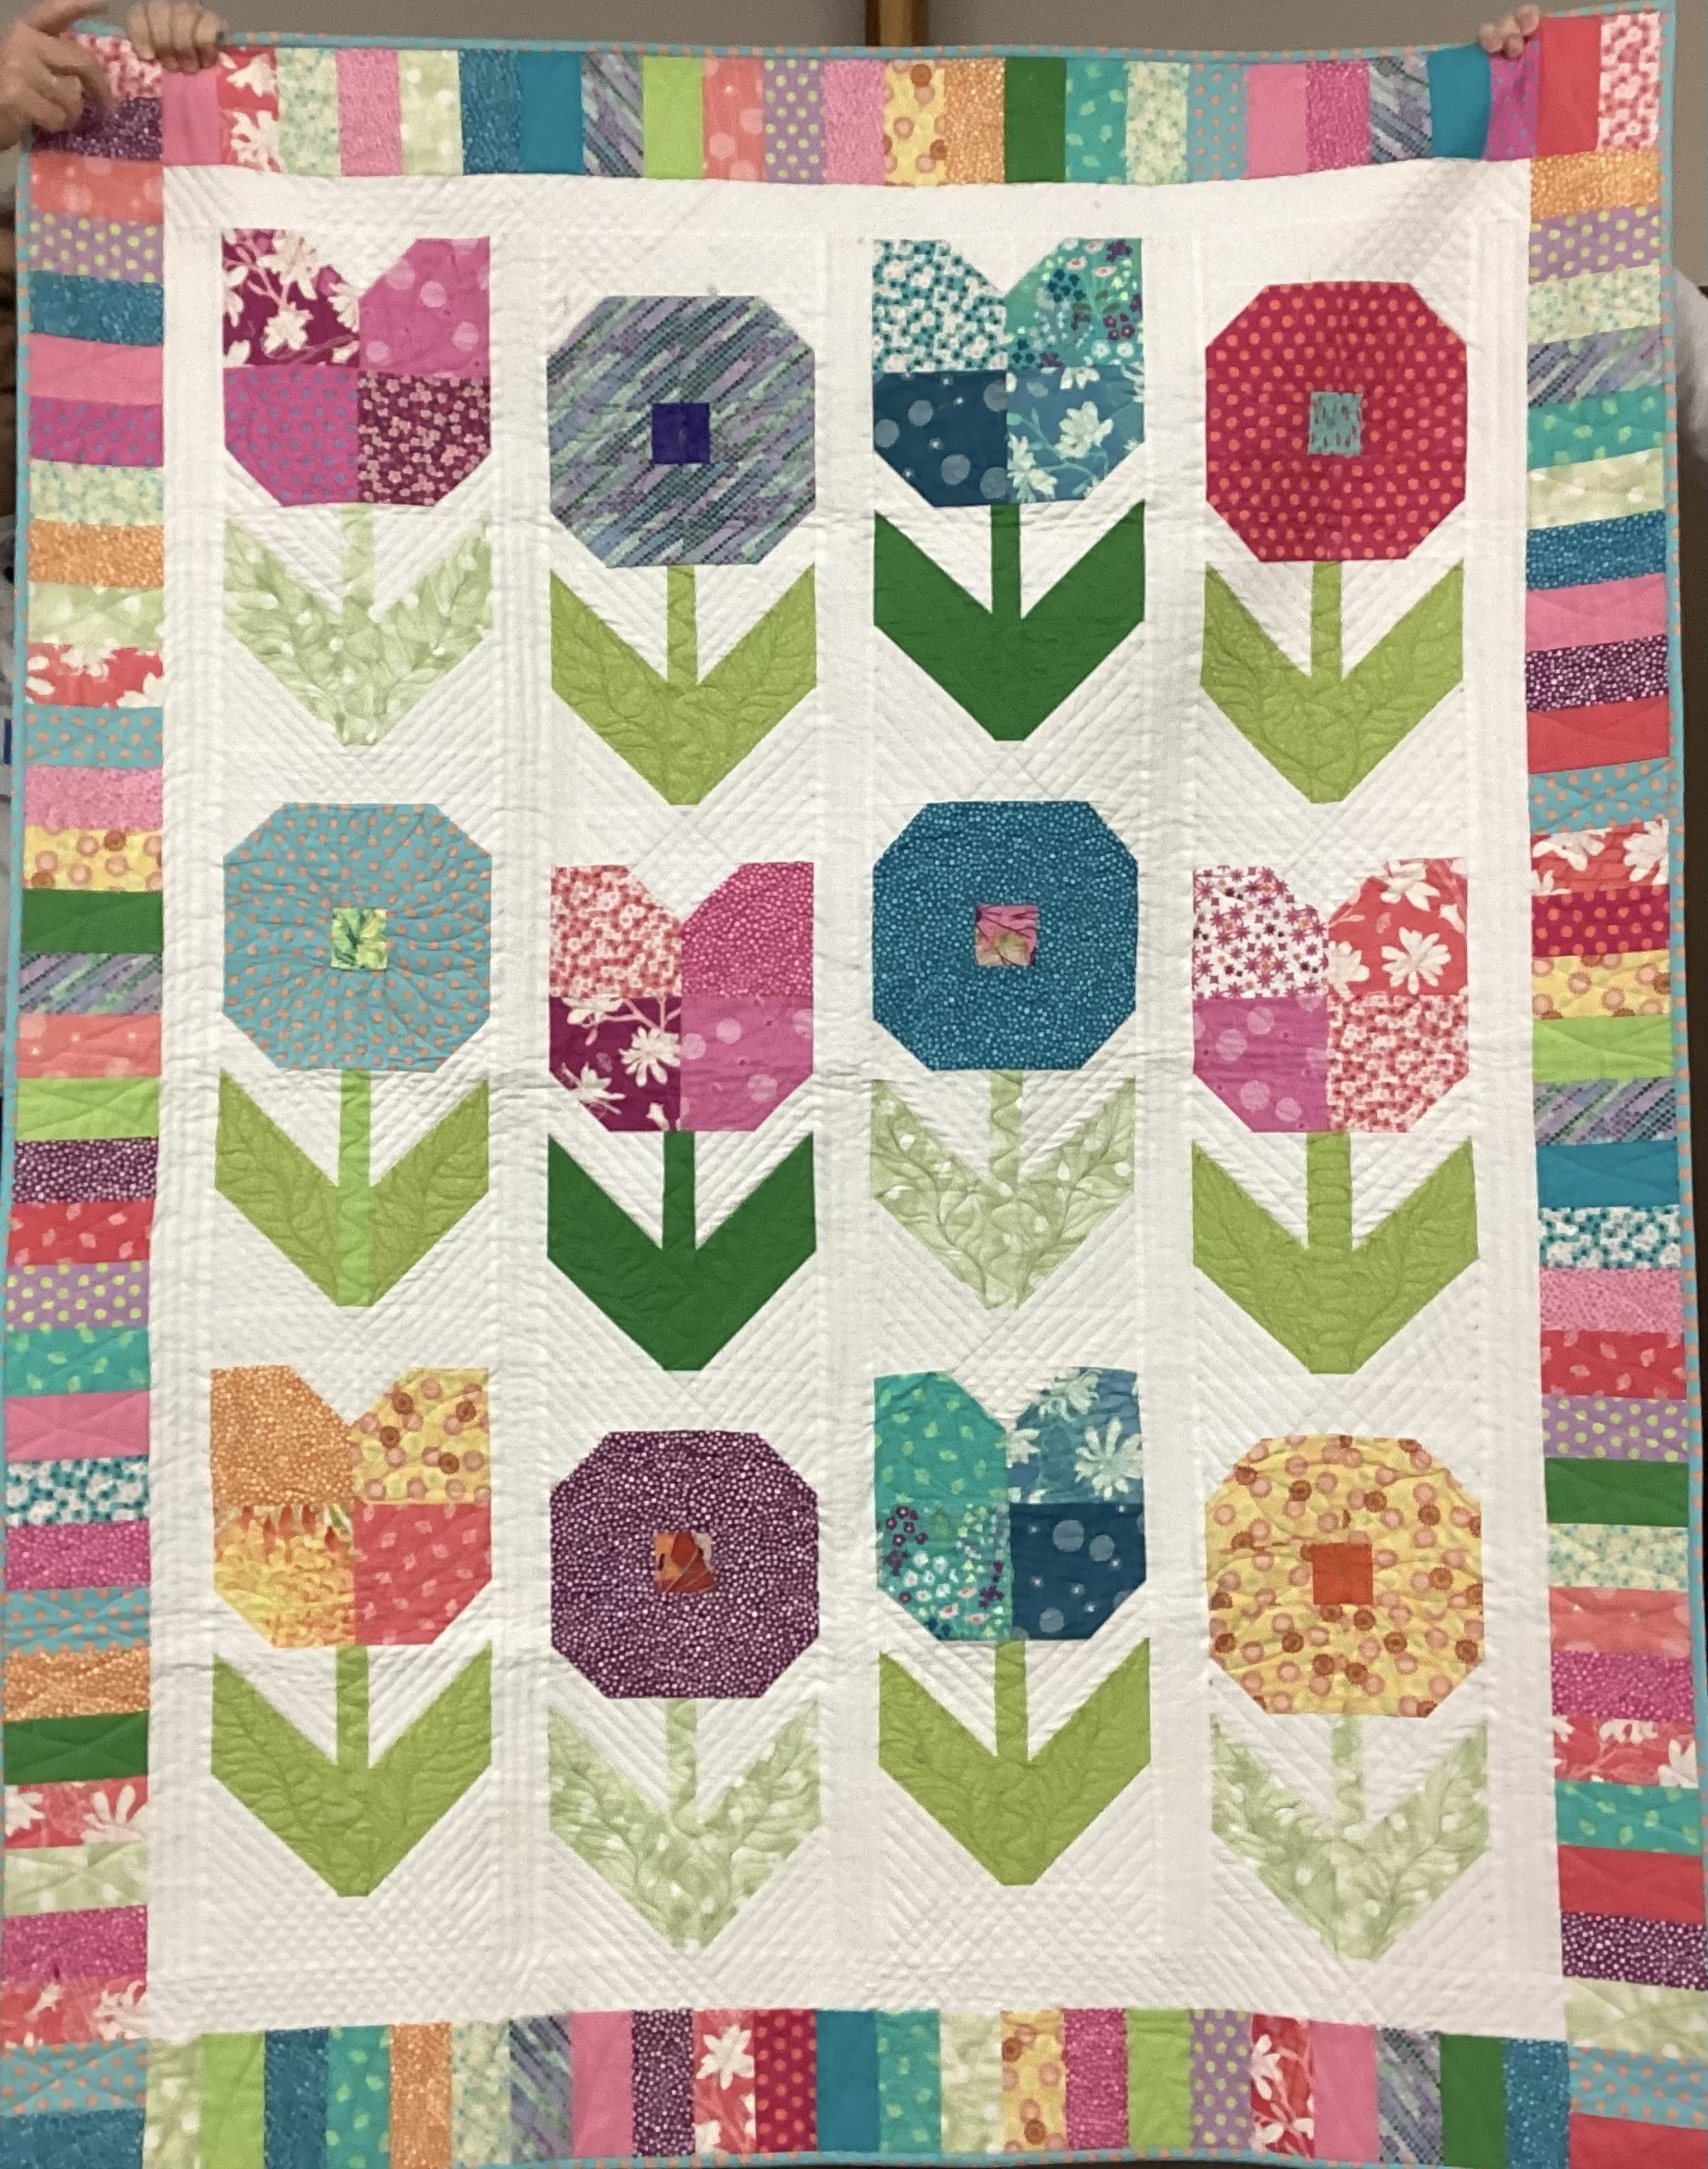
Billie Hobkirk Tulip Preemie

Slide 11
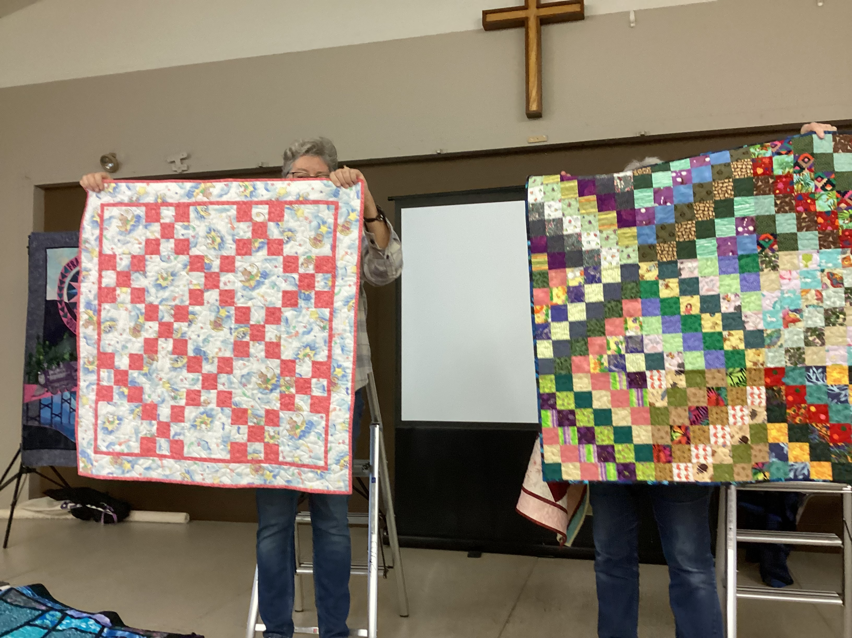
Preemies

Slide 12
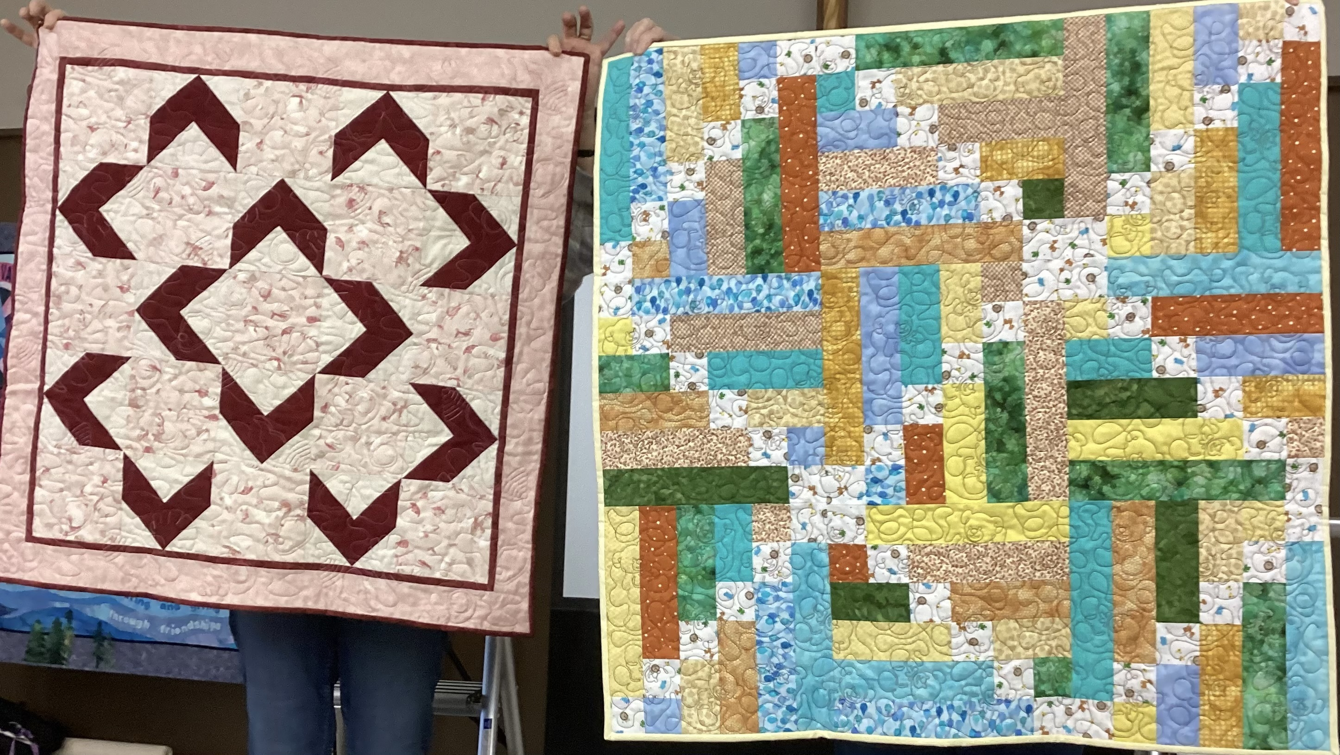
Wendy Whiting Preemies

Slide 13
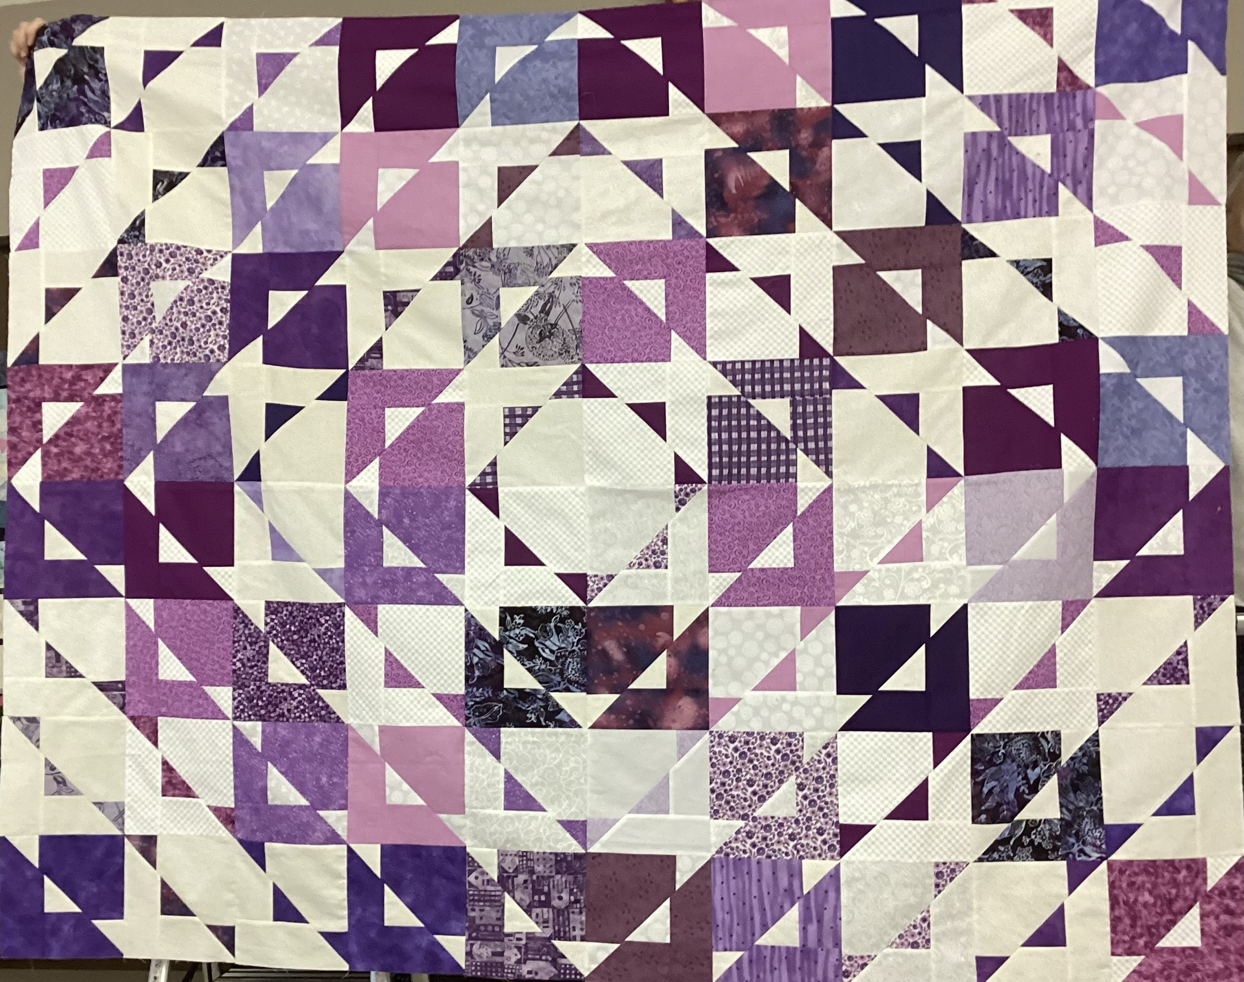
DAS Domestic Abuse Society Charity quilt “a group effort”

Slide 14
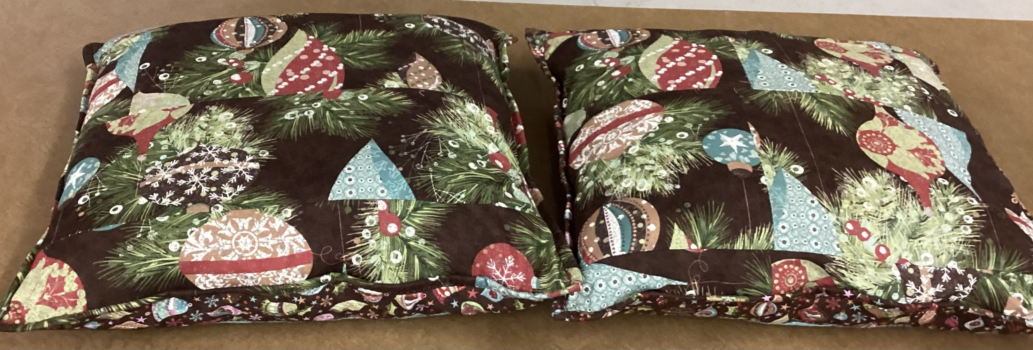
Donna Mae Pillows

Slide 15
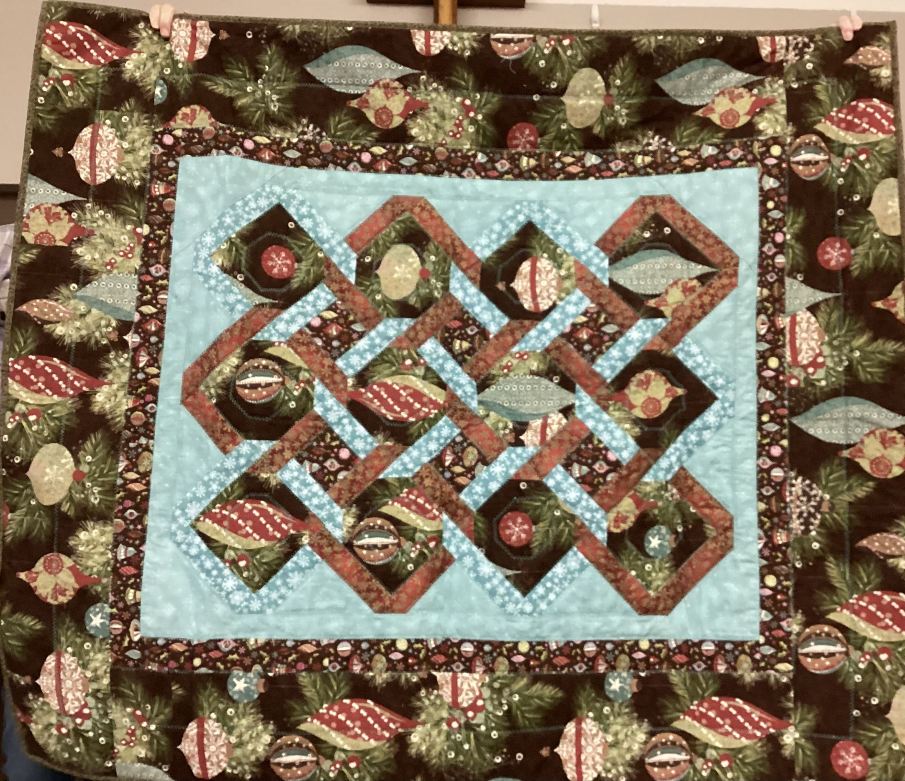
Donna Mae Quilt to match pillows

Slide 16
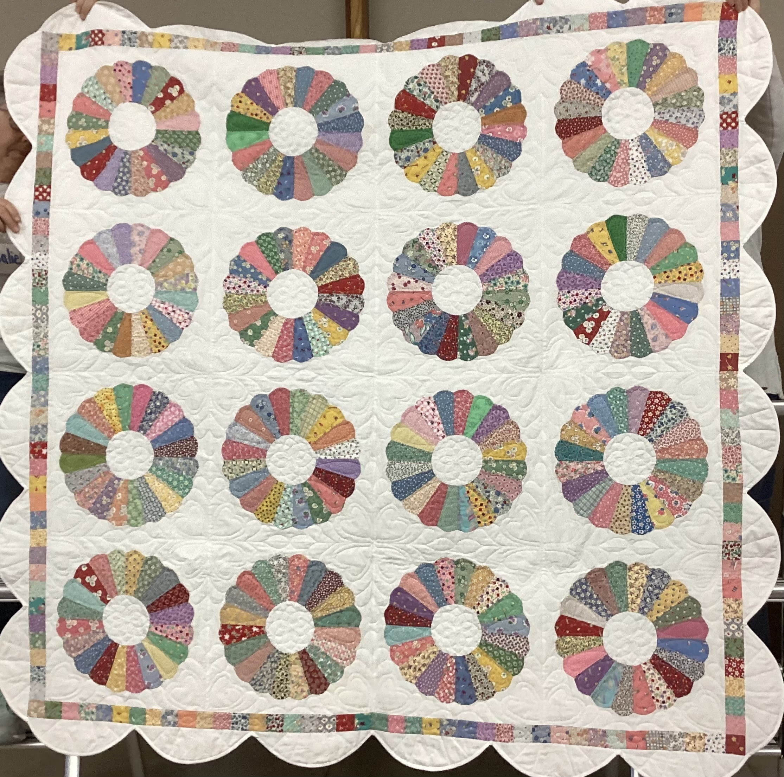
Fumiko Dresden plate

Slide 17
Fumiko Quilting on Dresden plate quilt

Slide 18
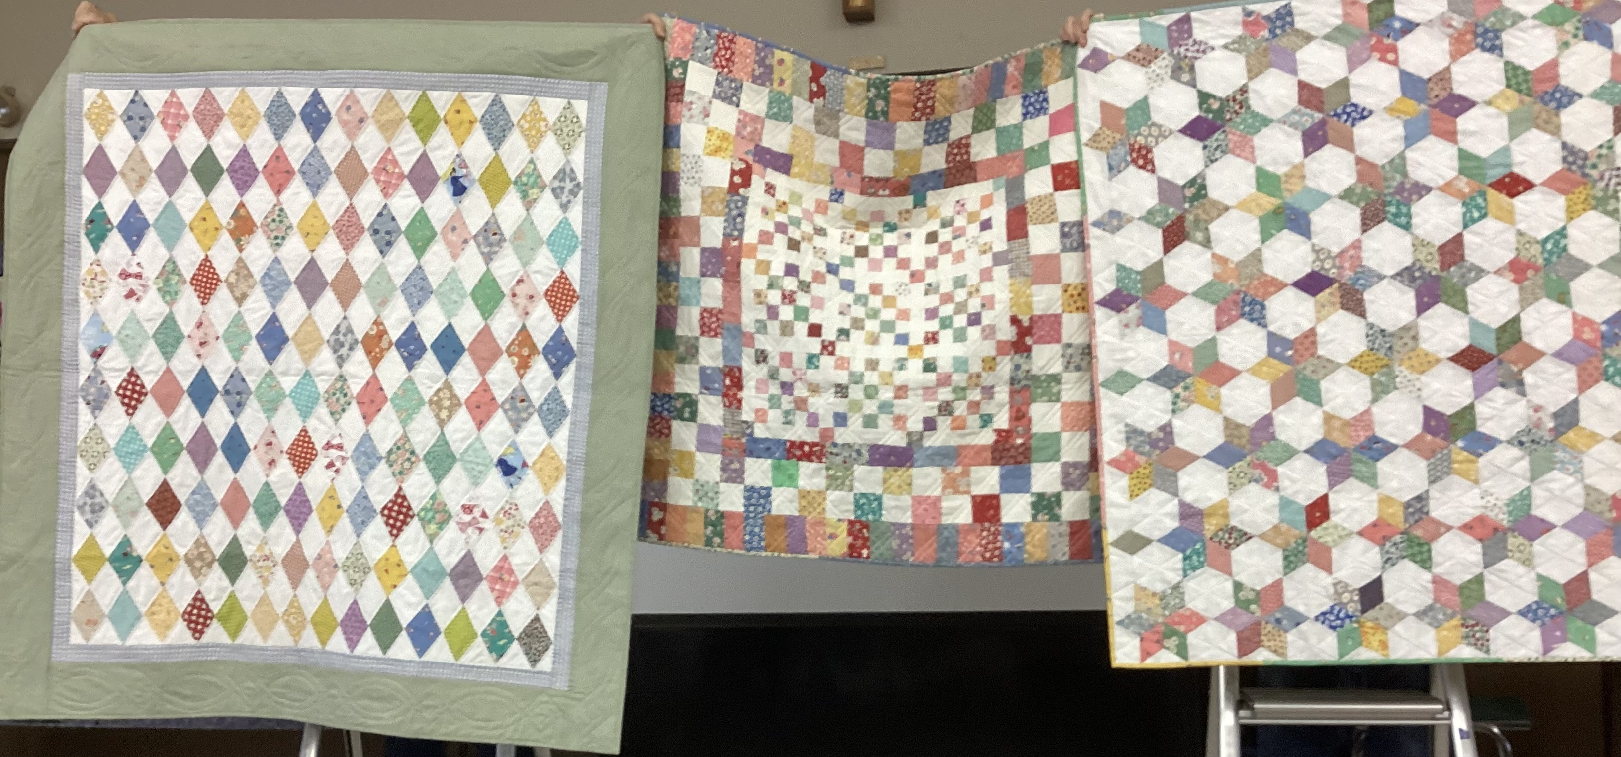

Slide 19
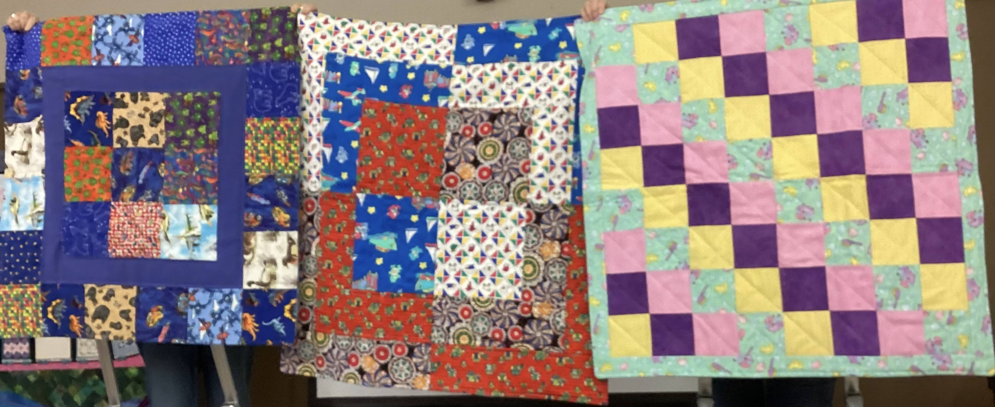
Preemies

Slide 20
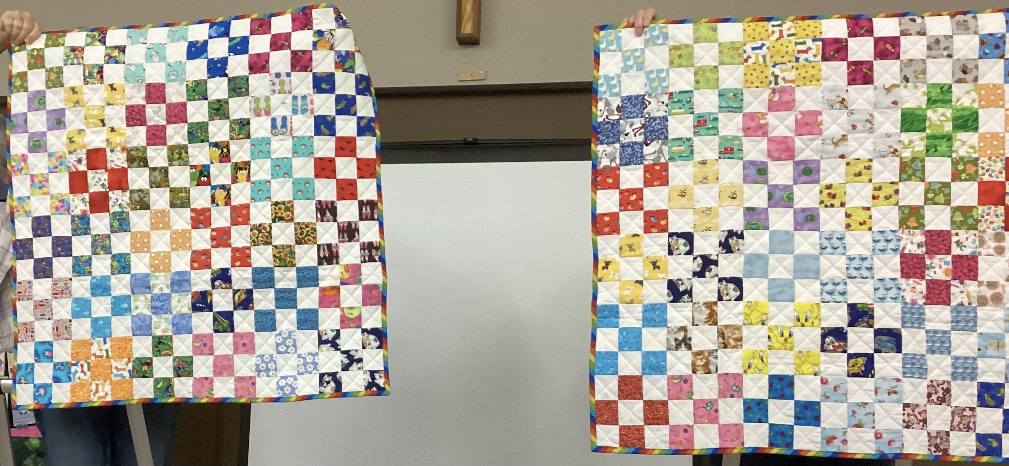
Preemies

Slide 21
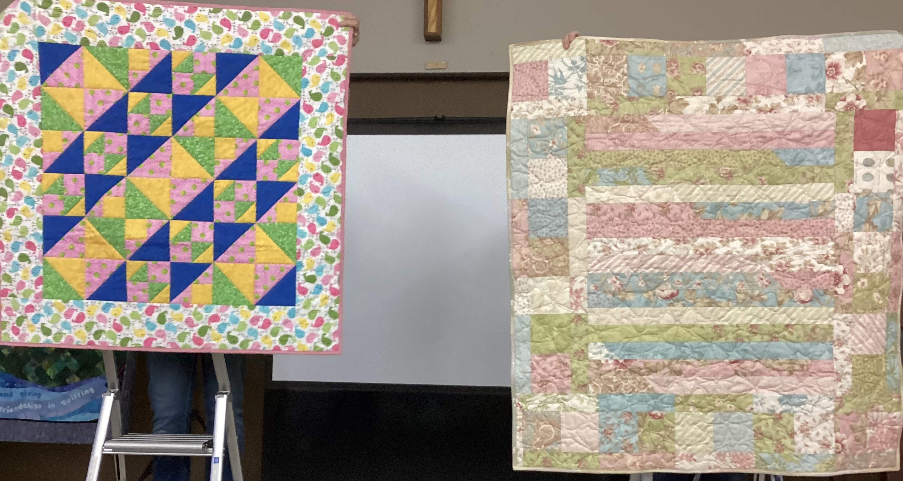
PREEMIES

Slide 22
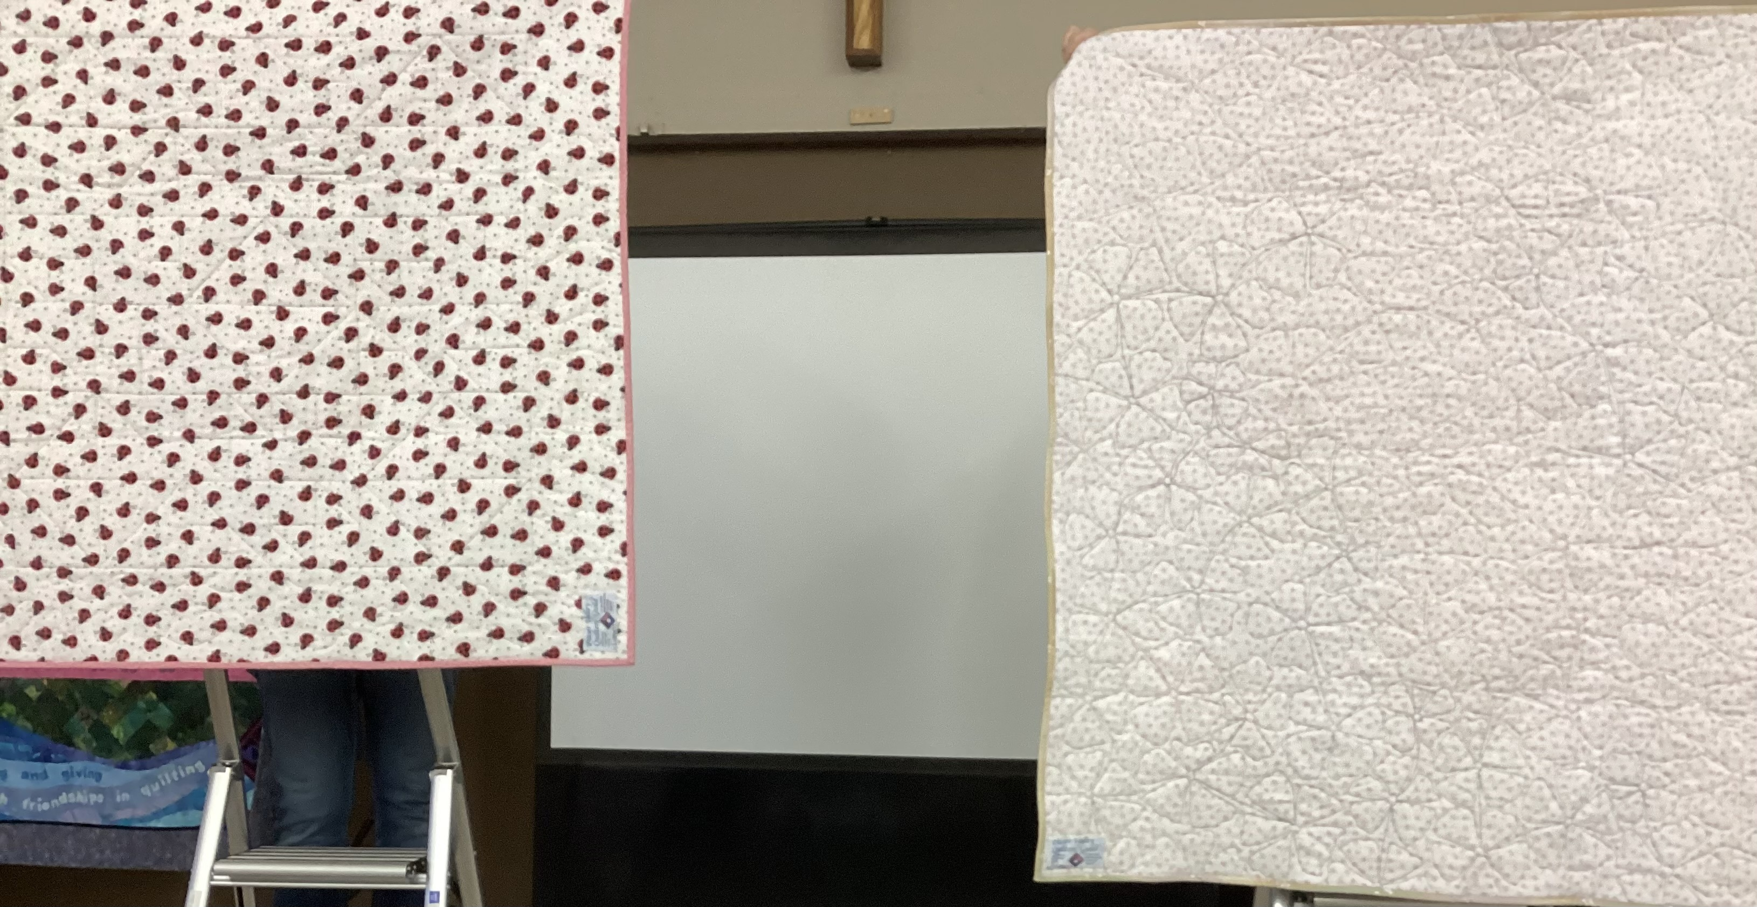
Preemies quilting

Slide 23
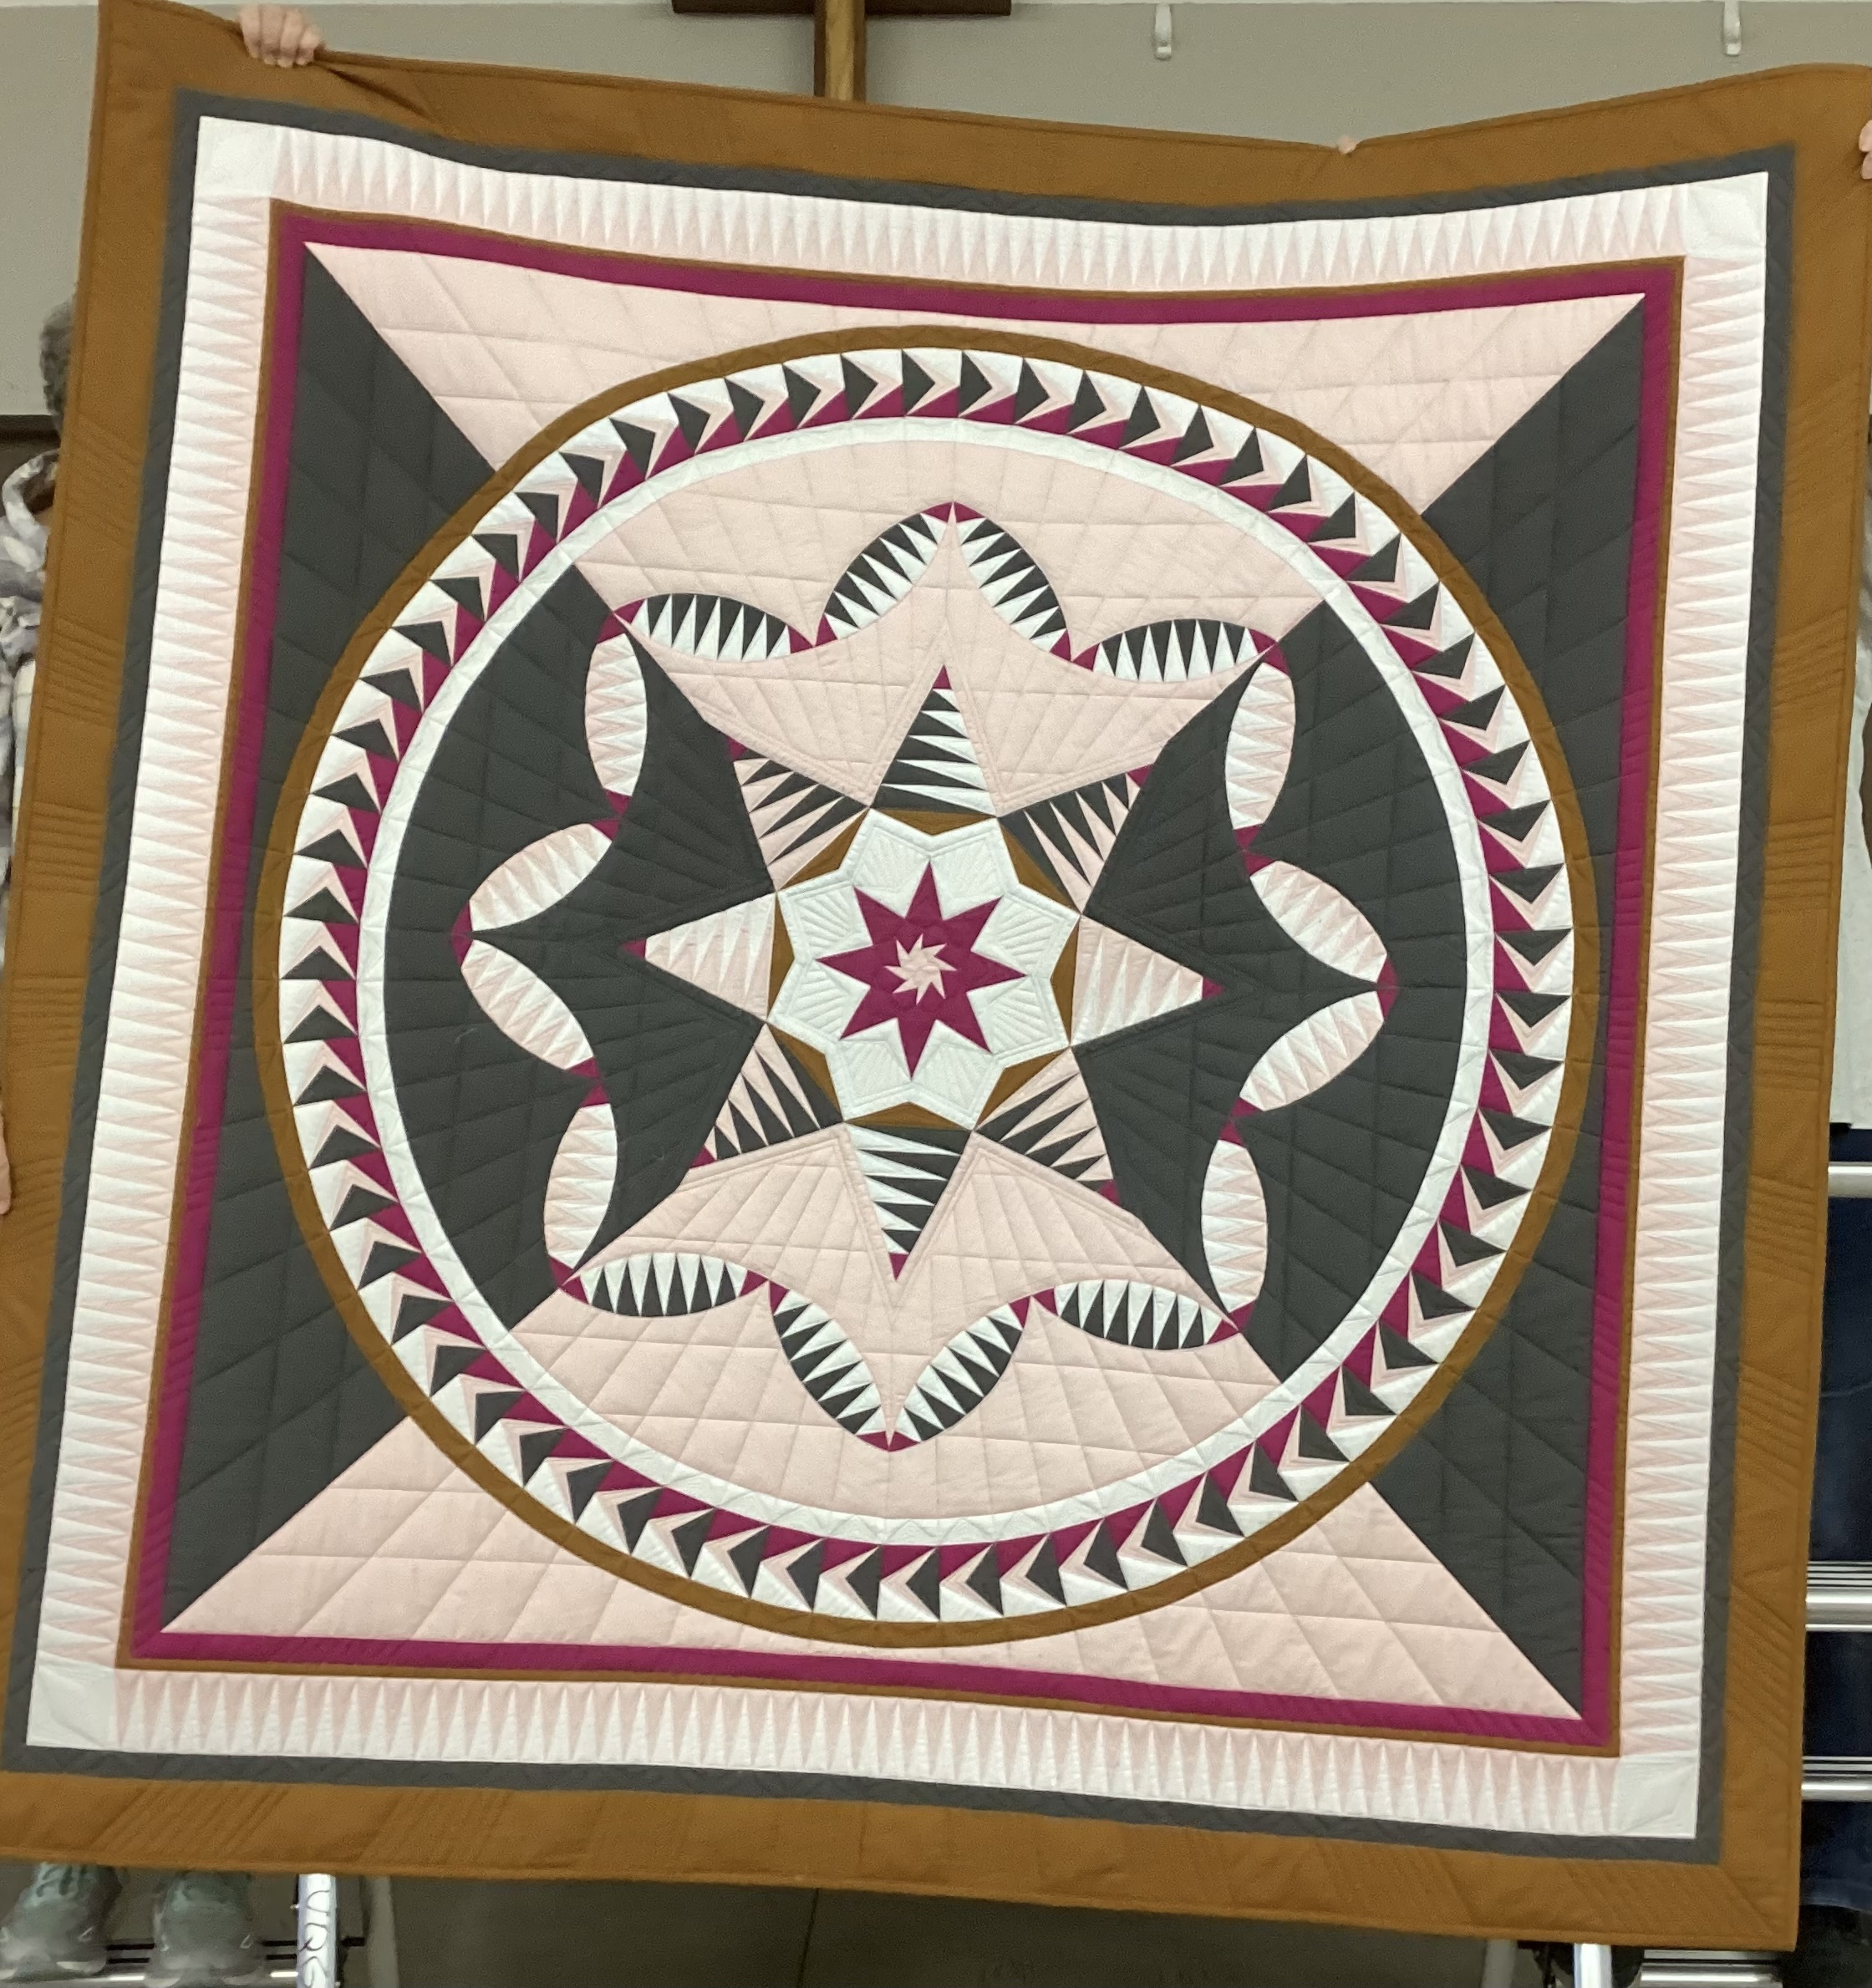
Laura Gates July Neimeyer pattern LADY OF THE HOUR

Slide 24
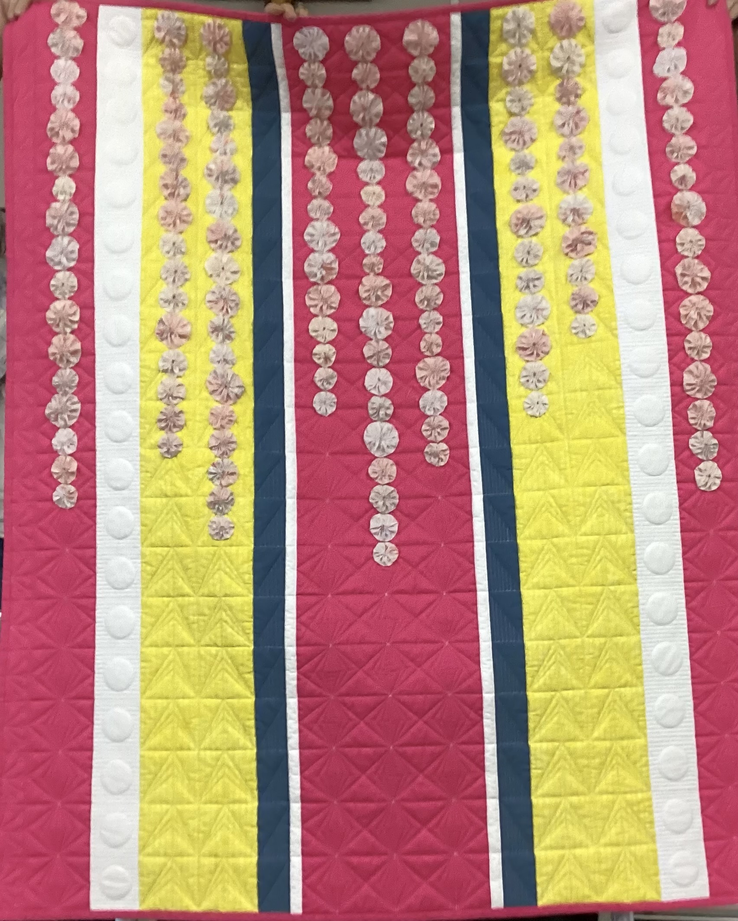
Laura Gates Poisies

Slide 25
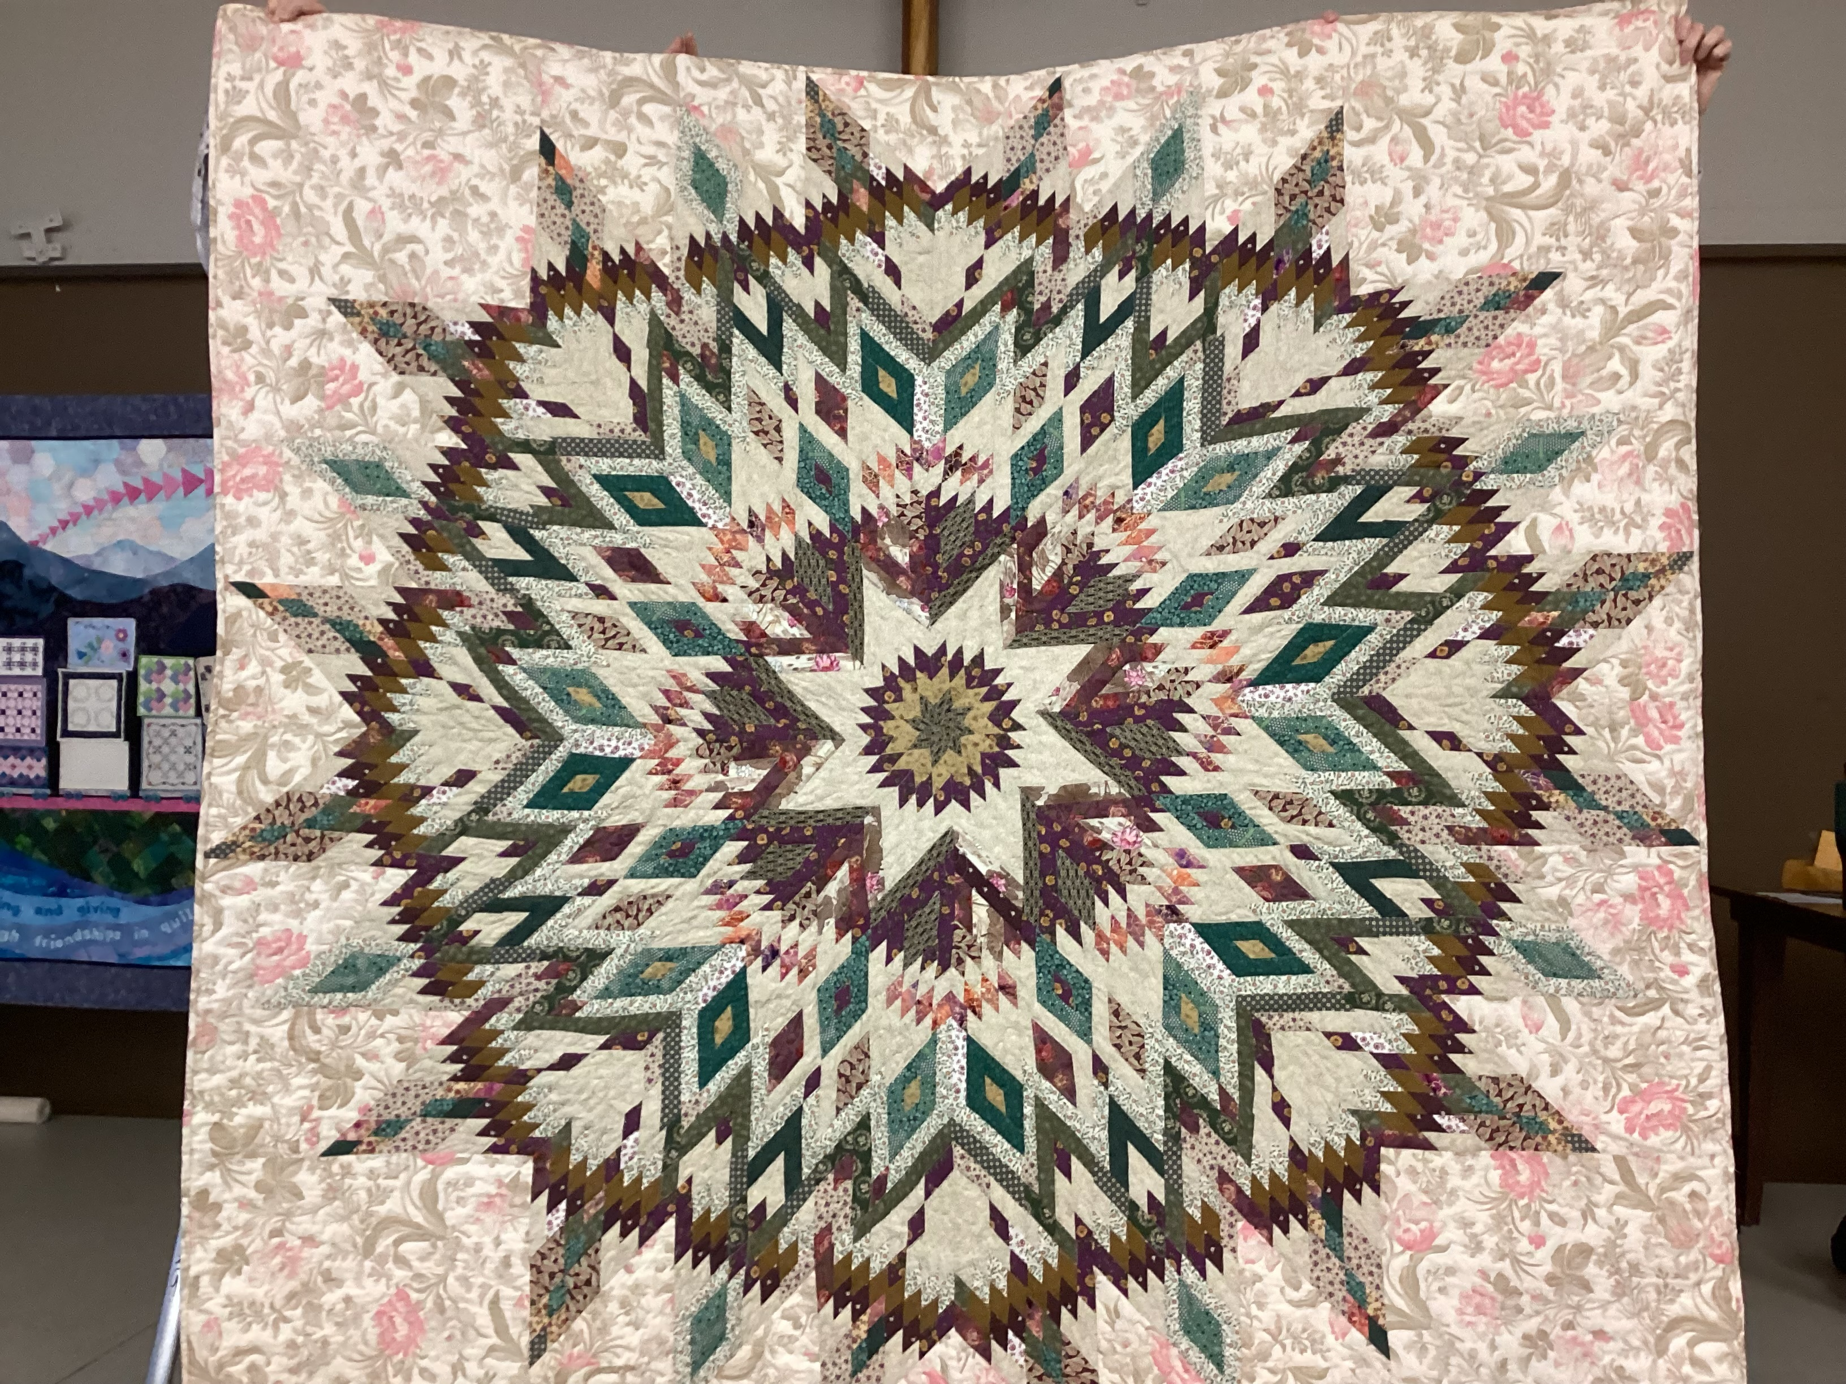
Lily Wong Tahoe

Slide 26
Nancy Chan Adding machine tape tops

Slide 27
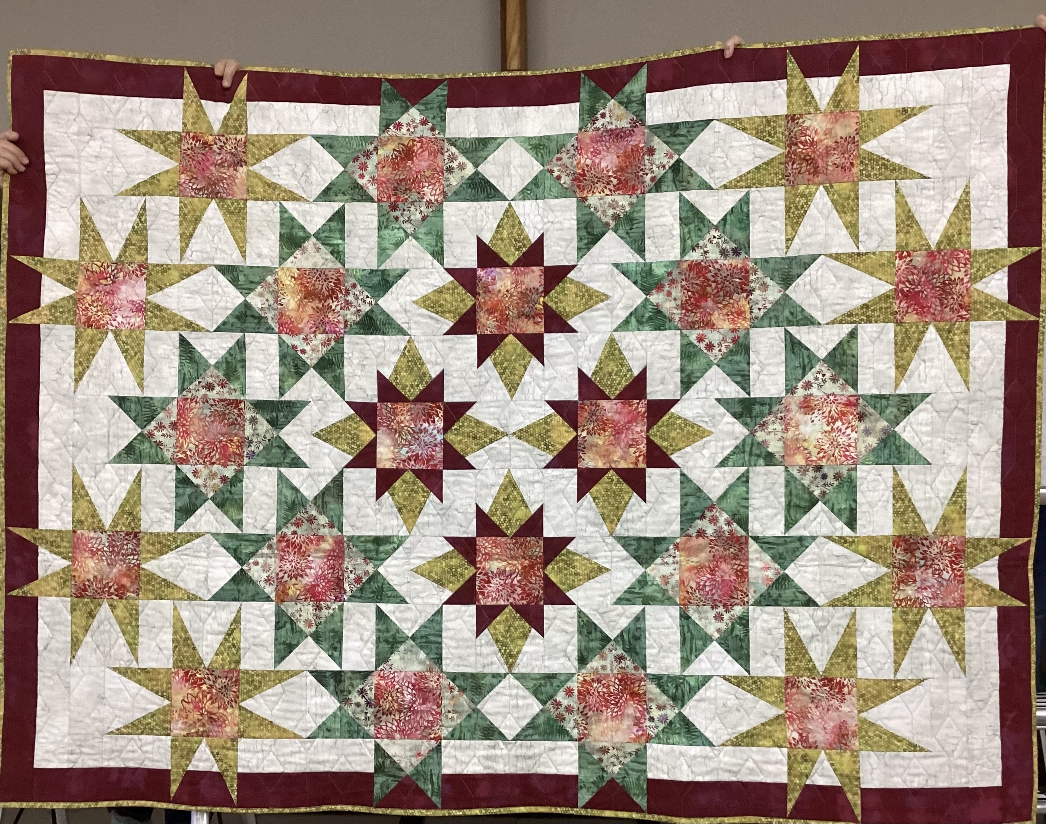
Nancy Chan 2022 mystery quilt

Slide 28
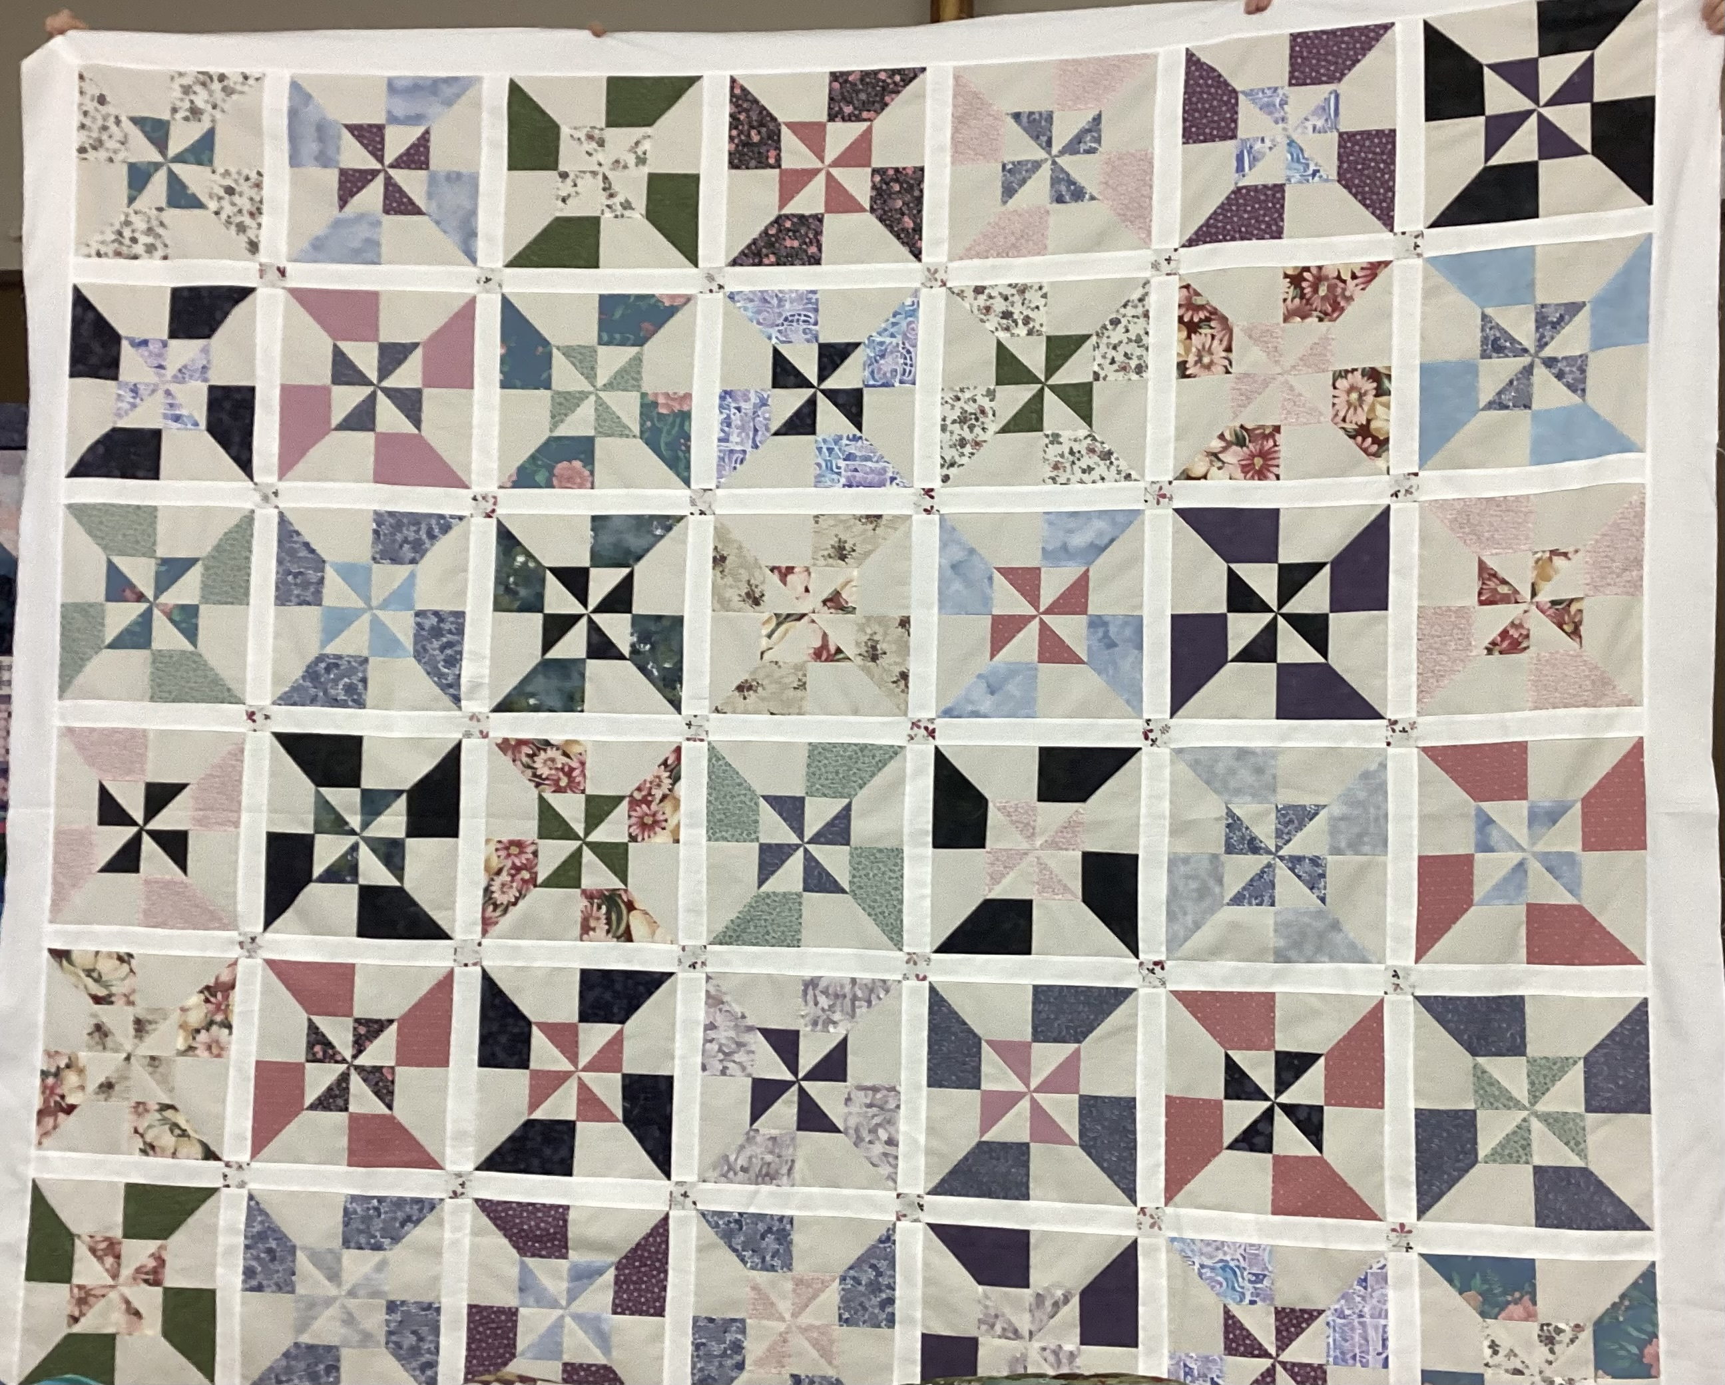
Charity quilt

Slide 29
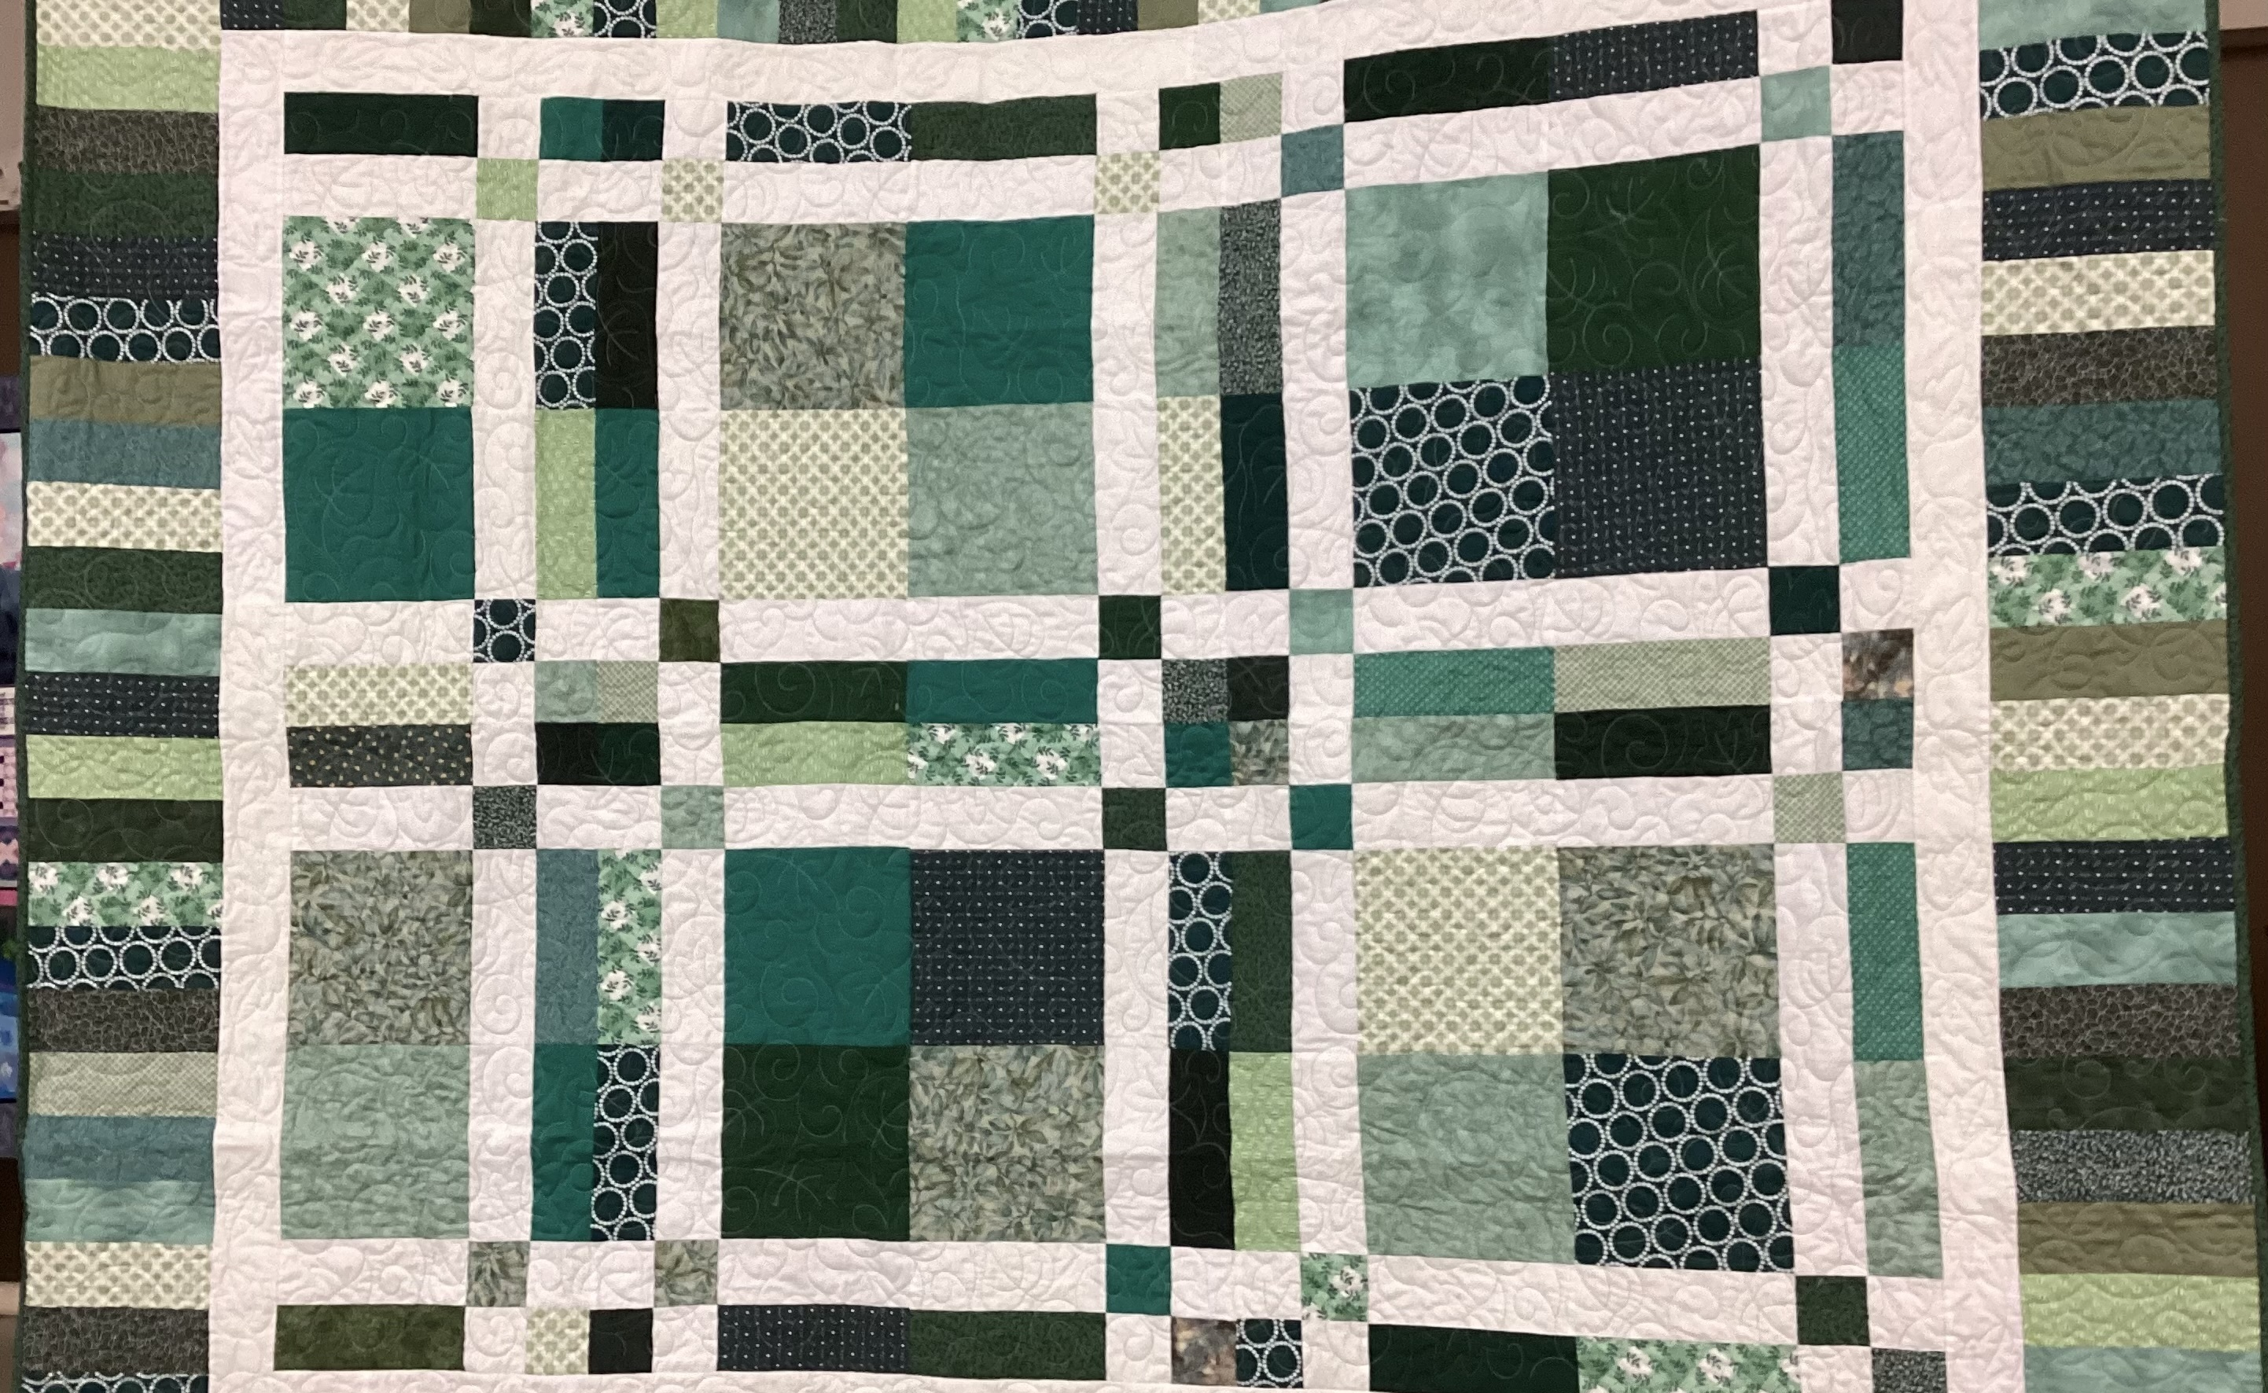
Sharon Betker green plaid

Slide 30
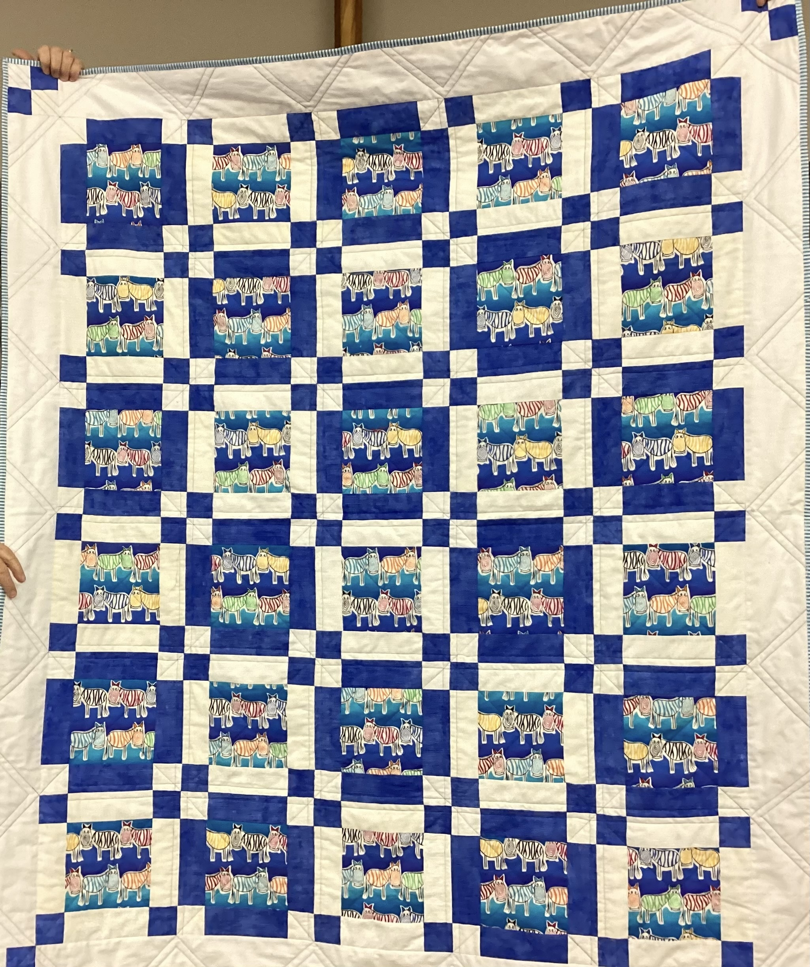
Trish Poehnell Funky zebras

Slide 31
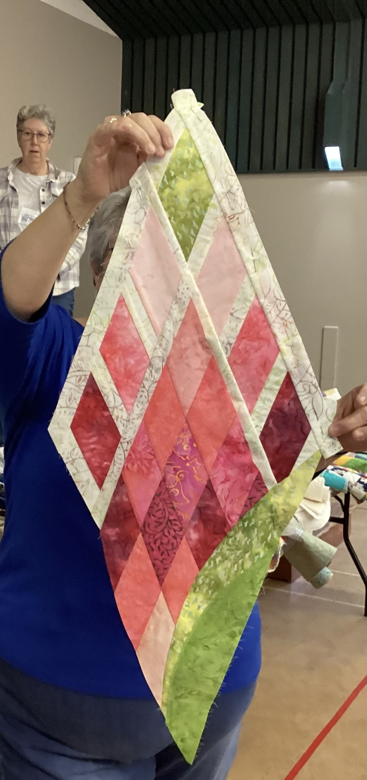
Vesna Judy Neimeyer diamonds

Slide 32
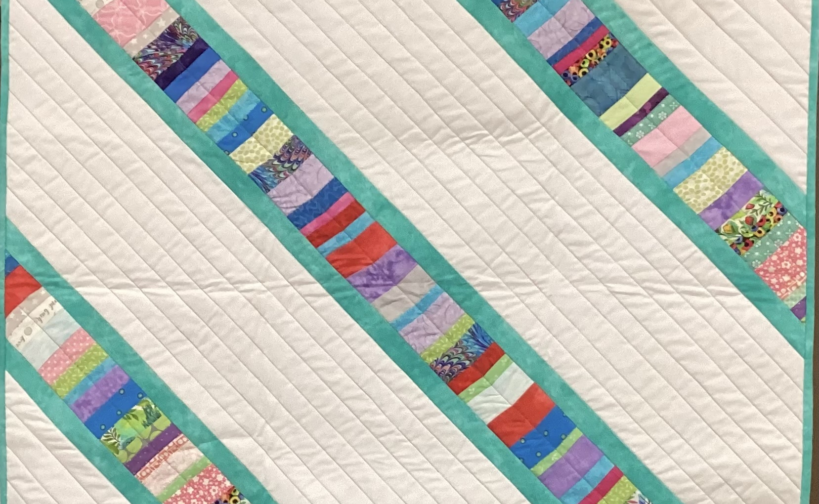
Wendy adding roll tape

Slide 33
THE END
Text Box

