Slide 1
Fraser Valley Quilters’ Guild October 2023
SHOW AND TELL

Slide 3
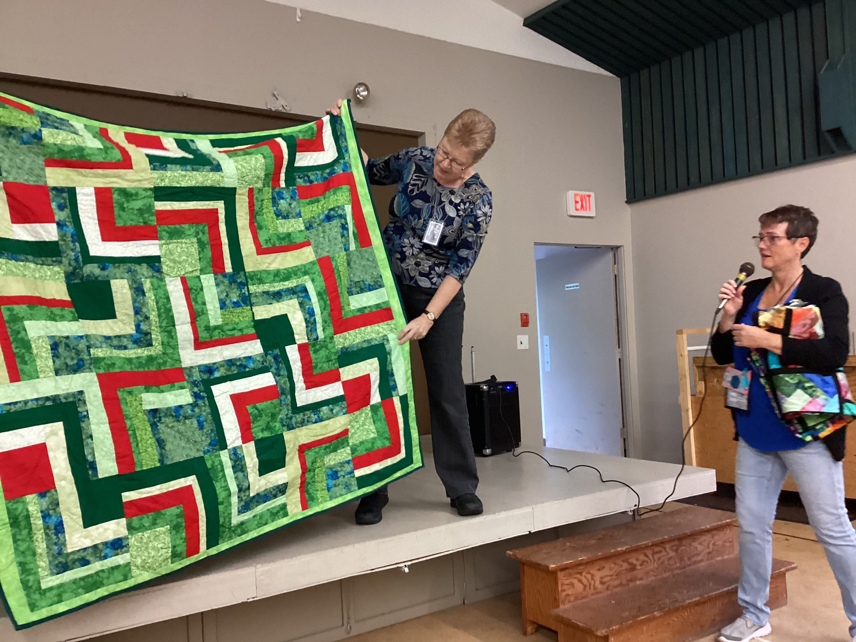
Barb Charlton Niece’s favorite colour is green
Notes:
Barb Charlton Nieces favorite colour is green

Slide 4
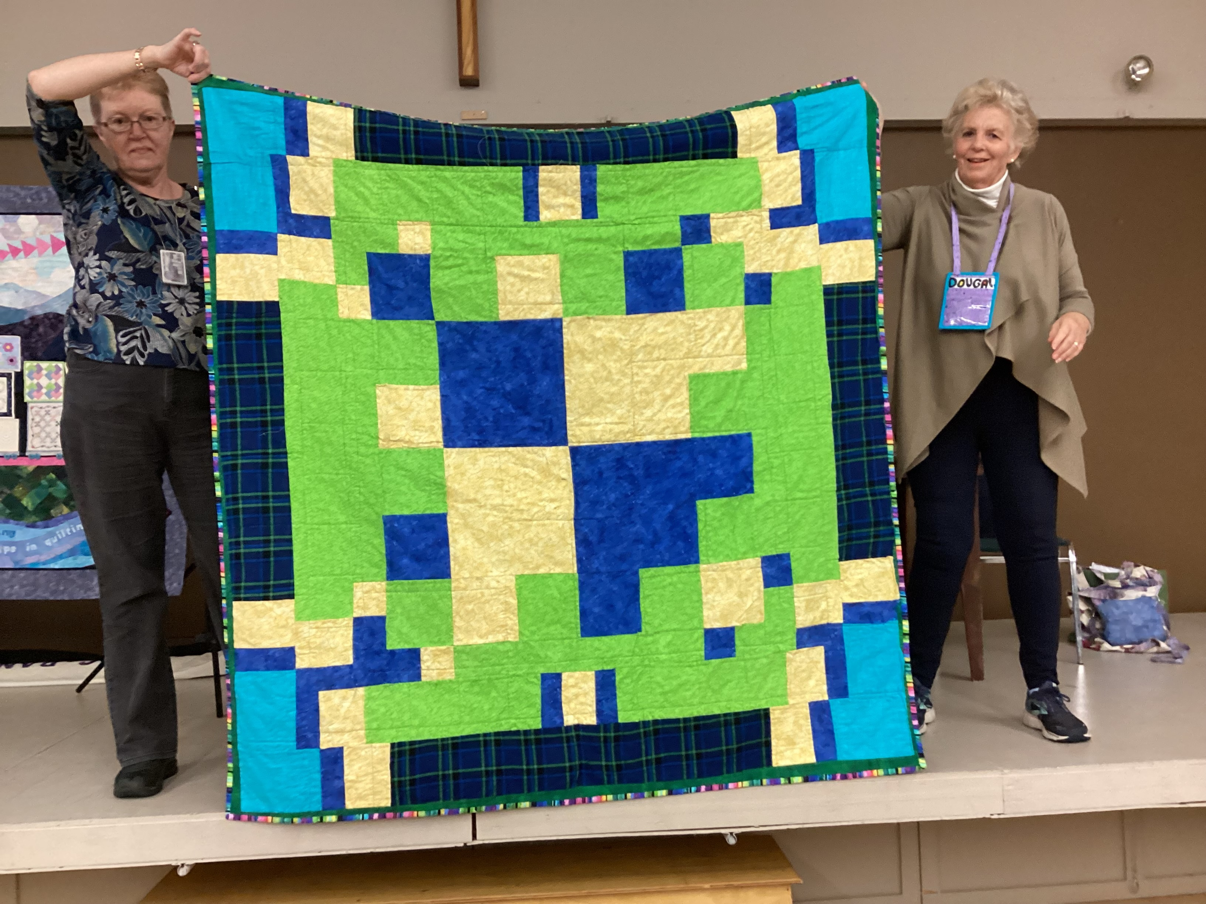
Barb Charlton
Back of her niece’s quilt
Notes:
Barb Charlton
Back of quilt

Slide 5
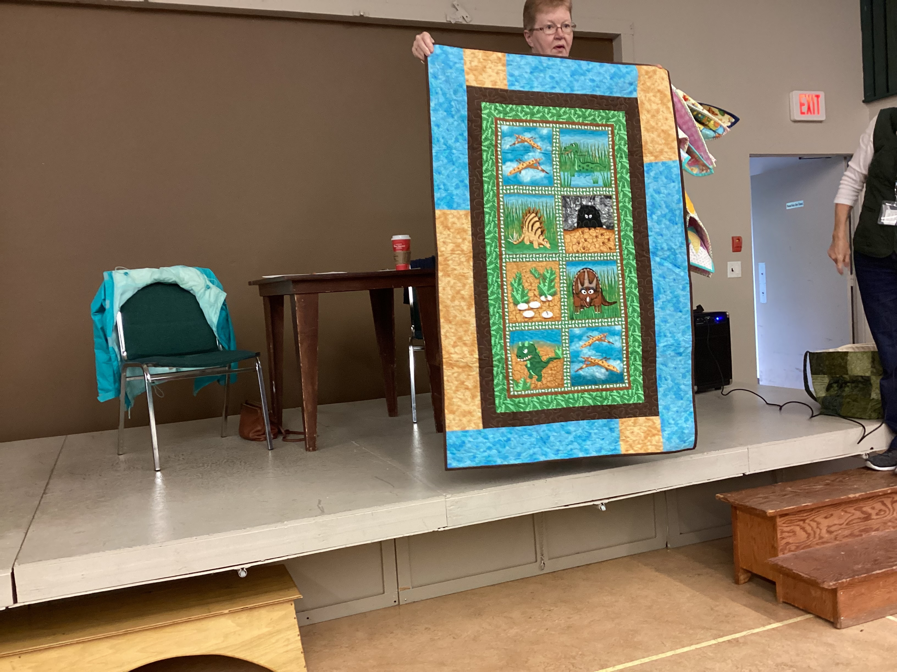
Barb Charlton
Dinosaurs
Notes:
Barb Charlton “Dinosaurs”

Slide 6
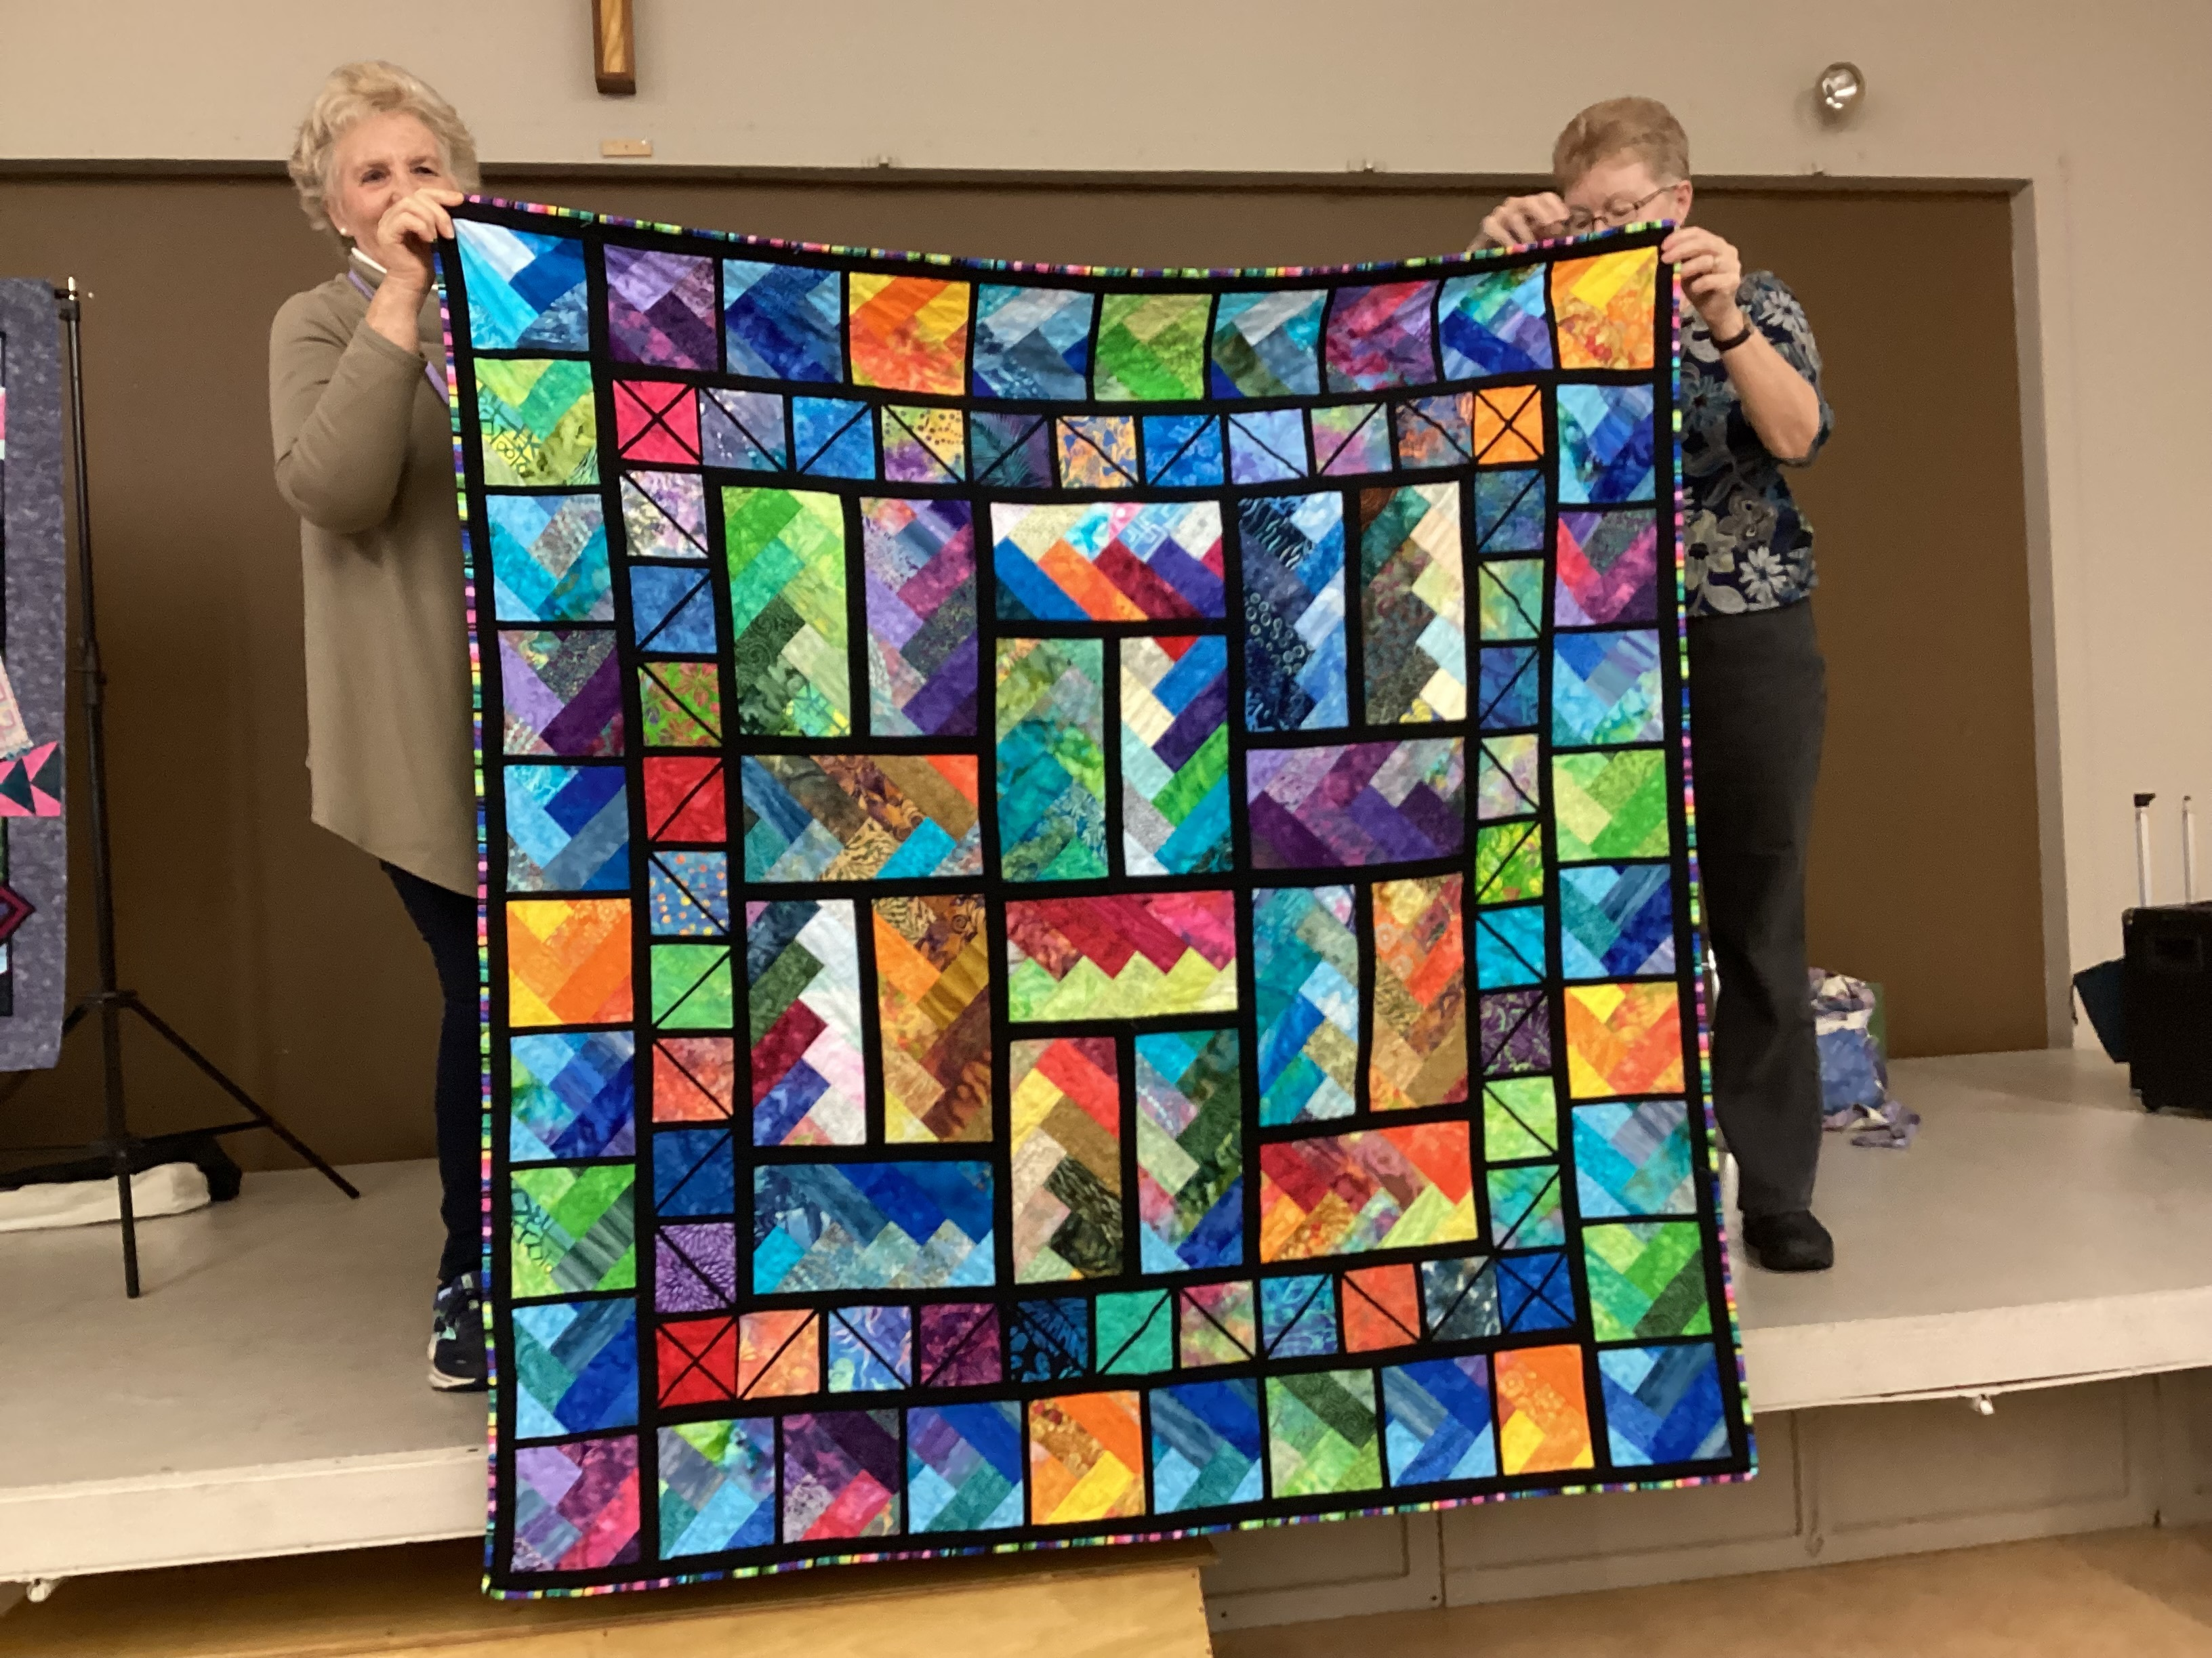
Barb Charlton Winner of the Block of the Month
Notes:
Barb Charlton won the Block of the Month

Slide 7
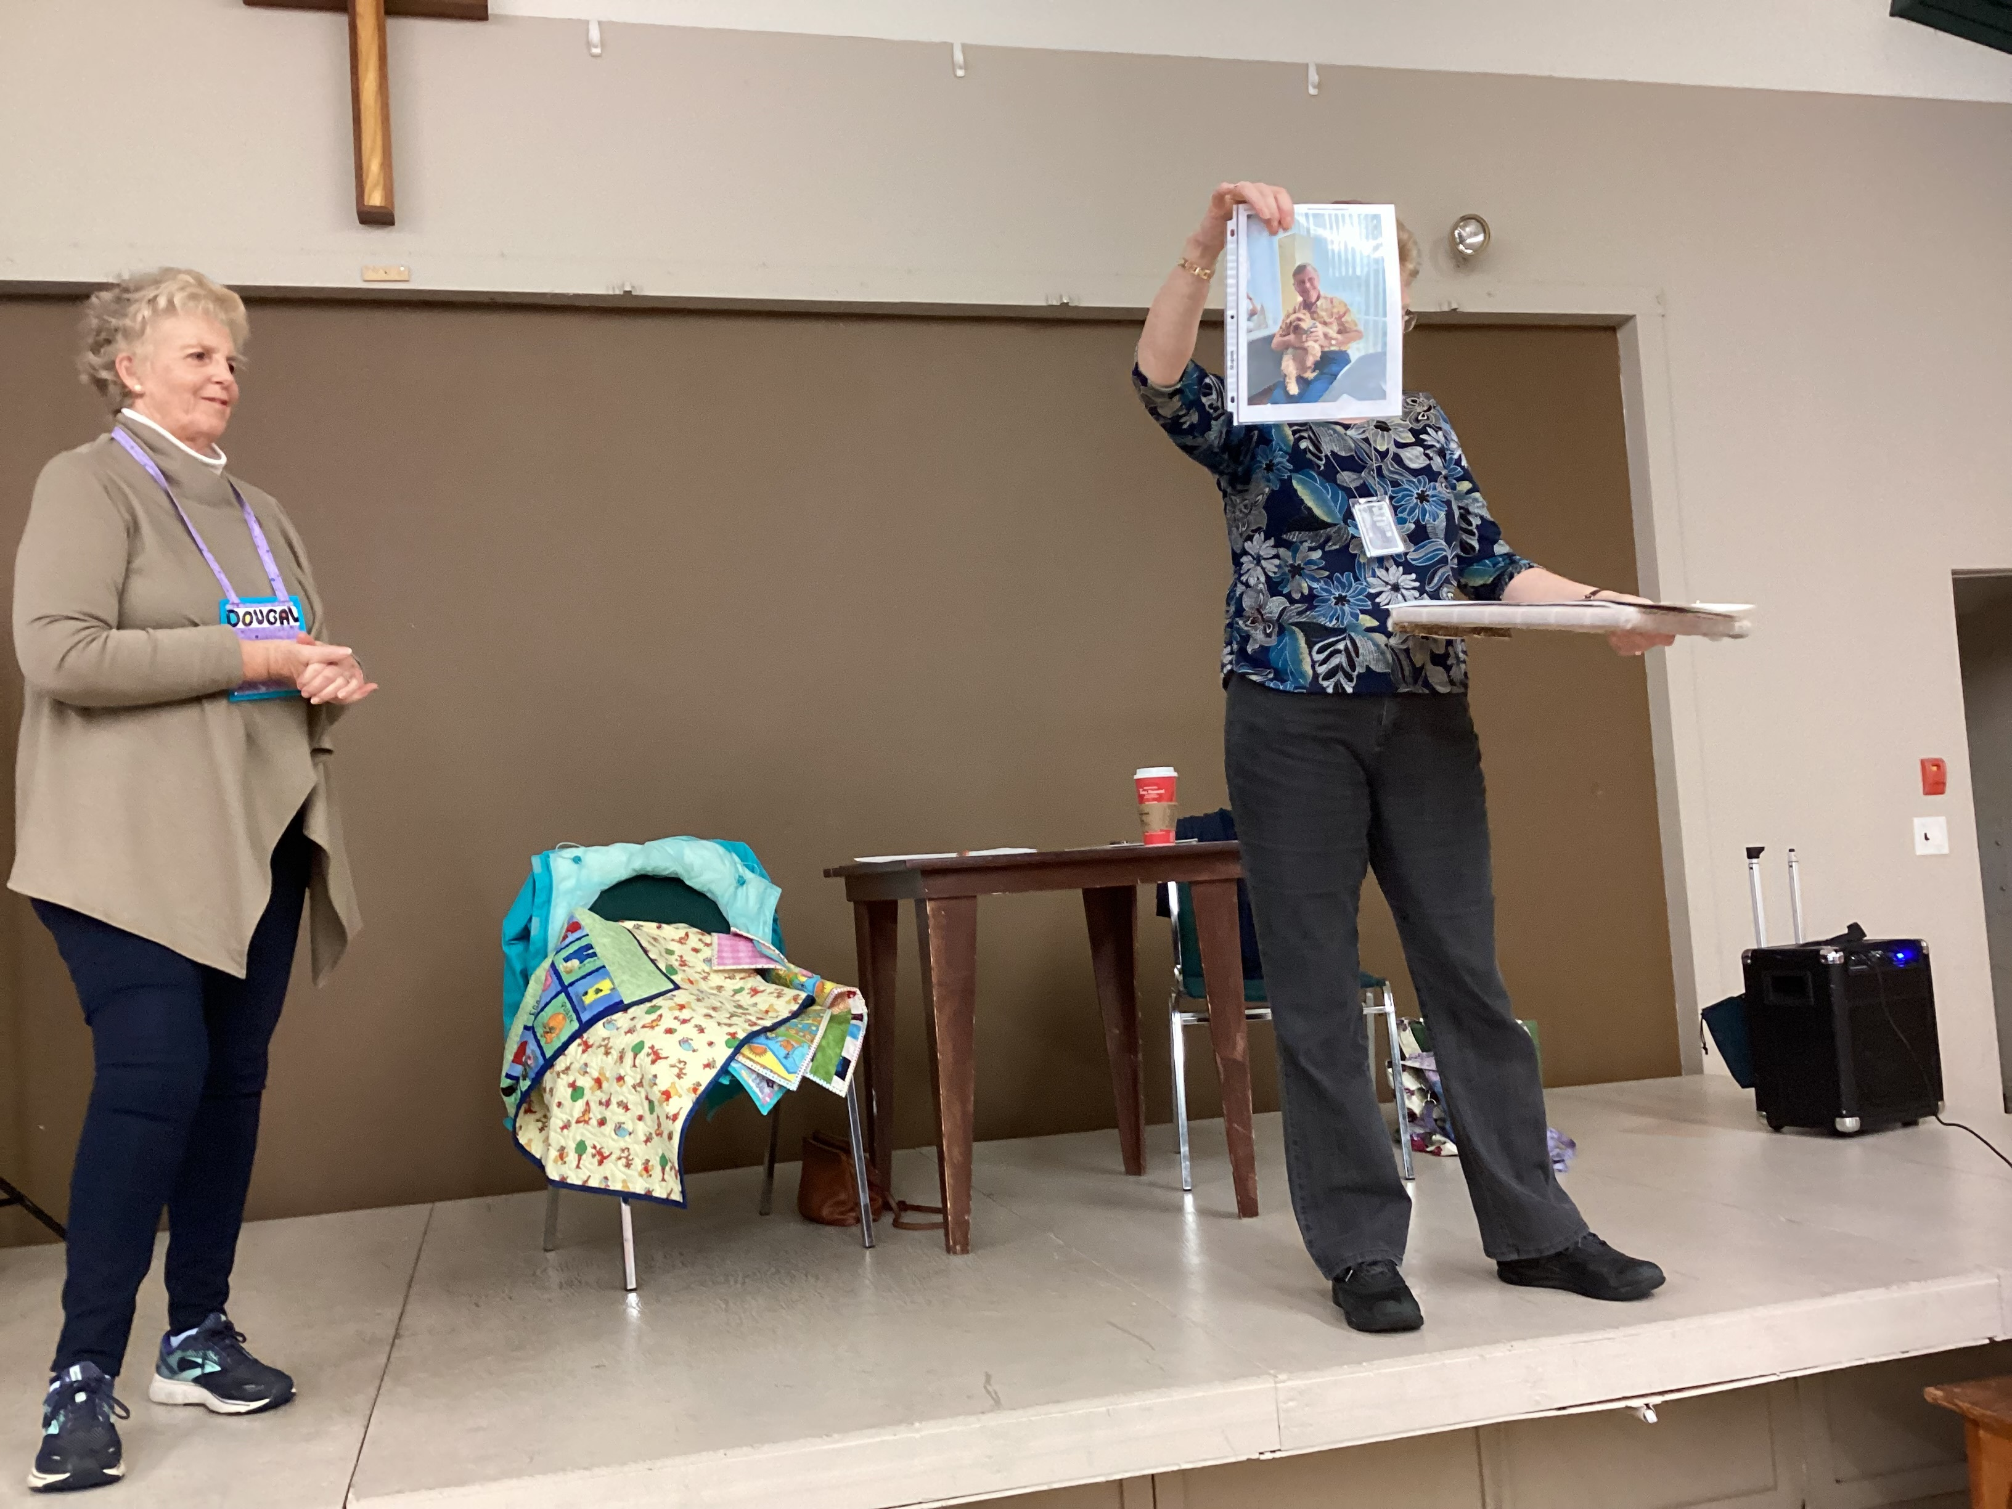
Betty Ann Knutson
Original photo used for hubby’s portrait
Notes:
Betty Ann Knutson original photo used for class in recreating photos

Slide 8
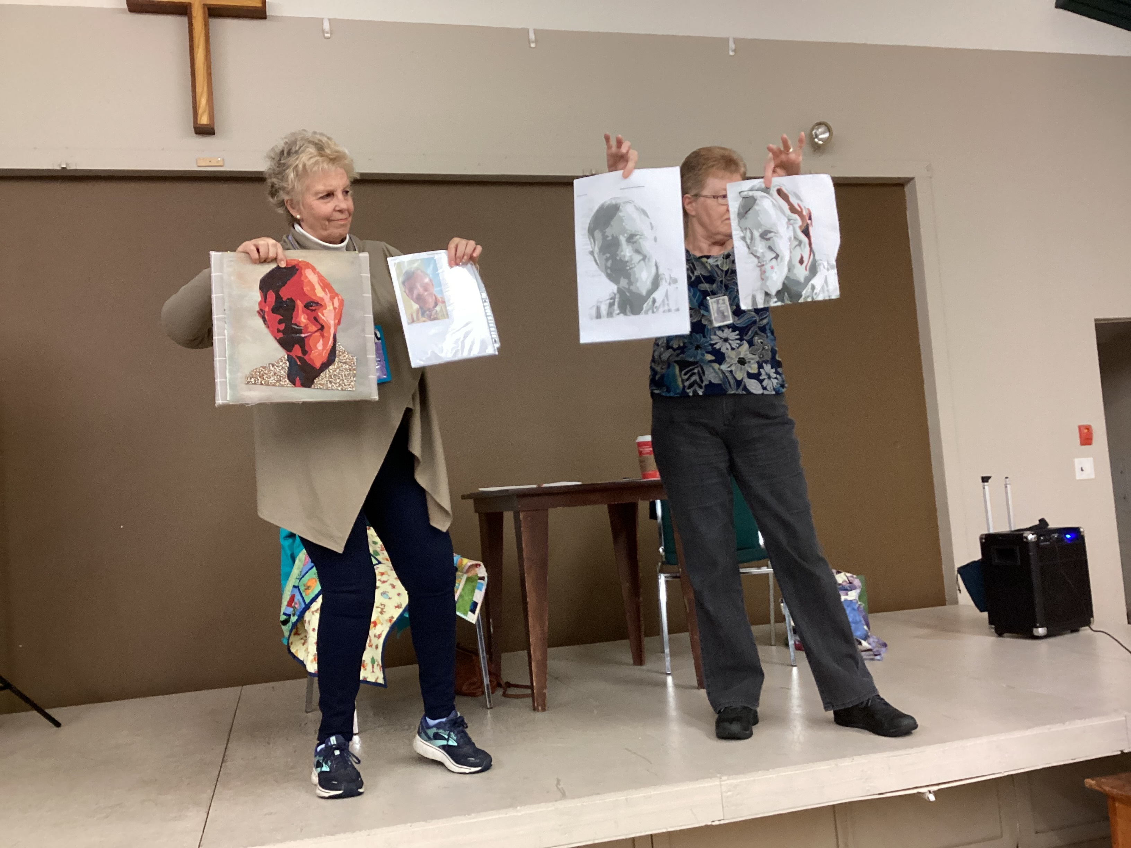
Betty Ann Knutson
The design stages of her hubby’s portrait
Notes:
Betty Ann Knutson the different stages 0f recreating hubby’s portrait from a class.

Slide 9
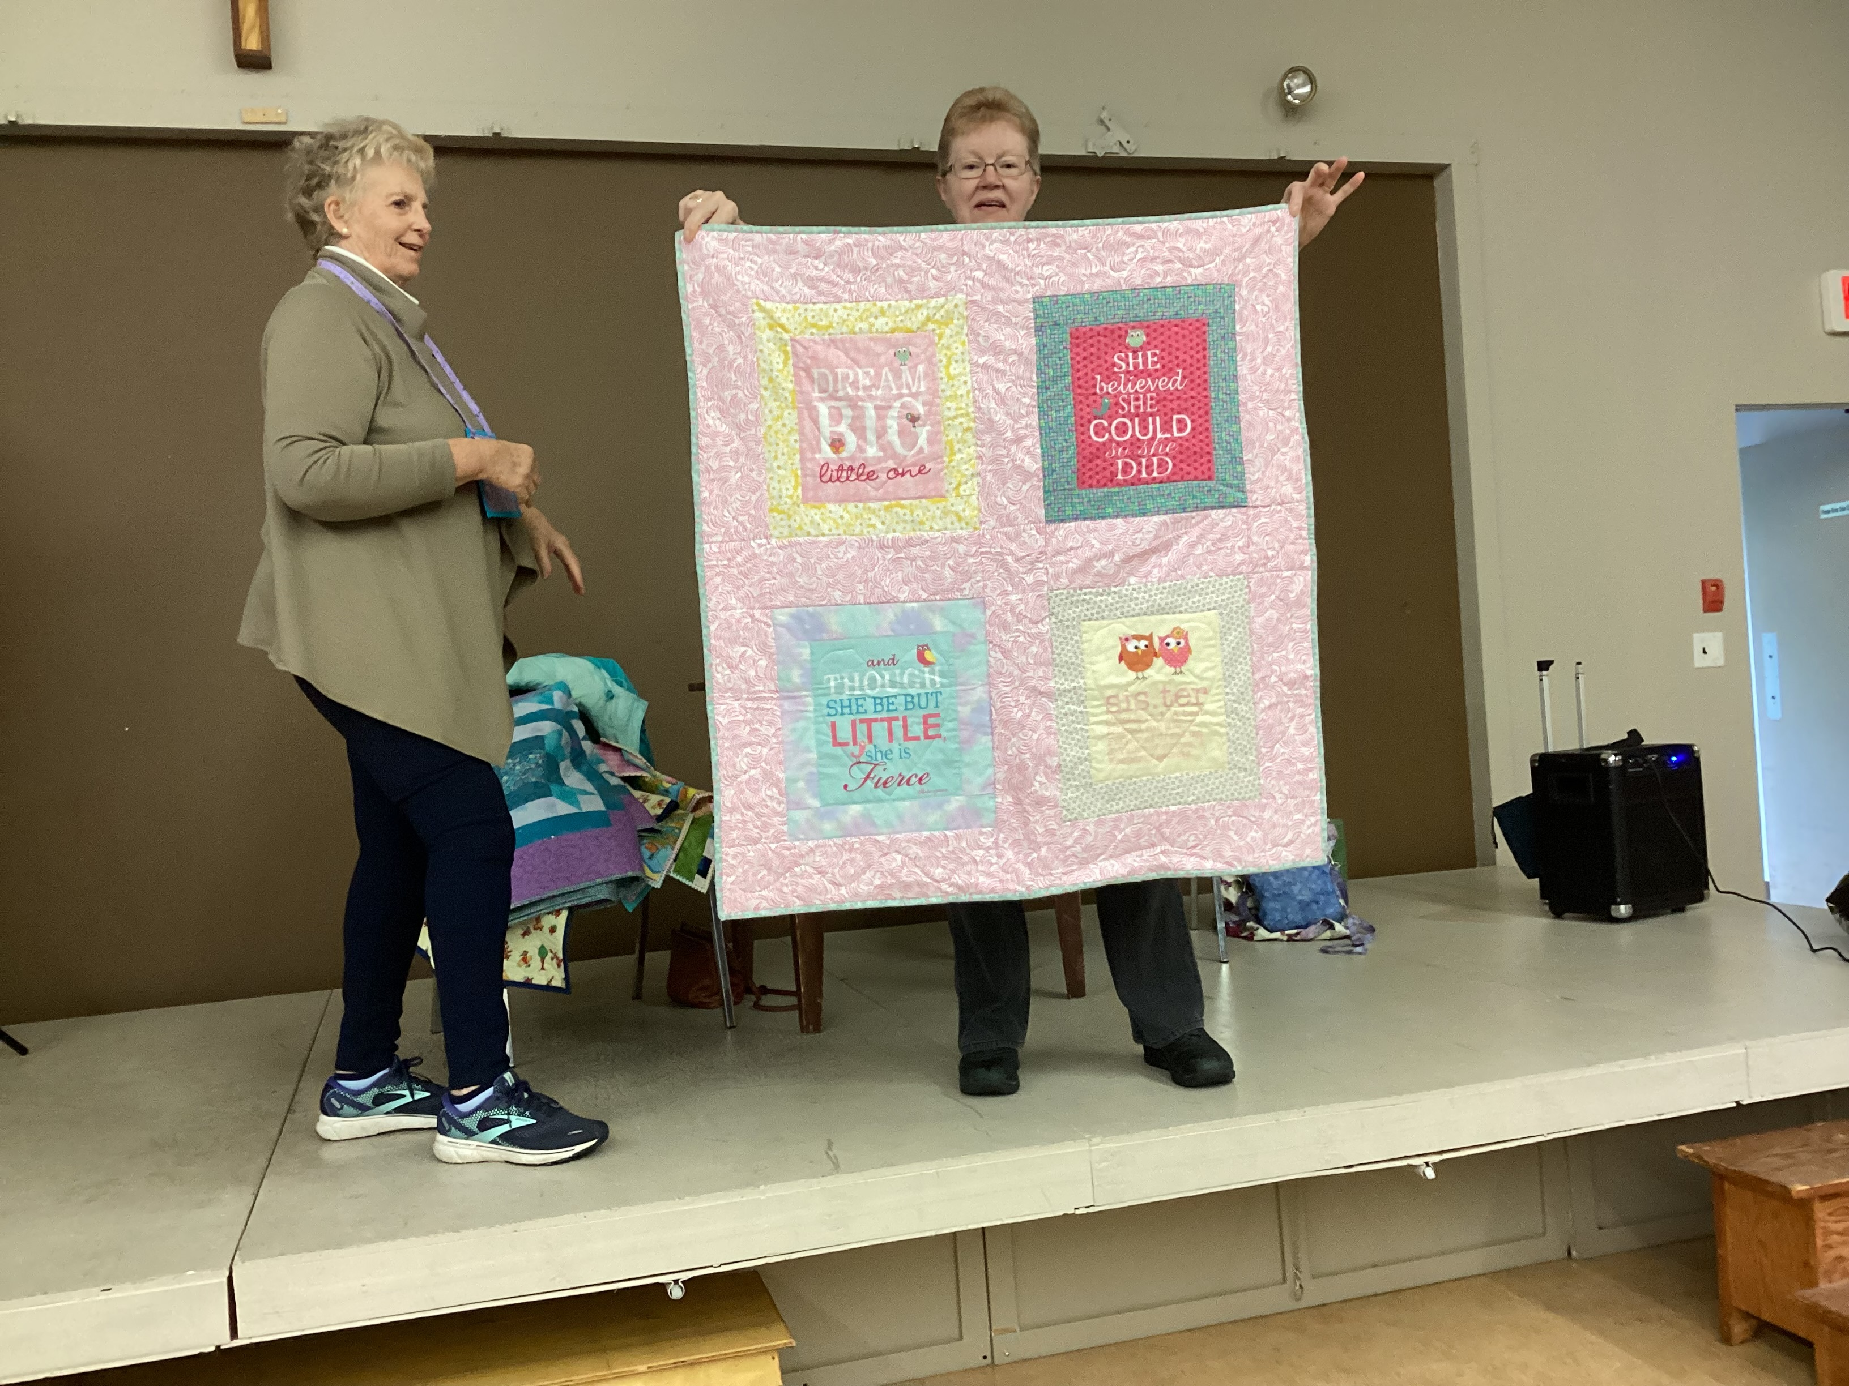
Karen
A quilt made for a new baby sister
Notes:
Karen (a new member) made this quilt for a new baby sister

Slide 10
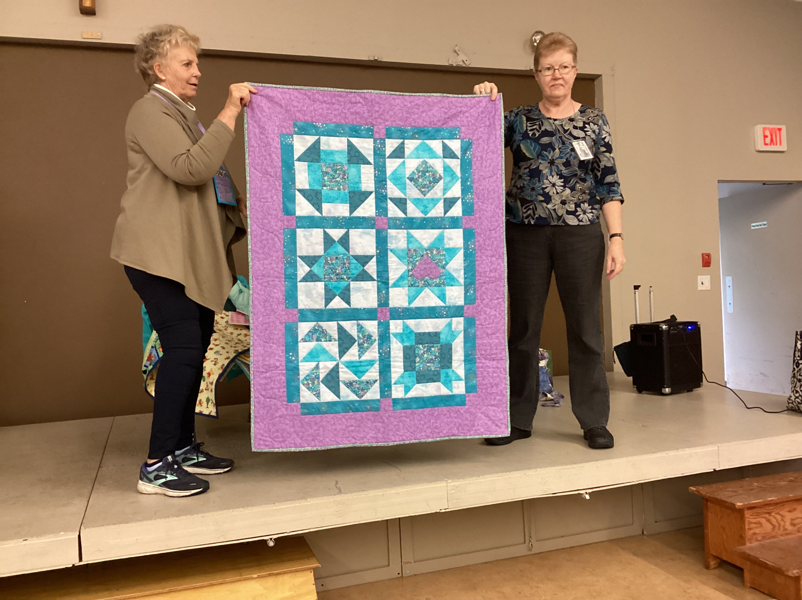
Karen
A quilt for new baby’s older sister
Notes:
Karen a quilt for new baby’s older sister

Slide 11
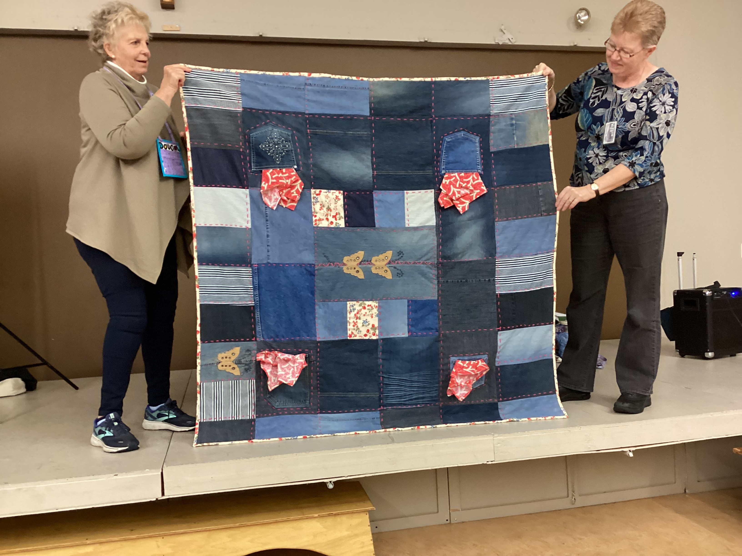
Karen
Recycled daughter’s jeans into a picnic quilt. Check out the pockets for napkins and cutlery.
Notes:
Karen repurposed jeans made into picnic quilt for my daughter. Check out the cutlery and napkin holders

Slide 12
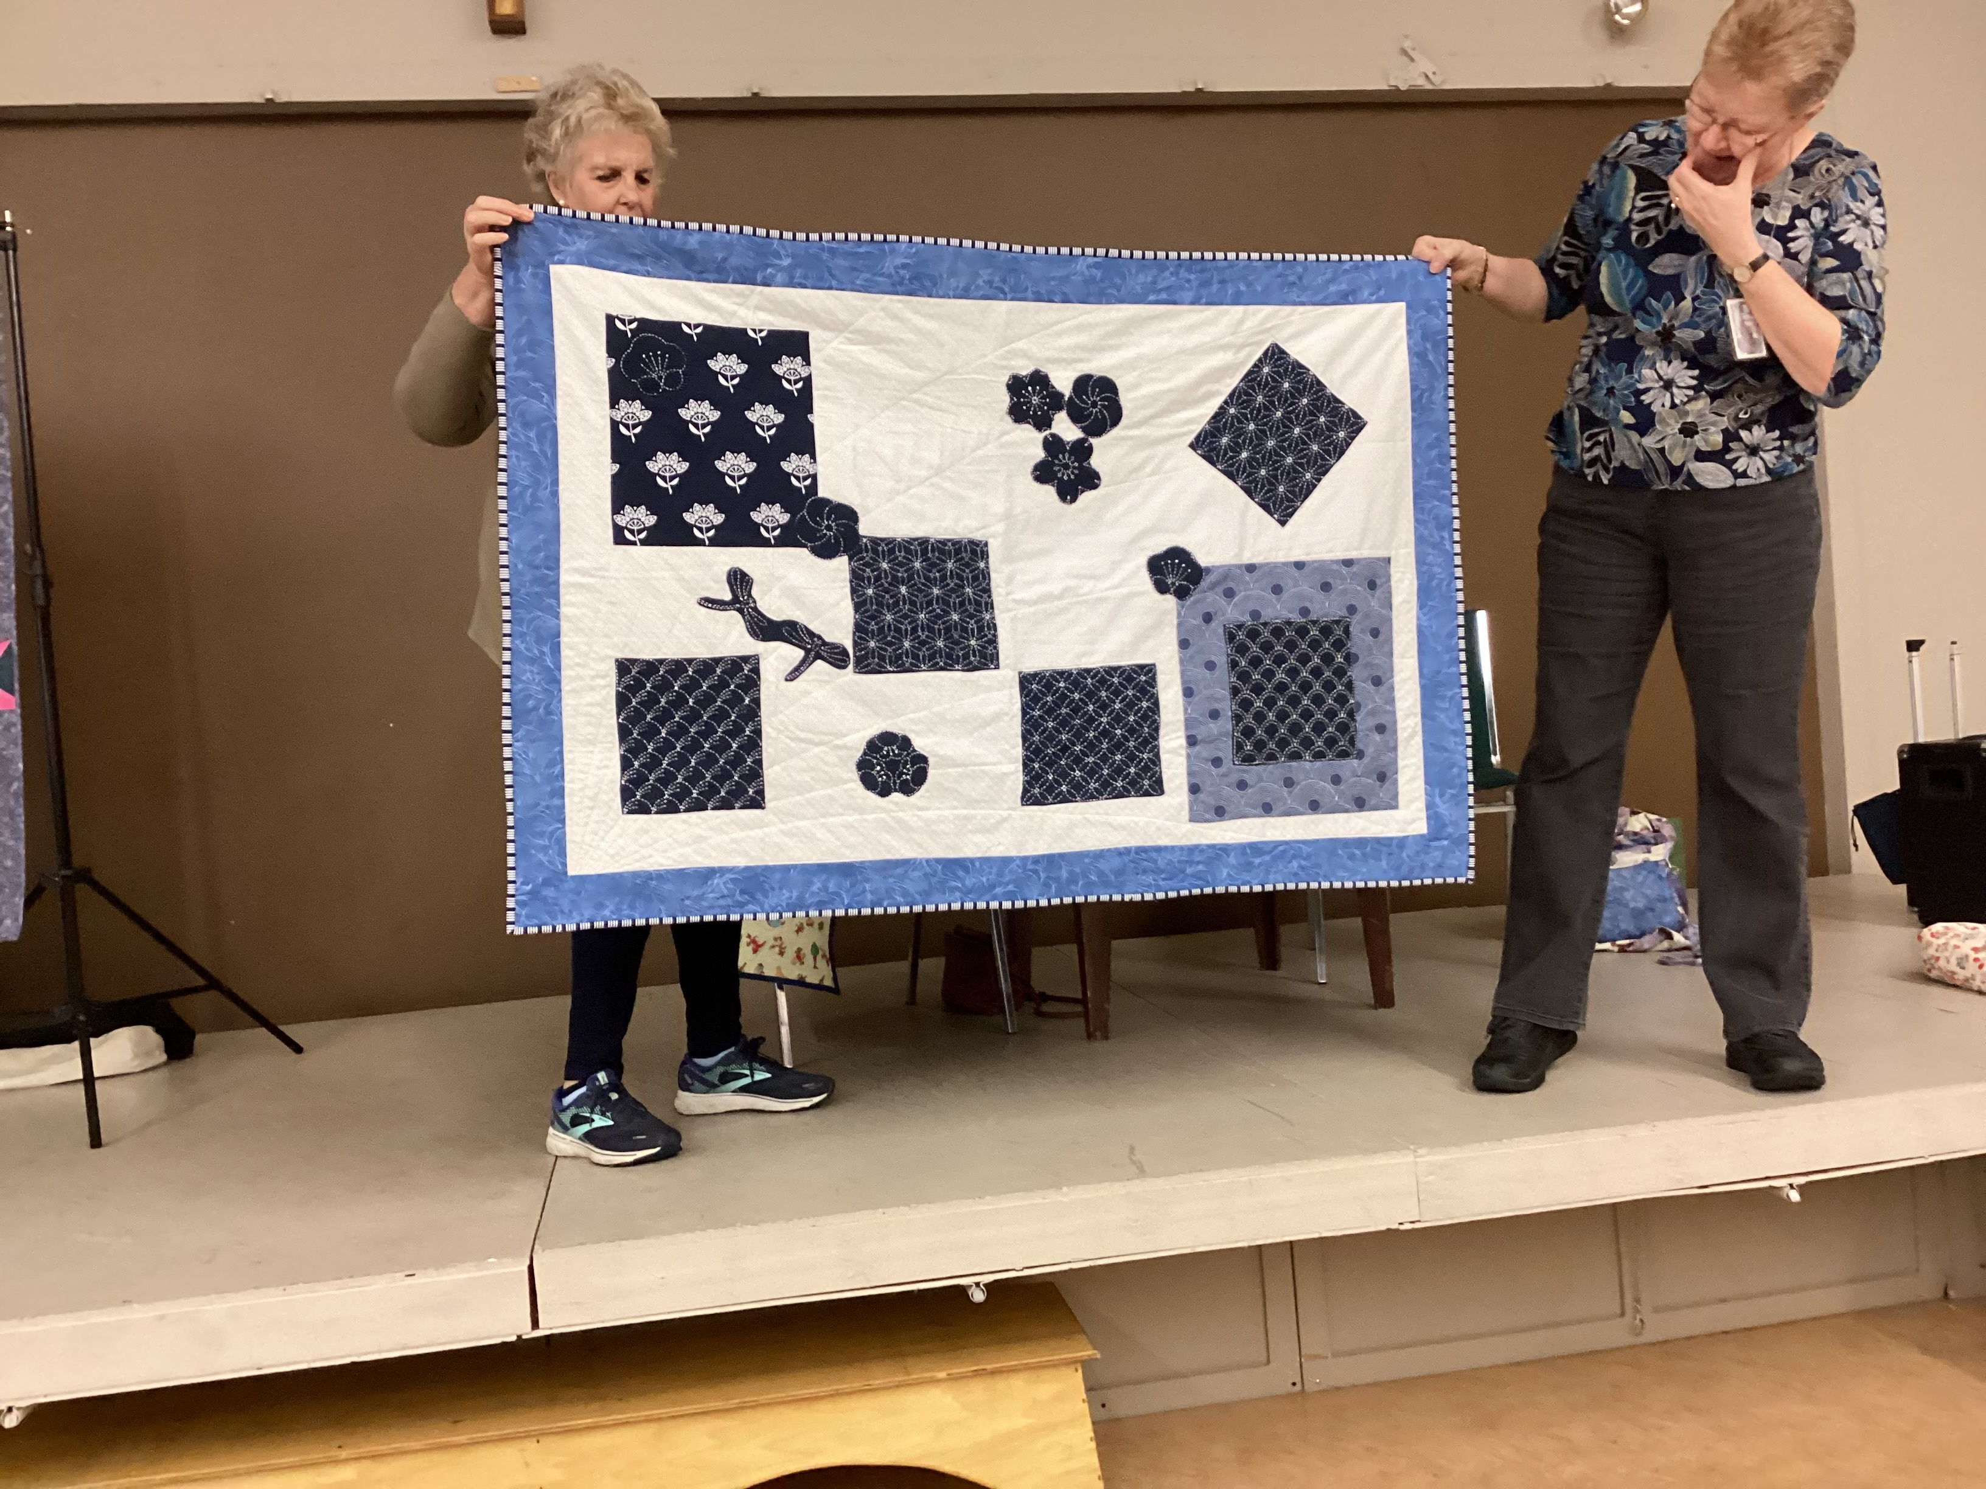
Karen
Unsure of what to do with my sashiko
Blocks, I put them together and tis is the result
Notes:
Karen this quilt end result of some Sashiko blocks I wasn’t sure what to do with

Slide 13
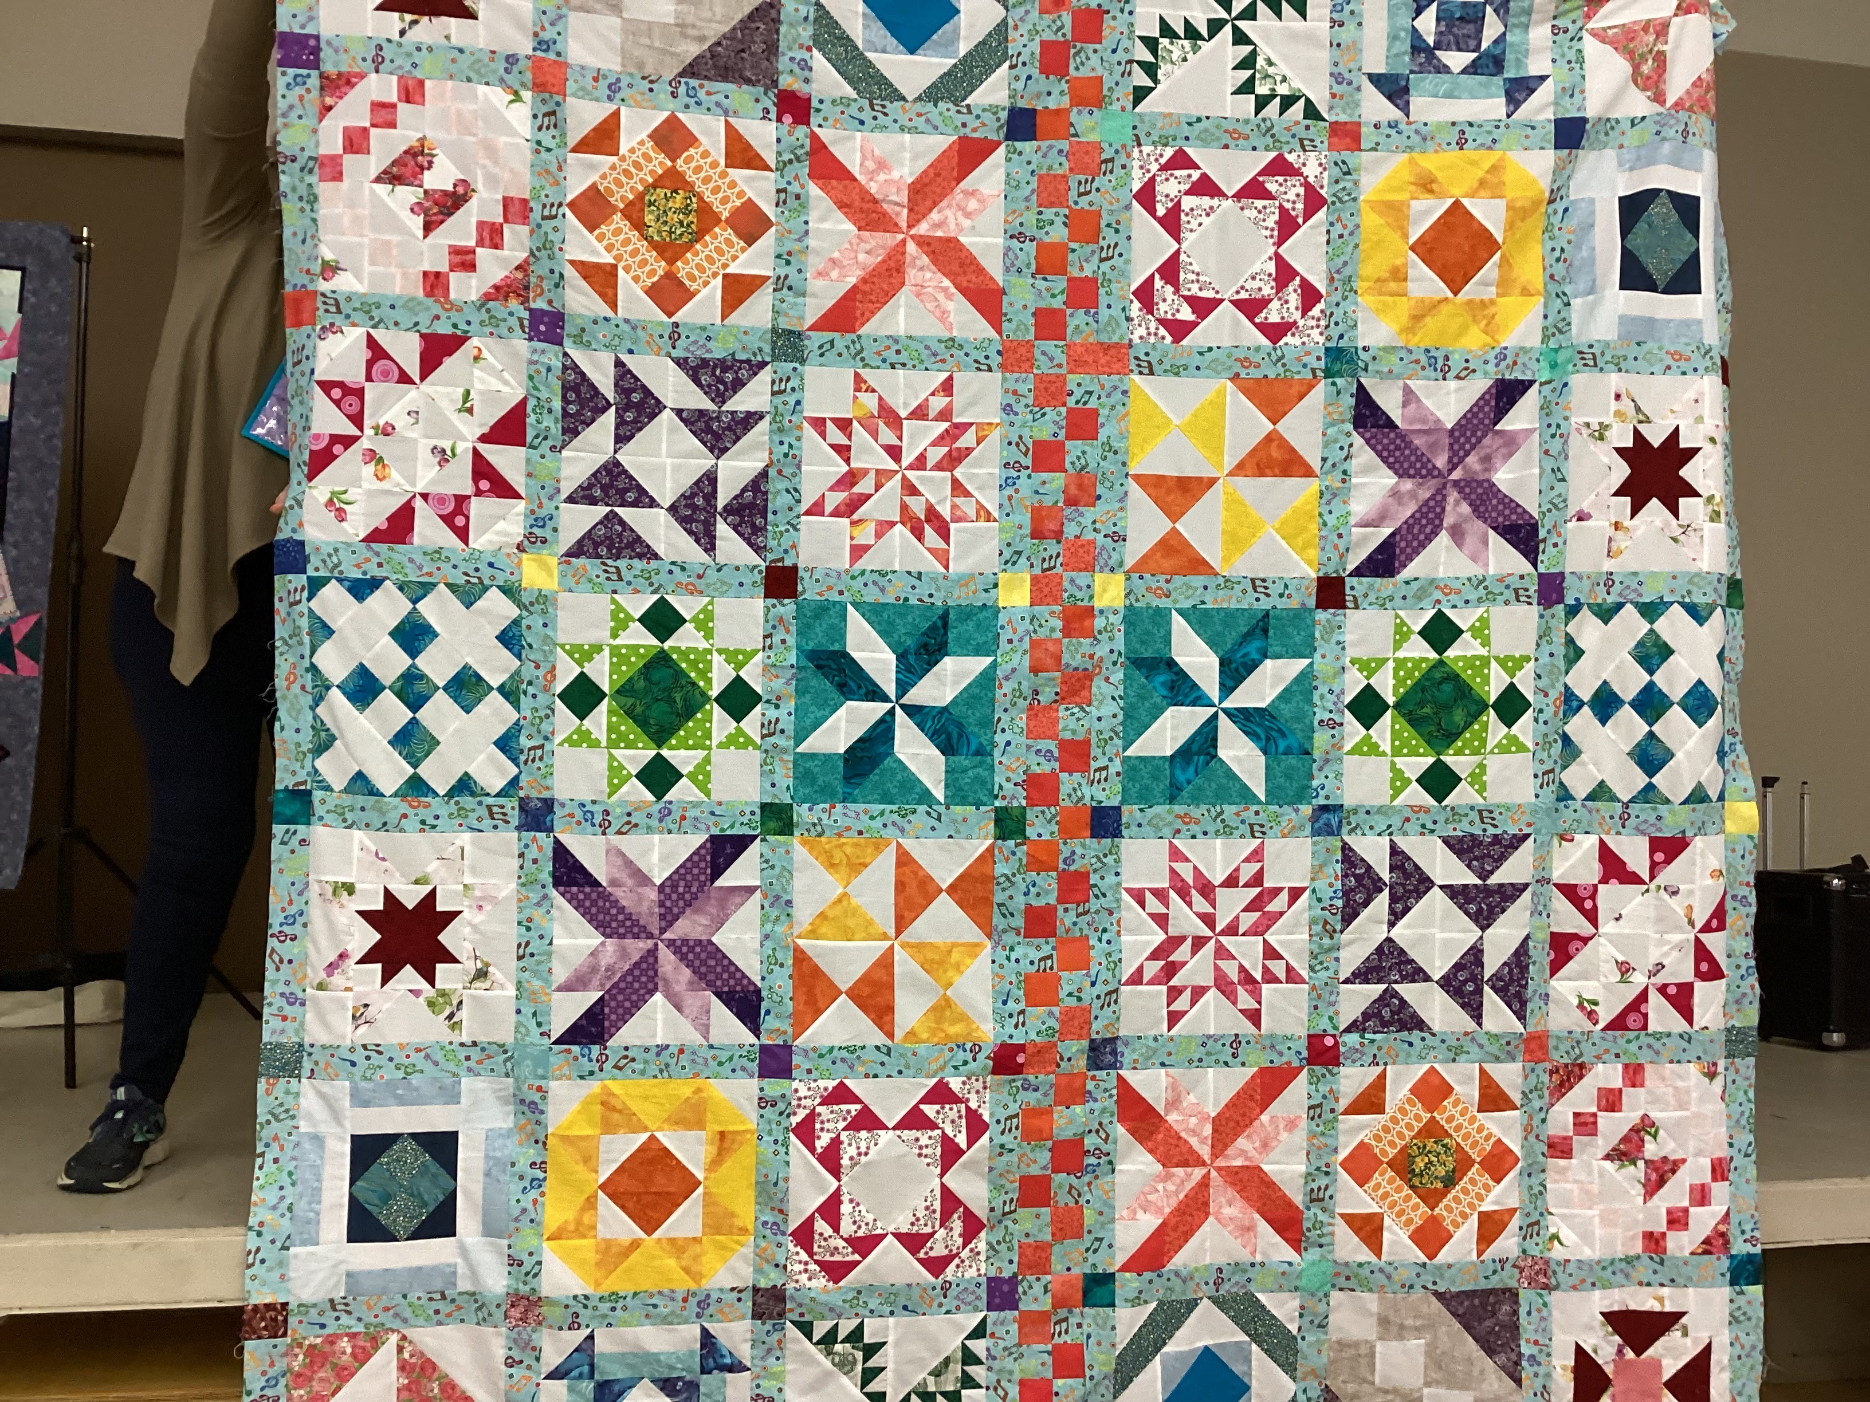
Lorraine Wilson
An orange themed quilt
Notes:
Lorraine Wilson Orange themed quilt

Slide 14
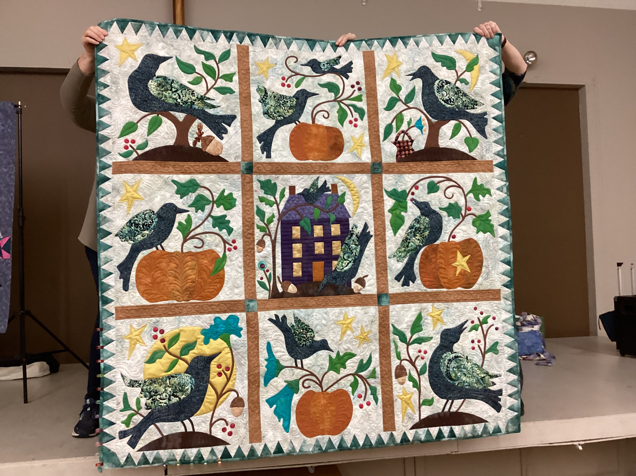
Sandra Moffatt
Birds,
Pumpkins and a house Appliqued on a quilt
Notes:
Sandra Moffat Pumpkin applique

Slide 15
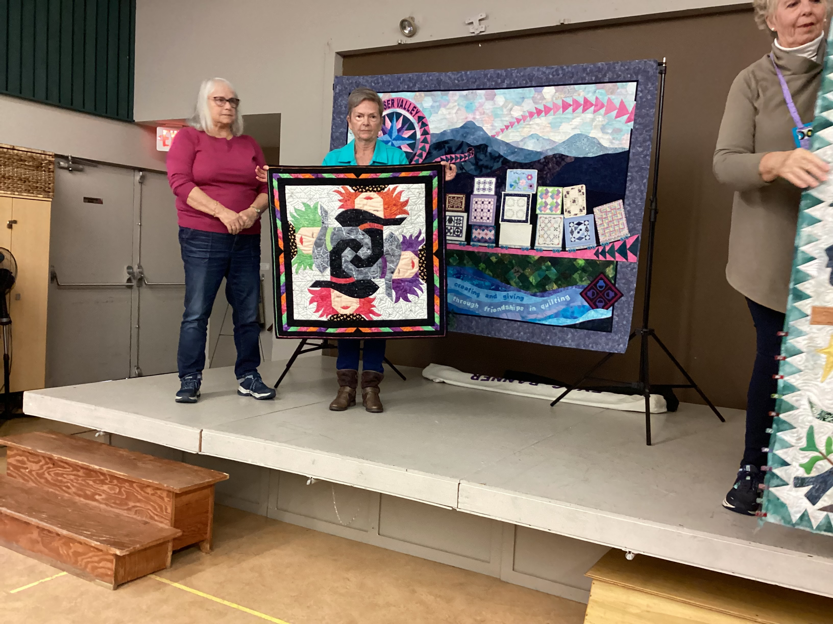
Sandra Moffatt
The appliqued pattern is called “Any Witch way”
Notes:
Sandra Moffatt This applique pattern is called “Any witch way”

Slide 16
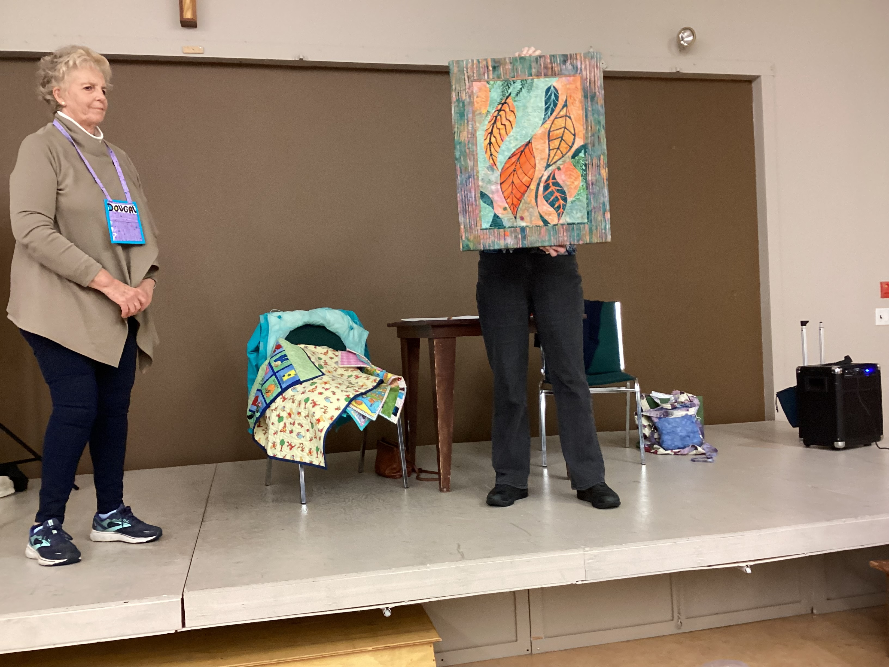
Susan Penty
A wallhanging called Luminosity
Pattern by Gloria Loughman
Notes:
Susan Penty a Gloria Loughman pattern called “Luminosity”

Slide 17
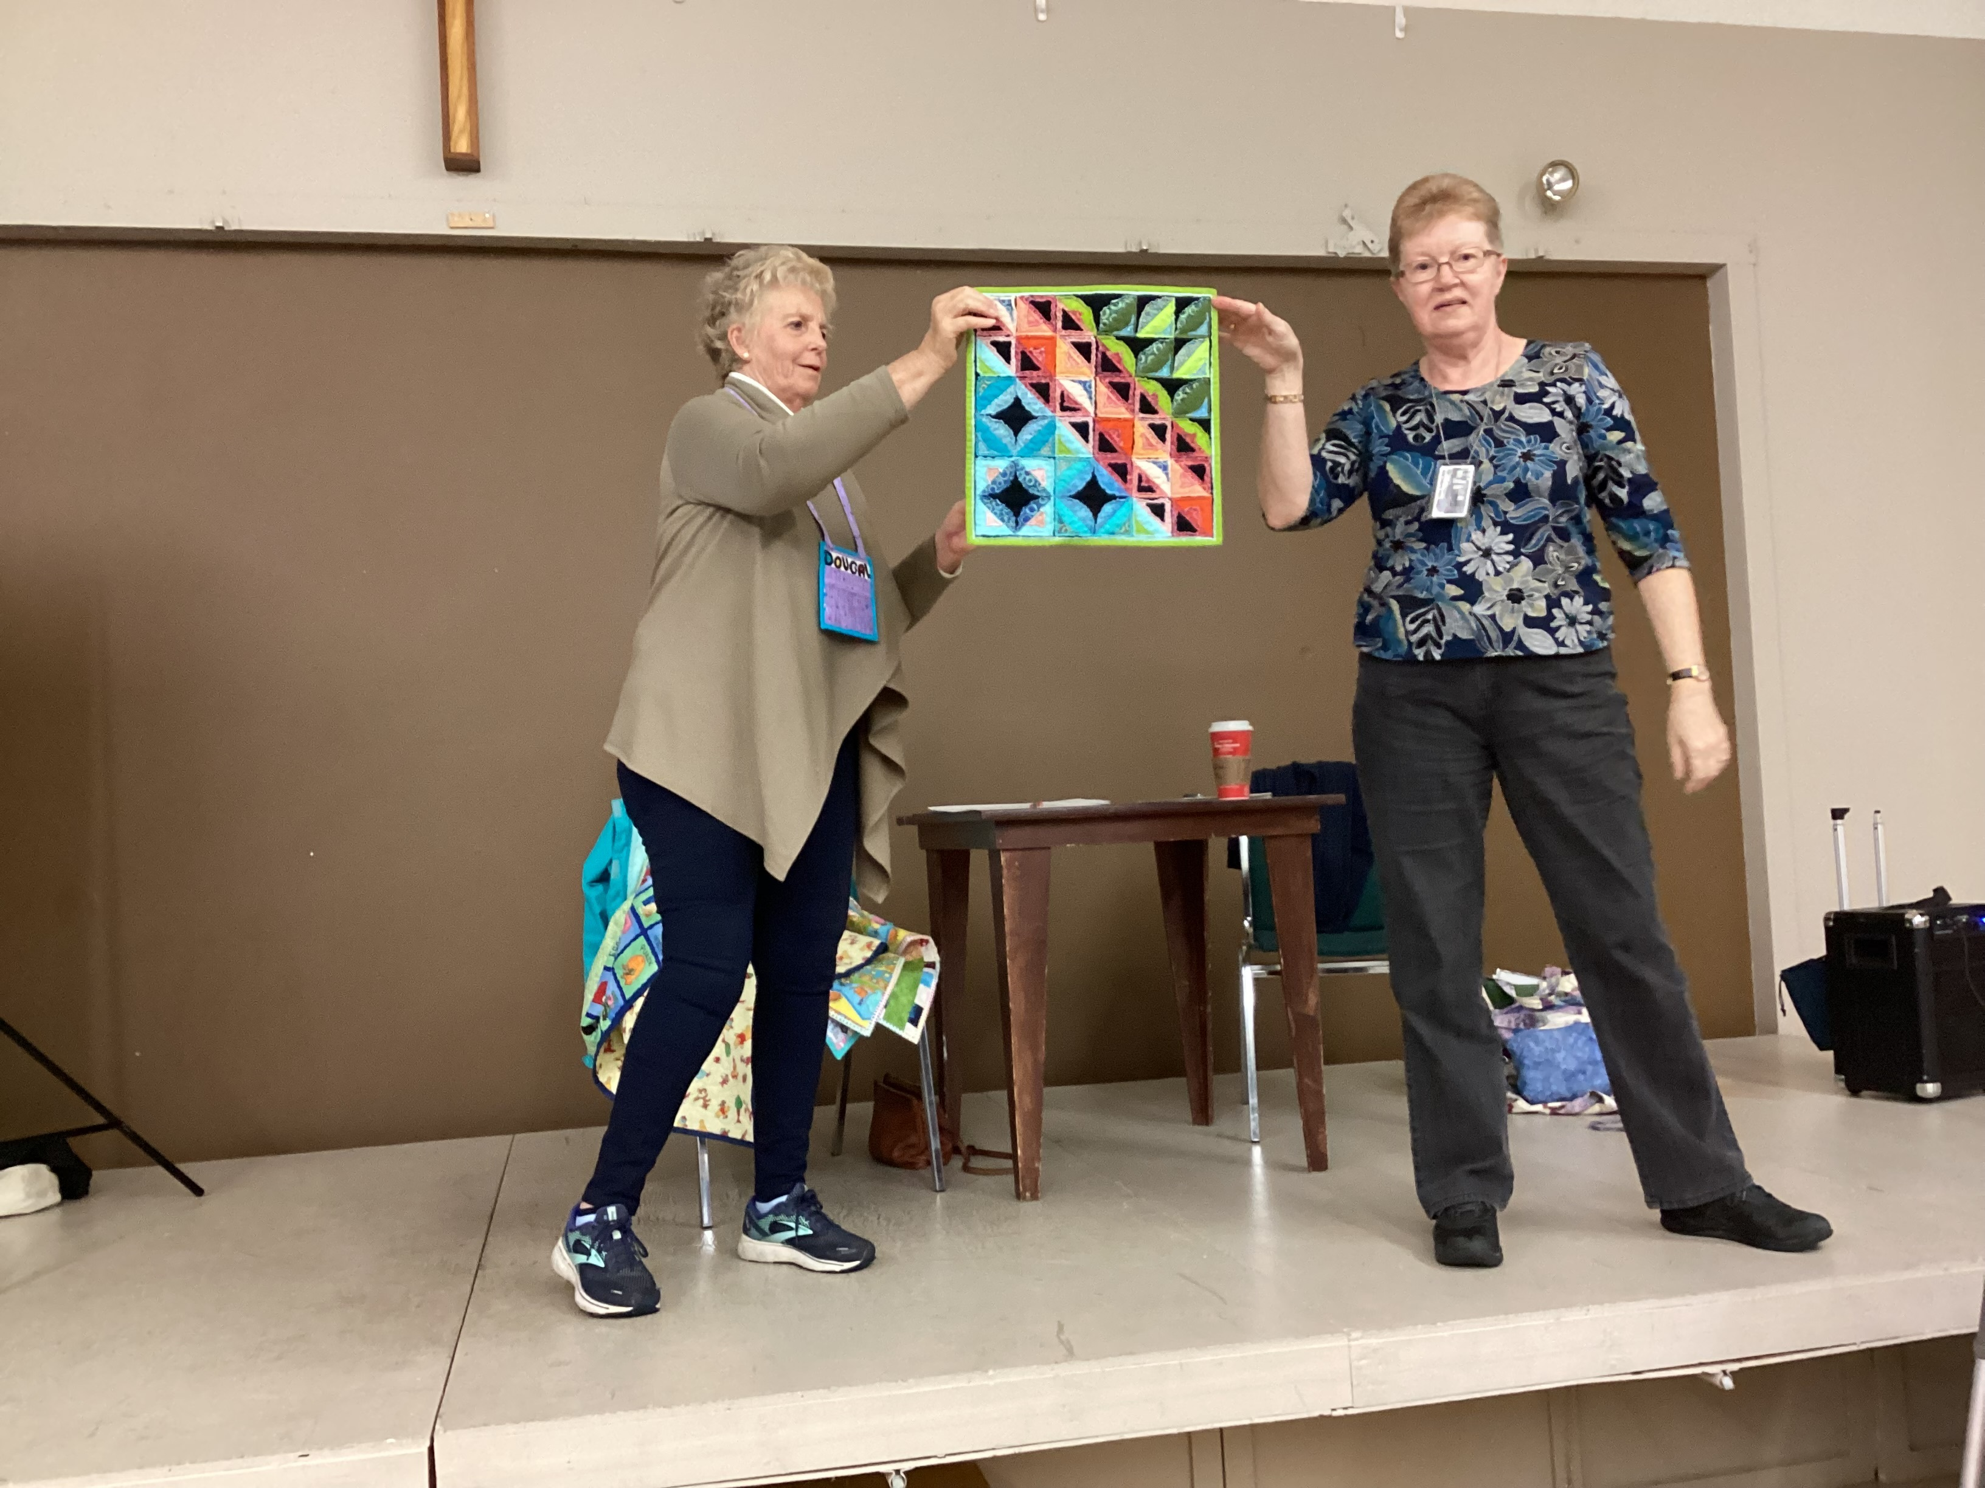
Susan Penty
A wall hanging in honour of the orange theme
Notes:
Susan Penty a small wall hanging featuring orange.

Slide 18
THE END THE END
THE ENDT

